Slide 1
Analysis of GNDs beneath indents of different depth using EBSD tomography
E. Demir, S. Zaefferer, F. Roters, D. Raabe
Department of Microstructure Physics and Metal Forming
Düsseldorf, Germany
d.raabe@mpie.de
27. October 2009, MS&T, Pittsburgh

Slide 2
Overview
Methods (3D EBSD, CP-FEM)
Characterization
Orientation gradients and dislocation analysis
Discussion
Dierk Raabe, MS&T, Pittsburgh, 27. Oct. 2009, MPIE

Slide 3
Motivation and approach: specific
Relationship between ISE and GND: hardness and GND in the same experiment
Indents of different depths, Cu single crystal
3D EBSD: plastic volume, orientation gradients, GNDs

Slide 4
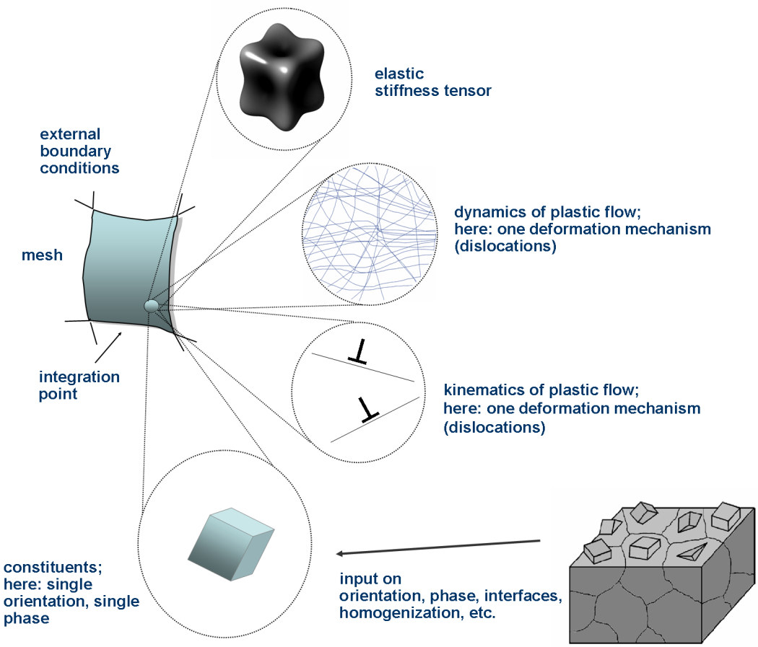
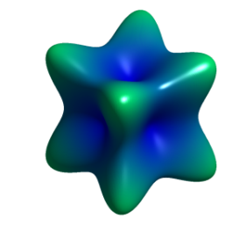
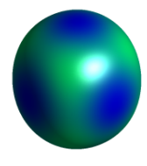
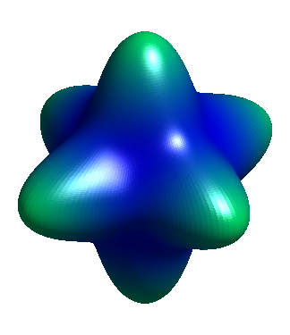
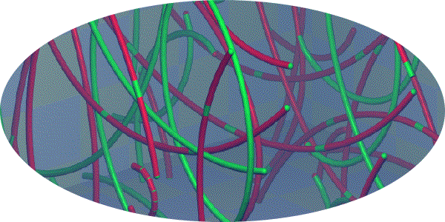

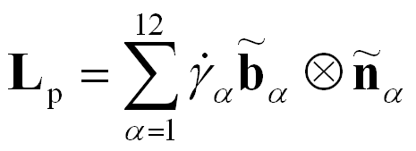
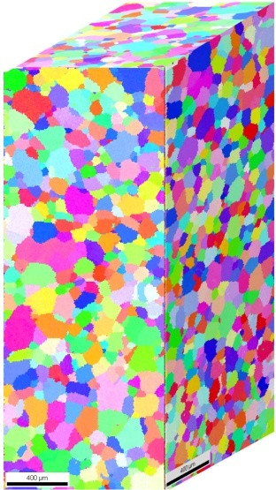
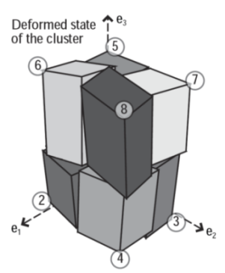
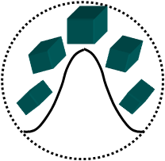
Multiscale crystal plasticity FEM
Raabe, Zhao, Park, Roters: Acta Mater. 50 (2002) 421

Slide 5
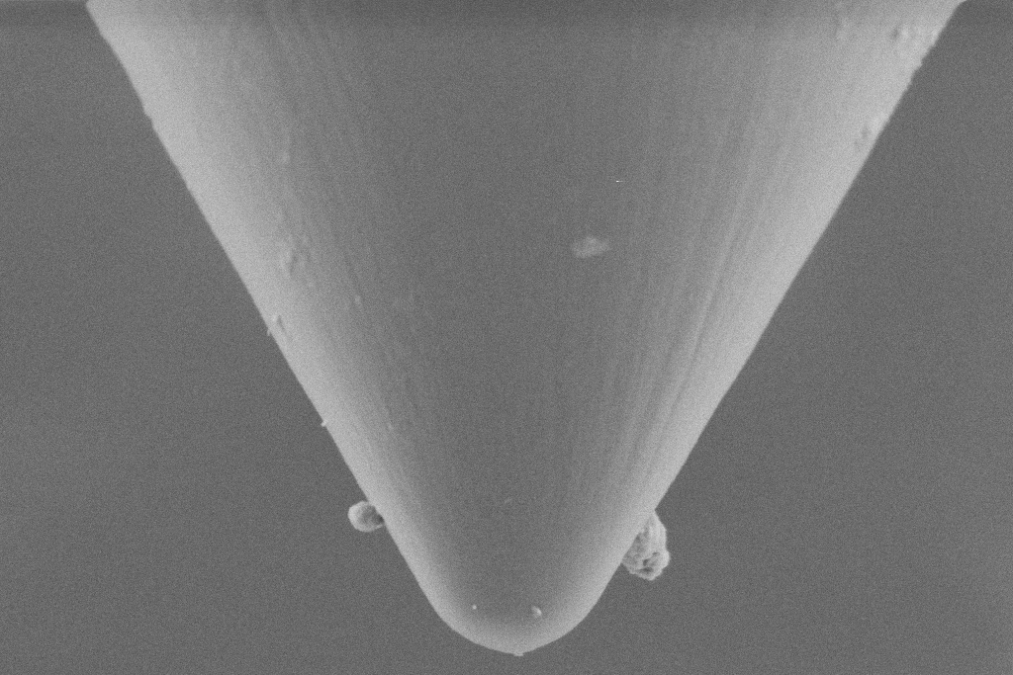
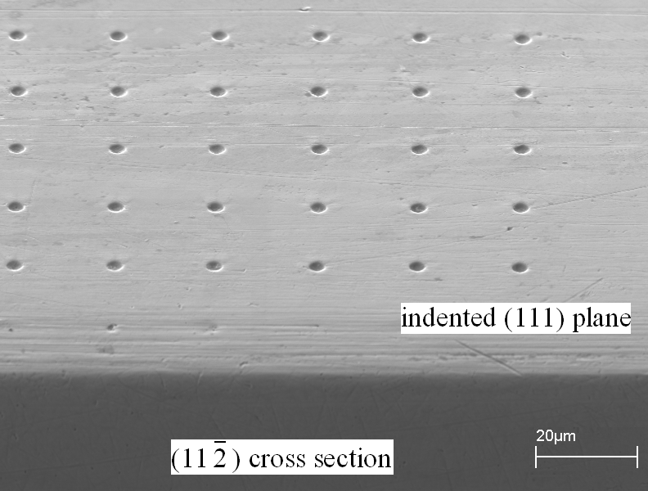
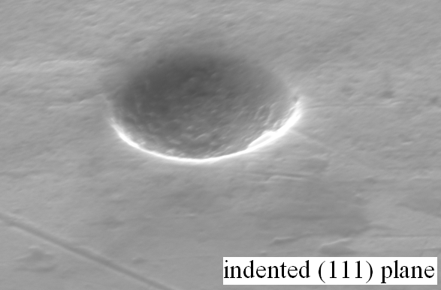
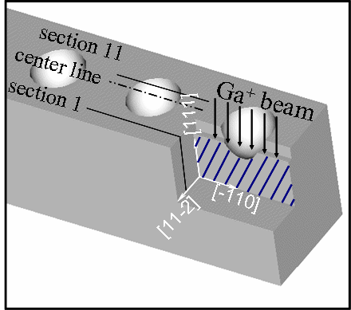
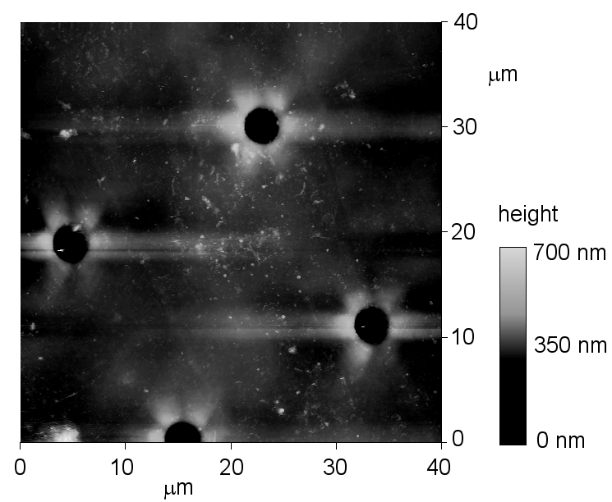
Nanoindentation
60° conical, tip radius 1μm, loading rate 1.82mN/s, loads of 4000μN, 6000μN, 8000μN and 10000μN
[111]
[-110]
[11-2]
Wang, Raabe, Klüber, Roters: Acta Mater. 52 (2004) 2229

Slide 6
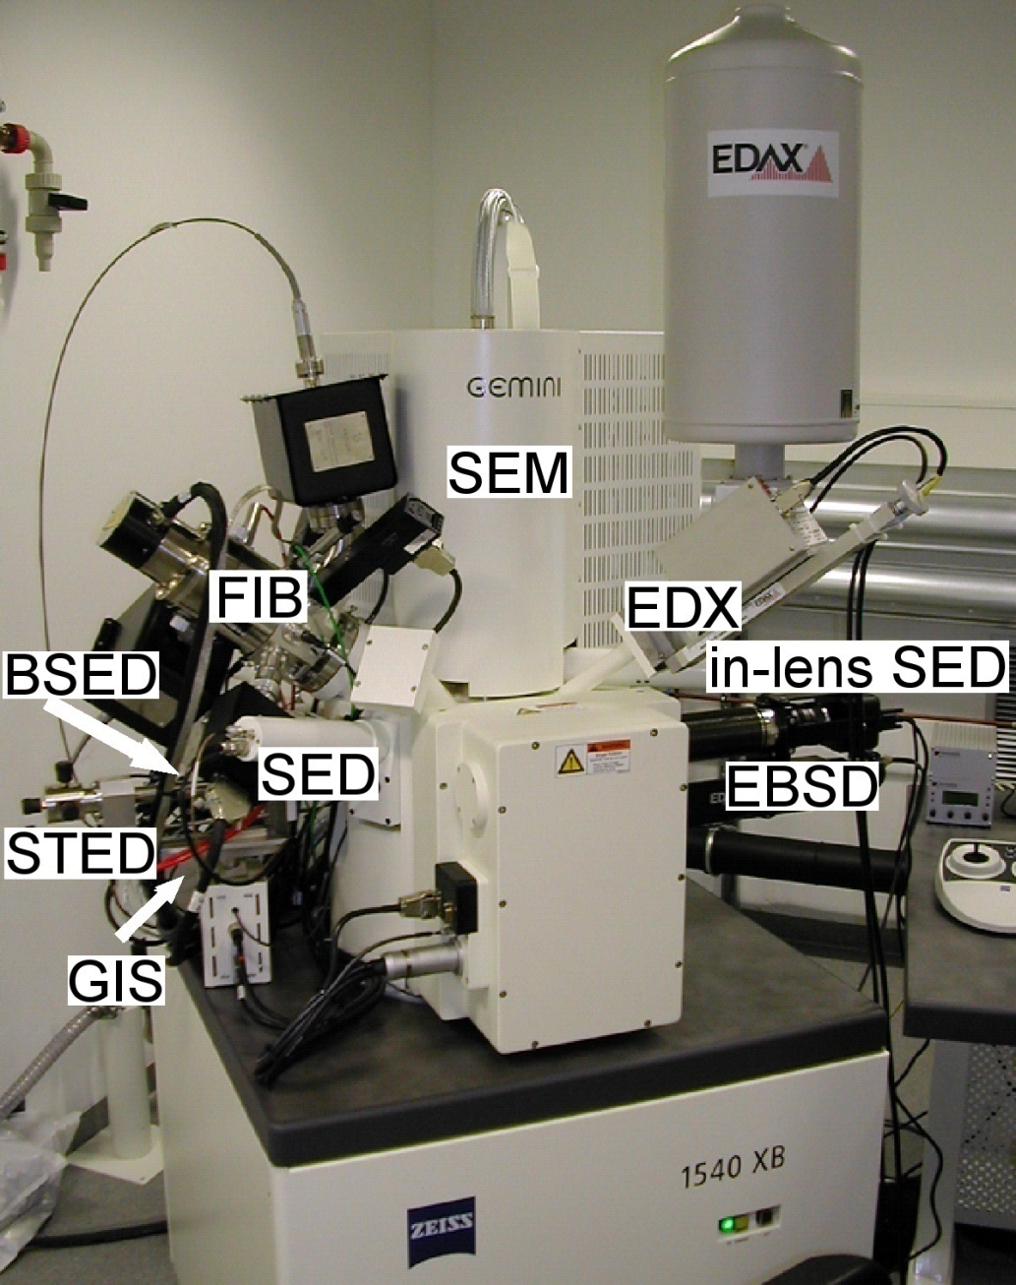
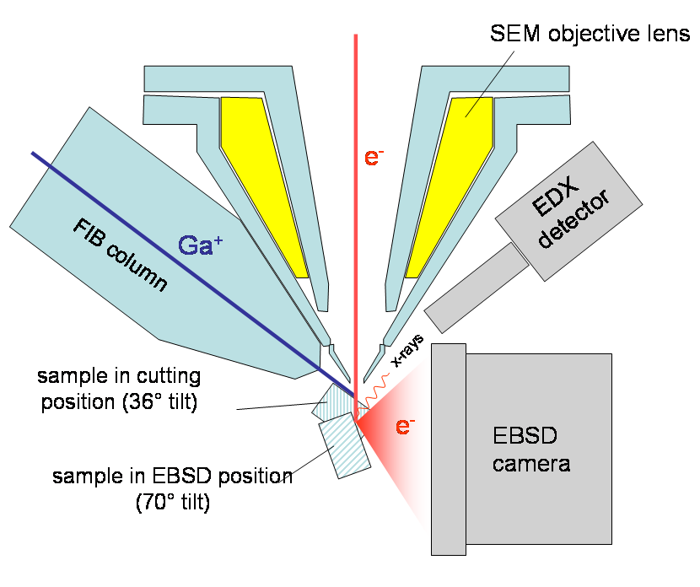
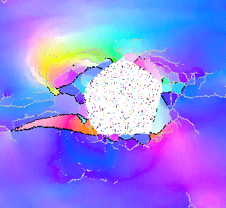
3D electron microscopy, 3D EBSD, tomography
J. Konrad, S. Zaefferer, D. Raabe, Acta Mater. 54 (2006) 1369
Zaefferer,. Wright, Raabe, Metall. Mater. Trans. A 39A (2008) 374

Slide 7
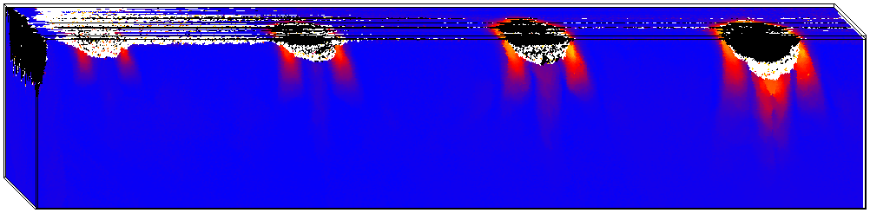
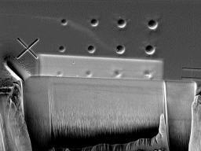
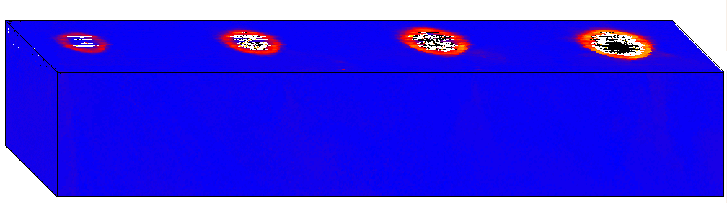
Crystal orientation distribution around nanoindents
Cu, 60° conical, tip radius 1μm, loading rate 1.82mN/s, loads: 4000μN, 6000μN, 8000μN, 10000μN
20°
0°
Misorientation angle
[111]
[-110]
[11-2]
Zaafarani, Raabe, Roters, Zaefferer: Acta Mater. 56 (2008) 31

Slide 8
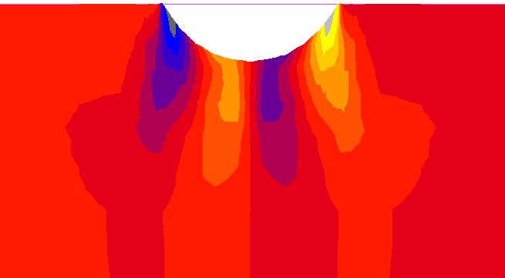
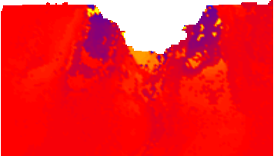
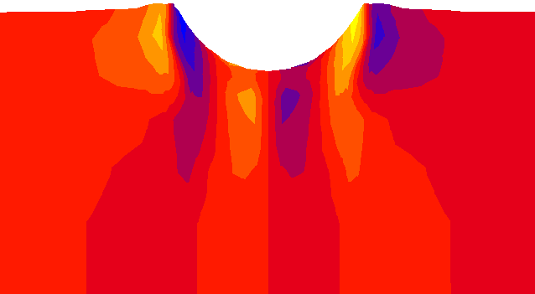

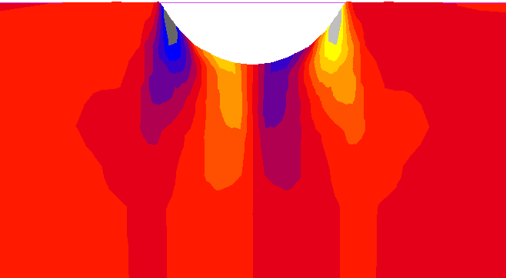
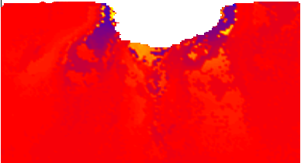
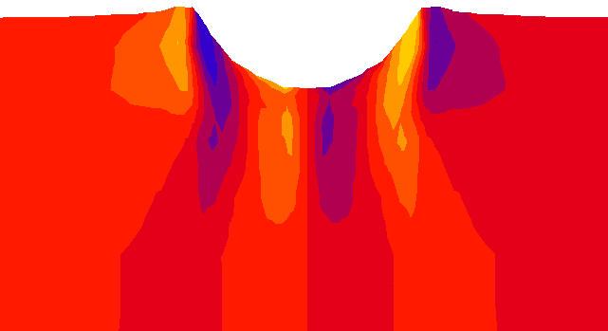
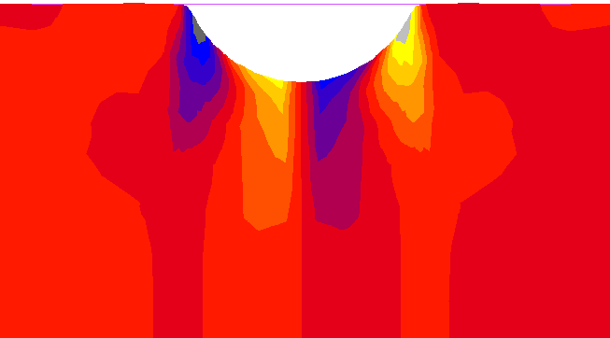
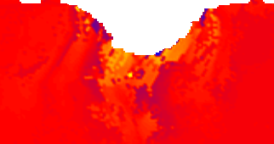
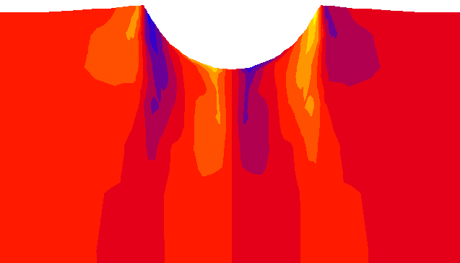
Comparison, crystal rotations about [11-2] axis
viscoplastic
CPFEM
experiment
3D EBSD
dislocation-based
CPFEM
experiment
simulation
scan 7
scan 8
scan 9
[111]
[-110]
[11-2]
Zaafarani, Raabe, Singh, Roters, Zaefferer: Acta Mater. 54 (2006) 1707
Zaafarani, Raabe, Roters, Zaefferer: Acta Mater. 56 (2008) 31

Slide 9
Simplify
Zaafarani, Raabe, Roters, Zaefferer: Acta Mater. 56 (2008) 31

Slide 10
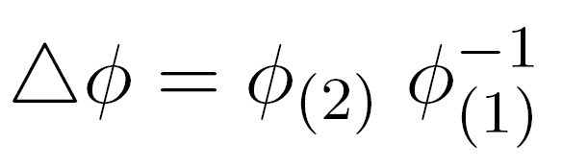
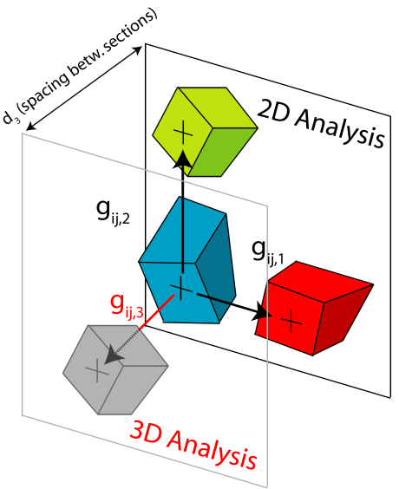
From local misorientations to GNDs
20°
0°
misorientation angle
misorientation
orientation difference
orientation gradient
(spacing d from EBSD scan)
Demir, Raabe, Zaafarani, Zaefferer: Acta Mater. 57 (2009) 559

Slide 11
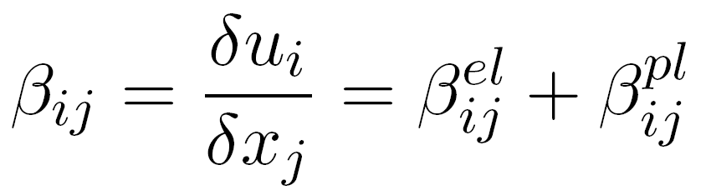
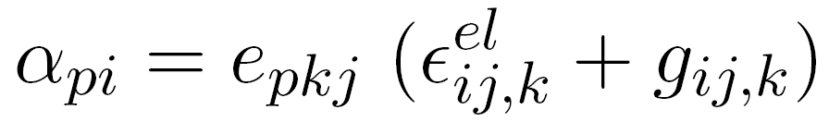
From local misorientations to GNDs
distortion
(sym, a-sym)
dislocation tensor (GND)
J. F. Nye. Some geometrical relations in dislocated crystals. Acta Metall. 1:153, 1953.
E. Demir, D. Raabe, N. Zaafarani, S. Zaefferer: Acta Mater. 57 (2009) 559–569
E. Kröner. Kontinuumstheorie der Versetzungen und Eigenspannungen (in German). Springer, Berlin, 1958.
E. Kröner. Physics of defects, chapter Continuum theory of defects, p.217. North-Holland Publishing, Amsterdam, Netherlands, 1981.
Demir, Raabe, Zaafarani, Zaefferer: Acta Mater. 57 (2009) 559

Slide 12
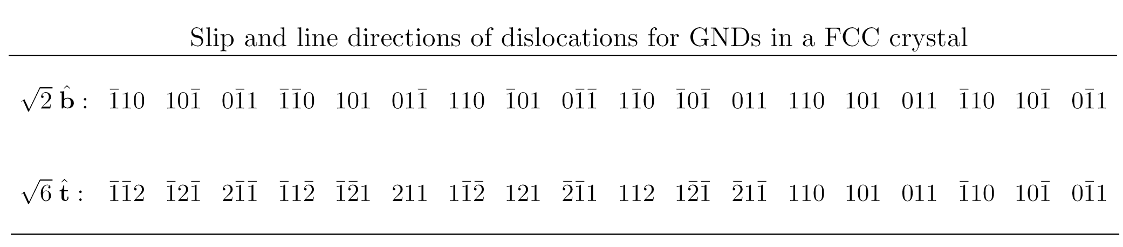

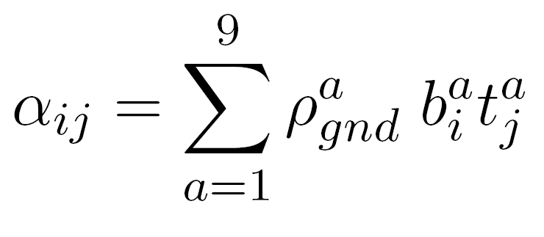
From local misorientations to GNDs
Frank loop through area r
DDT in terms of 18 b,t combinations
DDT in terms of 9 b,t combinations
Demir, Raabe, Zaafarani, Zaefferer: Acta Mater. 57 (2009) 559

Slide 13
Distribution of GNDs for different gradient resolutions
50 nm
100 nm
200 nm
center section, 2D analysis, color code: GND density (decadic log. (1/m²) )
Demir, Raabe, Zaafarani, Zaefferer: Acta Mater. 57 (2009) 559

Slide 14
Identification of the plastic volume
depth [μm]
Reference volumes (red color) indicates the plastic volume using lower threshold of GNDs of 10¹⁴/m²
center section, 2D analysis, color code: GND density (decadic log. (1/m²) )
Demir, Raabe, Zaafarani, Zaefferer: Acta Mater. 57 (2009) 559

Slide 15
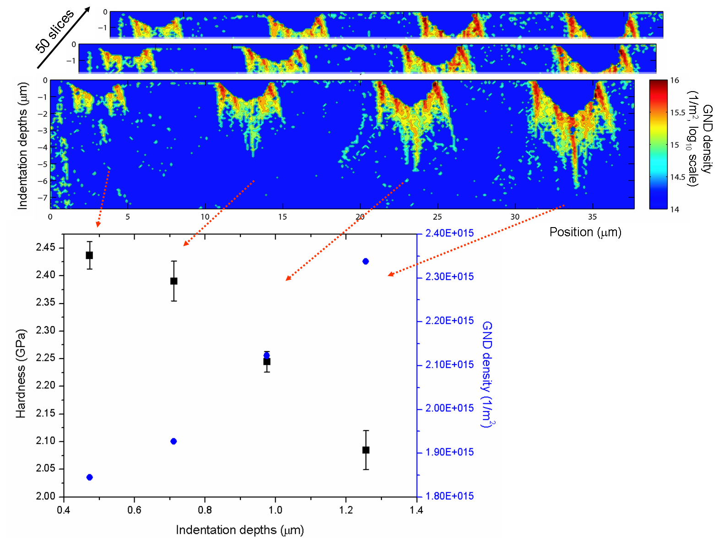
Extract geometrically necessary dislocations
Demir, Raabe, Zaafarani, Zaefferer: Acta Mater. 57 (2009) 559

Slide 16
Conclusions
GNDs have inhomogeneous distribution below indents with very high local density values.
Total GND density below indents drops with decreasing indentation depths. Observation contradicts strain gradient theory.

