Slide 1
Piling-up behavior during axisymmetric indentation and its relation to the activated deformation mechanisms in γ-TiAl
C. Zambaldi, S. Zaefferer, F. Roters, D. Raabe
MRS Fall Conference 30. November 2010 Dierk Raabe

Slide 2
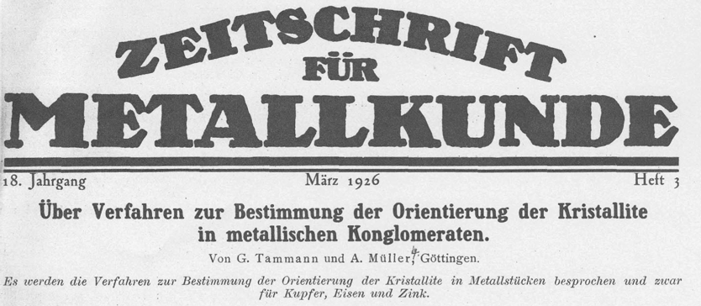

Pile-up in γ-Fe single crystals
Microindentation with gramophone and sewing needles in 1905
Osmond&Cartaud 1905, fig. taken from Tammann 1926 Zeitschrift für Metallkunde 18 (3)

Slide 3
Overview
Introduction
Experiments: nanoindentation, AFM, EBSD
Crystal plasticity finite element (CP-FEM) simulation of anisotropic flow during nanoindentation
Comparison of experiment and simulation
Anisotropic hardness of γ-TiAl

Slide 4
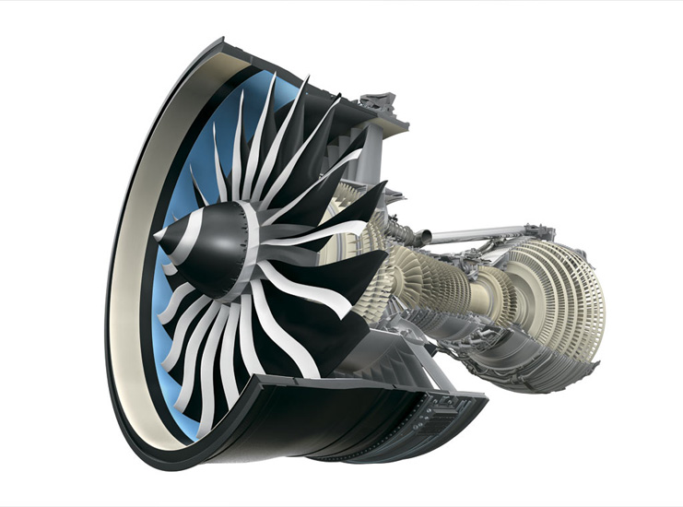
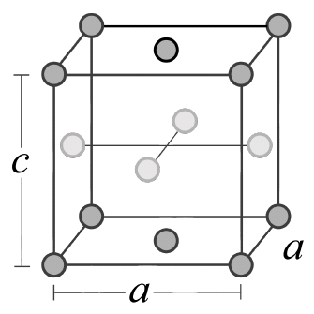

Two-phase TiAl / Ti₃Al
[Schuster&Palm 2006]
γ-
α₂-
GEnx jet engine
γ/α₂
two-phase TiAl / Ti₃Al
Ti
Al
γ-TiAl: L1₀-ordered
face centered tetragonal c/a ~ 1.02

Slide 5
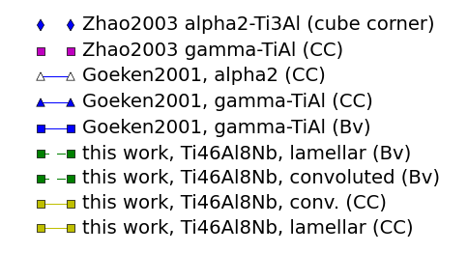
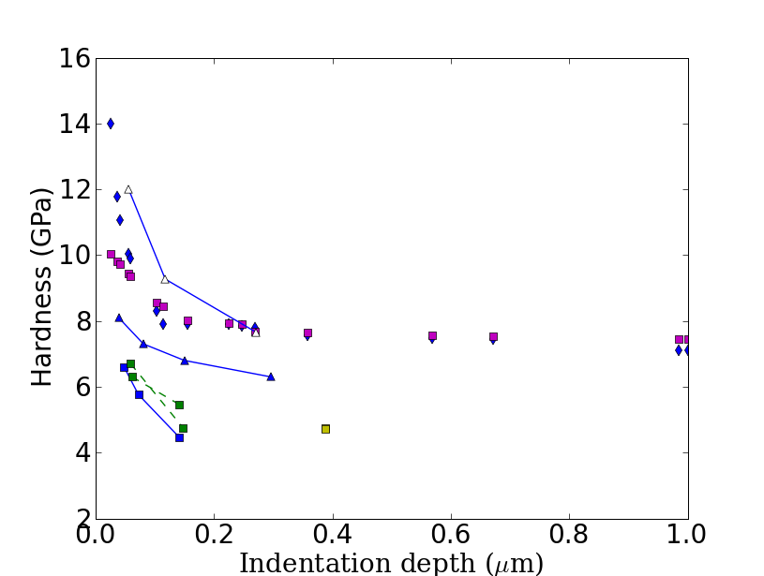
Indentation size effect in γ-TiAl

Slide 6
Nanoindentation
Instrumented indentation is a simple and potentially highly accurate materials testing method
Mechanical characterization from nano to macro
Uniaxial testing: 1-d flow curve;
Indentation: load-displacement curve (1-d)
as well as pile-up (2-d).
Crystal-Plasticity-FEM (CPFEM) capable to describe the orientation dependency during indentation; orientation information needed
Complex 3-dimensional deformation

Slide 7
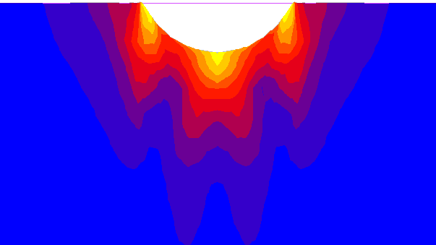
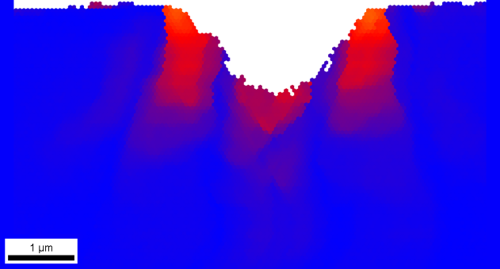
Comparison, crystal rotations : Exp. (3D EBSD) – CP FEM
Absolute rotations
25°
20°
15°
10°
CPFEM, viscoplastic
experiment
[111]
5°
[-110]
0
[11-2]
Zaafarani et al.: Acta Mater. 56 (2008) 31
Zaafarani et al. Acta Mat. 54 (2006) 1707; Wang et al. Acta Mat. 52 (2004) 2229

Slide 8
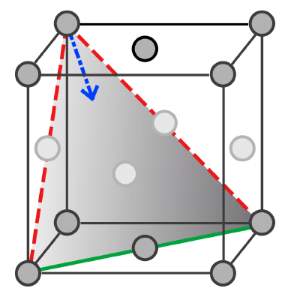
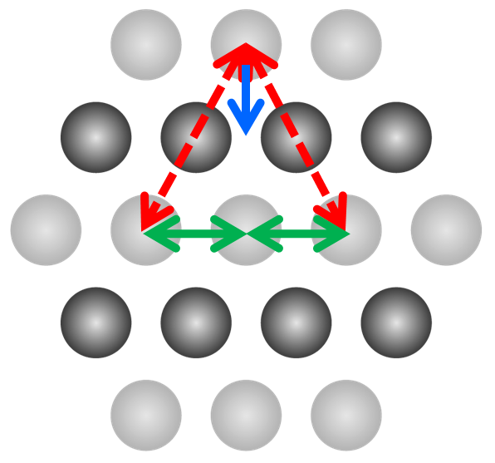
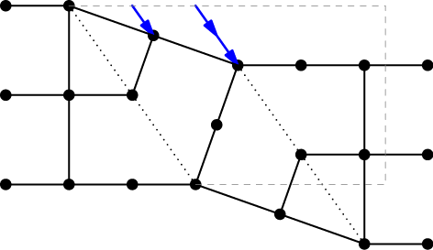
Crystal plasticity of γ-TiAl
Deformation modes
4 systems for {111} ⟨1-10] slip by
ordinary dislocations, b=1/2 ⟨110]
8 systems for {111} ⟨-101] slip by superdislocations, b= ⟨101]
4 twinning systems of type {111}⟨11-2]
unidirectional with a fixed amount of shear (1/sqrt(2)), b= 1/6 ⟨11-2]
(110)
(111)
(111)

Slide 9
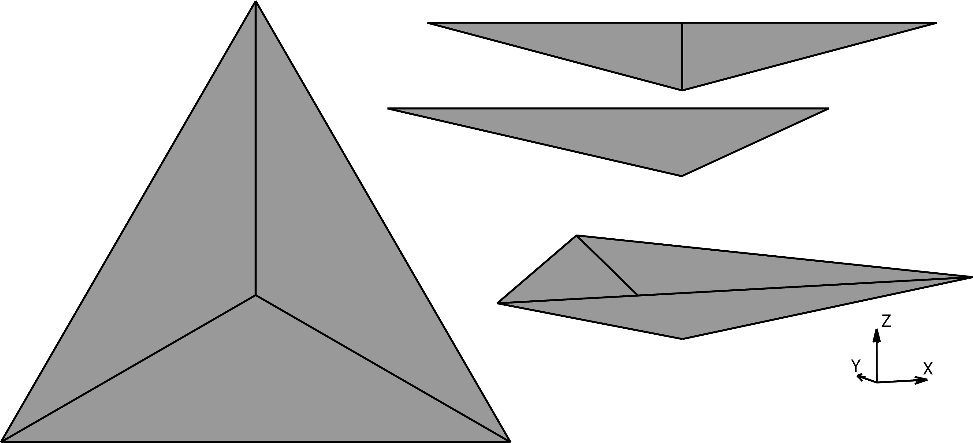
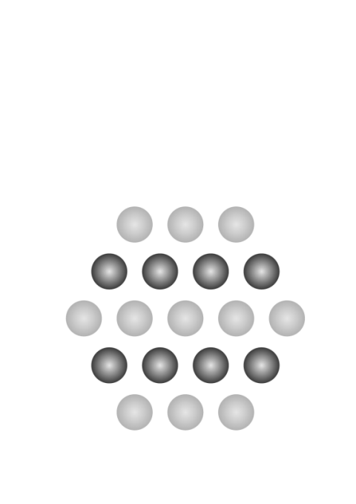
γ-TiAl , indentation experiments
[Göken & Kempf, 2001, 2002]
[Göken & Kempf, 2001, 2002]
[111] indentation
Pronounced orientation dependence during indentation, e.g. pile-up
Order variants result in
3-fold symmetry of pile-up during ⟨111⟩ indentation

Slide 10
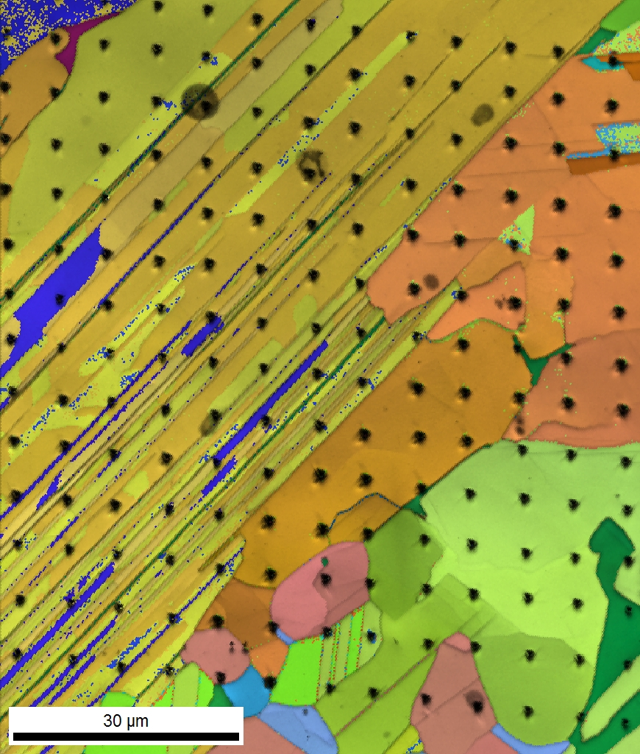
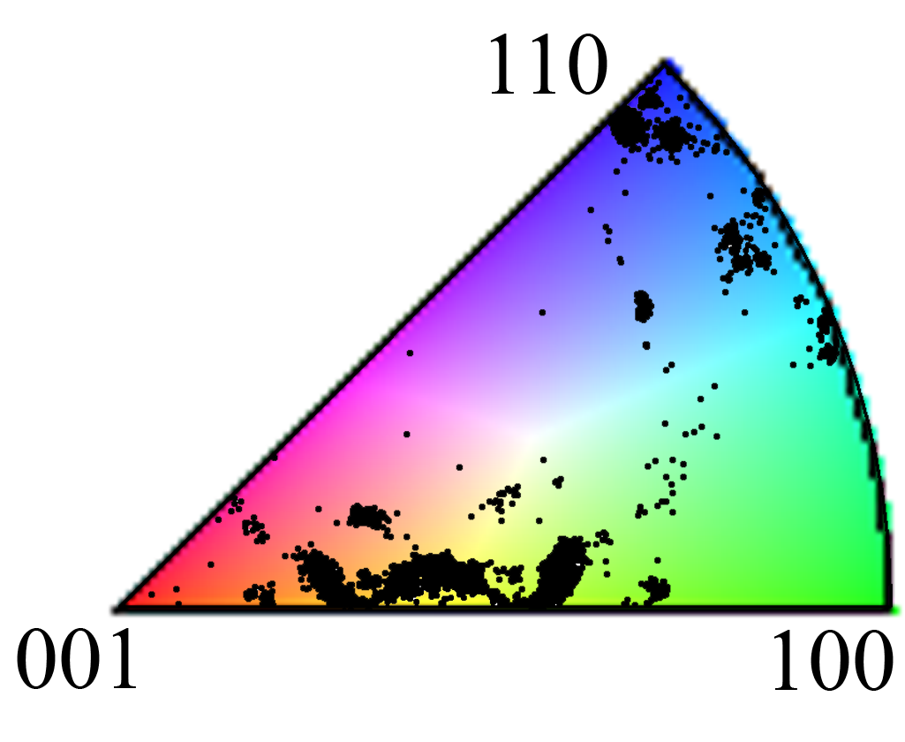
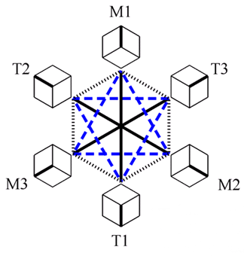
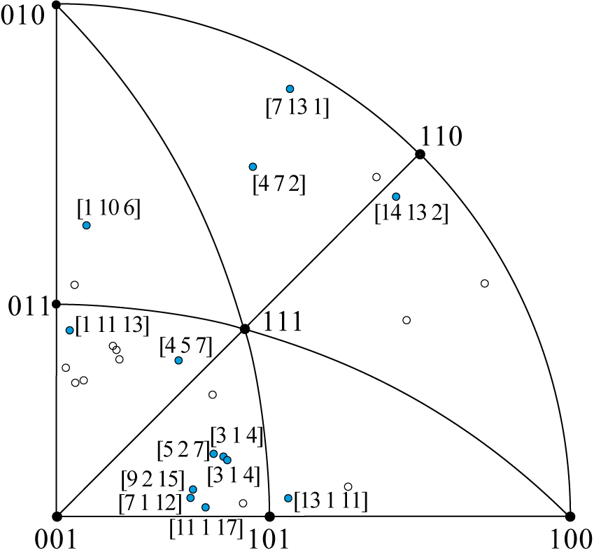

Identification of order domains by EBSD
120°@[111]
o
o
o
x
x
x
x
x
x
x
x
x
x
x
o
o
o
o
o
o
x
x
o
o
o
x
o
o
o
o
o
o
o
o
x
o
x
o
o
o
o
Fit-rank EBSD indexing
Zambaldi, Zaefferer, Wright; J. Appl Cryst. (Dec 2009)
Notes:
Reliable indexing of the ordering domains (the c-axis direction) by improved indexing procedure based on the fit between measured and recalculated Kikuchi band positions.

Slide 11
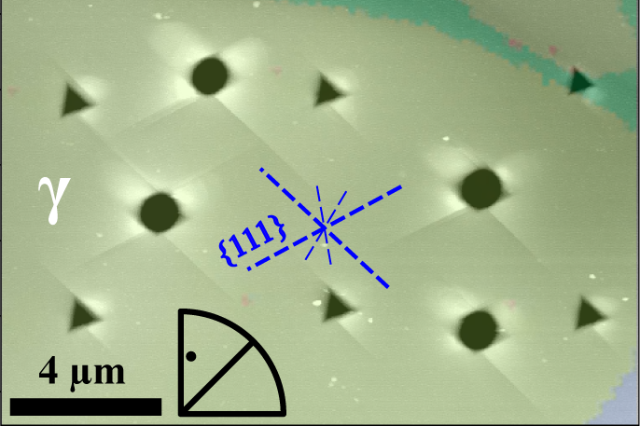
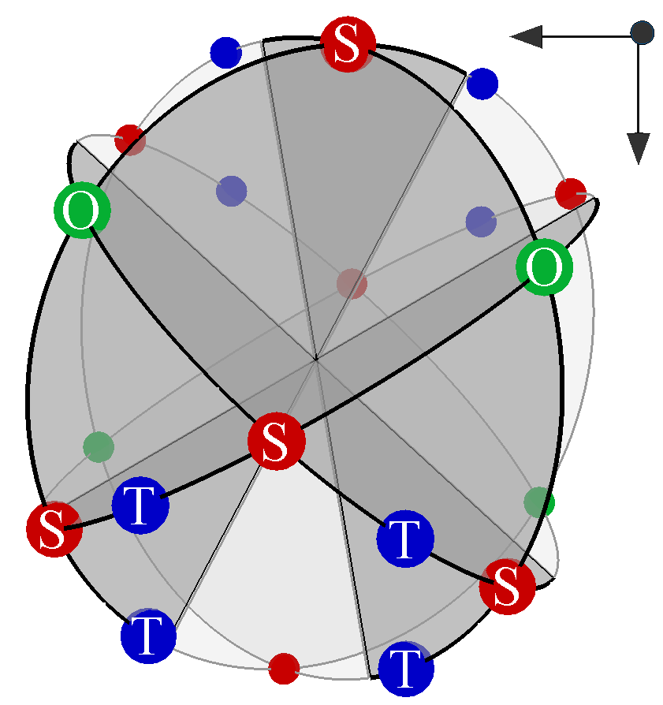
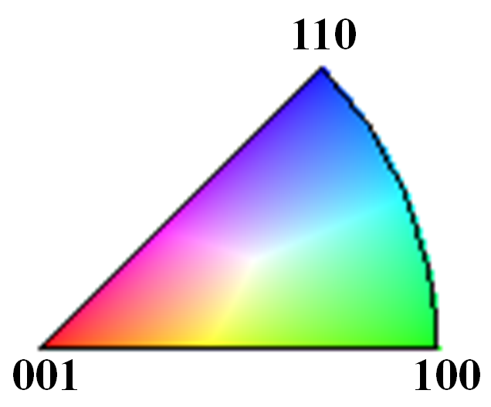
Nanoindentation & EBSD & AFM
γ-TiAl single crystals cannot be grown in the specific compositions➔ Nanoindentation in fine microstructures
Characterization by AFM & EBSD
AFM topographic and EBDF maps superimposed
Zambaldi & Raabe, Acta Mater. 2010
Notes:
* As for many other intermetallics, TiAl plasticity very sensitive against change in chemical composition
* Glide steps align with the {111} traces as expected.
* Circled indents: Berkovich indenter does not give reproduceable pile-up for a given indentation axis.

Slide 12
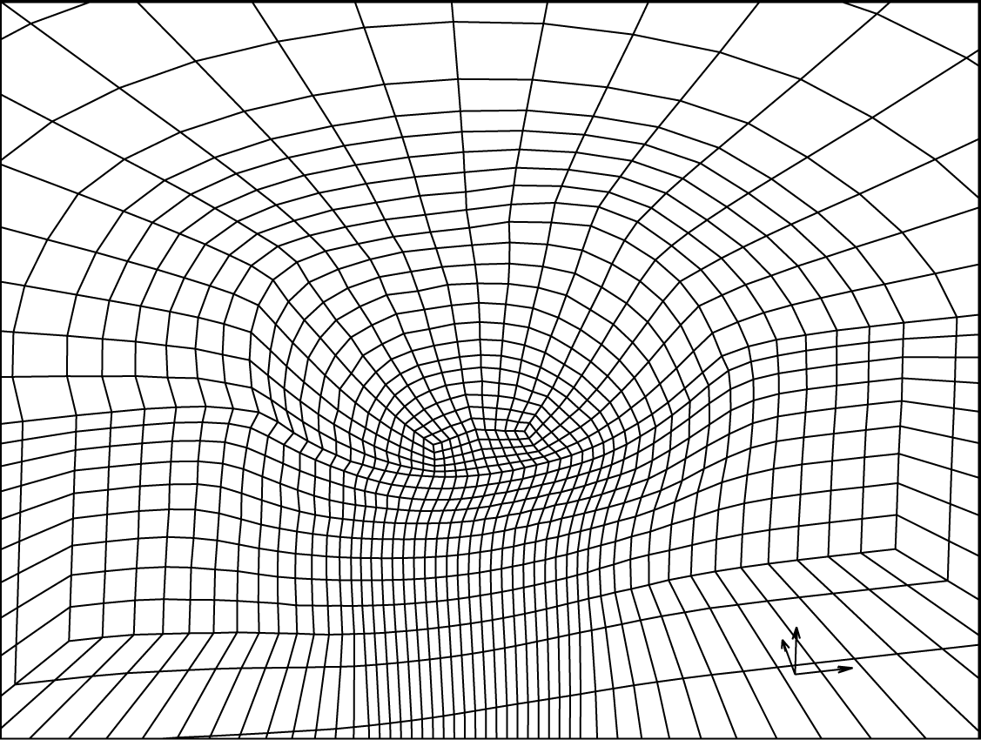
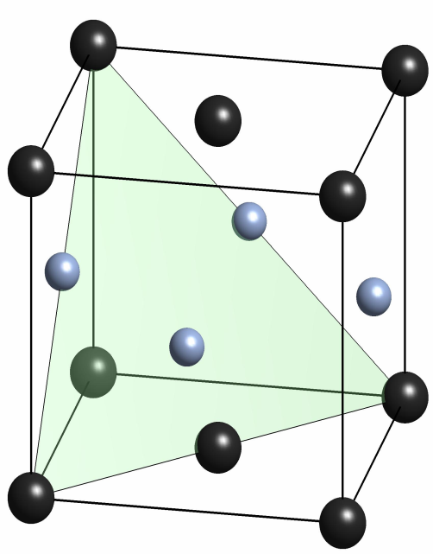


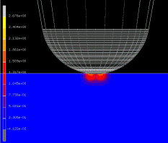
3-dimensional simulation of nanoindentation
Meshing, contact, strong gradients, numerical robustness,…
Ti Al
Zambaldi & Raabe, Acta Mater. 2010
Notes:
Incorporation of the TiAl deformation mechanisms by allowing for different shear strengths and hardening characteristics of ordinary and super dislocations and using uni-directional deformation for the twinning shear.

Slide 13
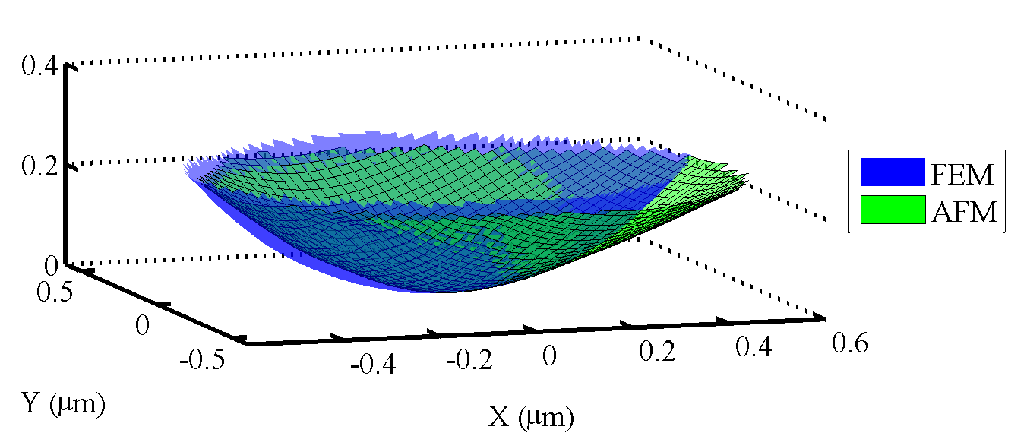
Iterative fitting of tip geometry
Comparison of remaining impression shape with simulated indent

Slide 14
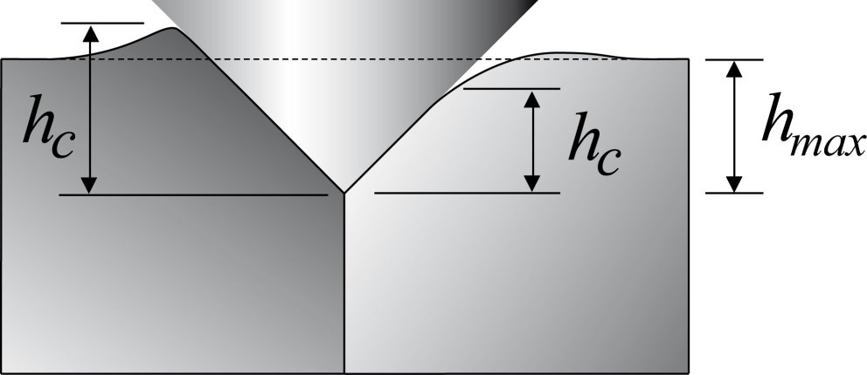
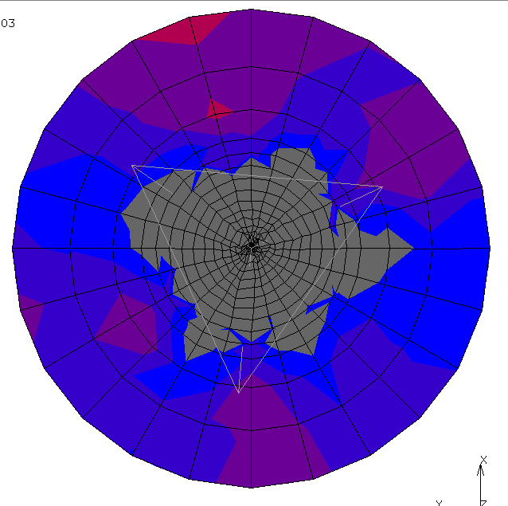
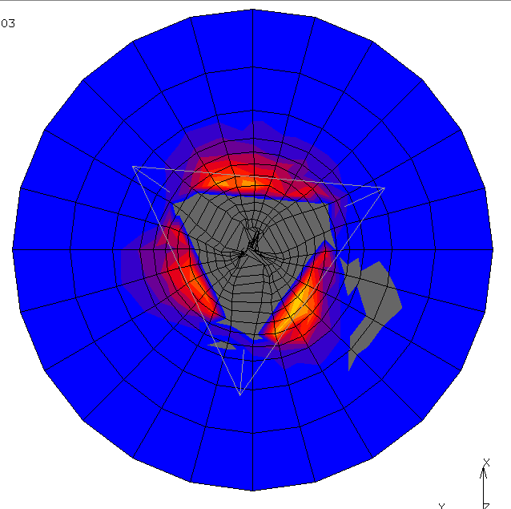
Piling-up / sinking-in behavior
Influence of hardening parameters
Pile-up Sink-in
τ_{c}
High hardening: sink-in
Small hardening: pile-up
Sink-in
Pile-up
shear strain γ
Notes:
High hardening results in sink-in, little hardening in pronounced pile-up
Red: super dislocation single slip
Green: ordinary dislocation single slip

Slide 15
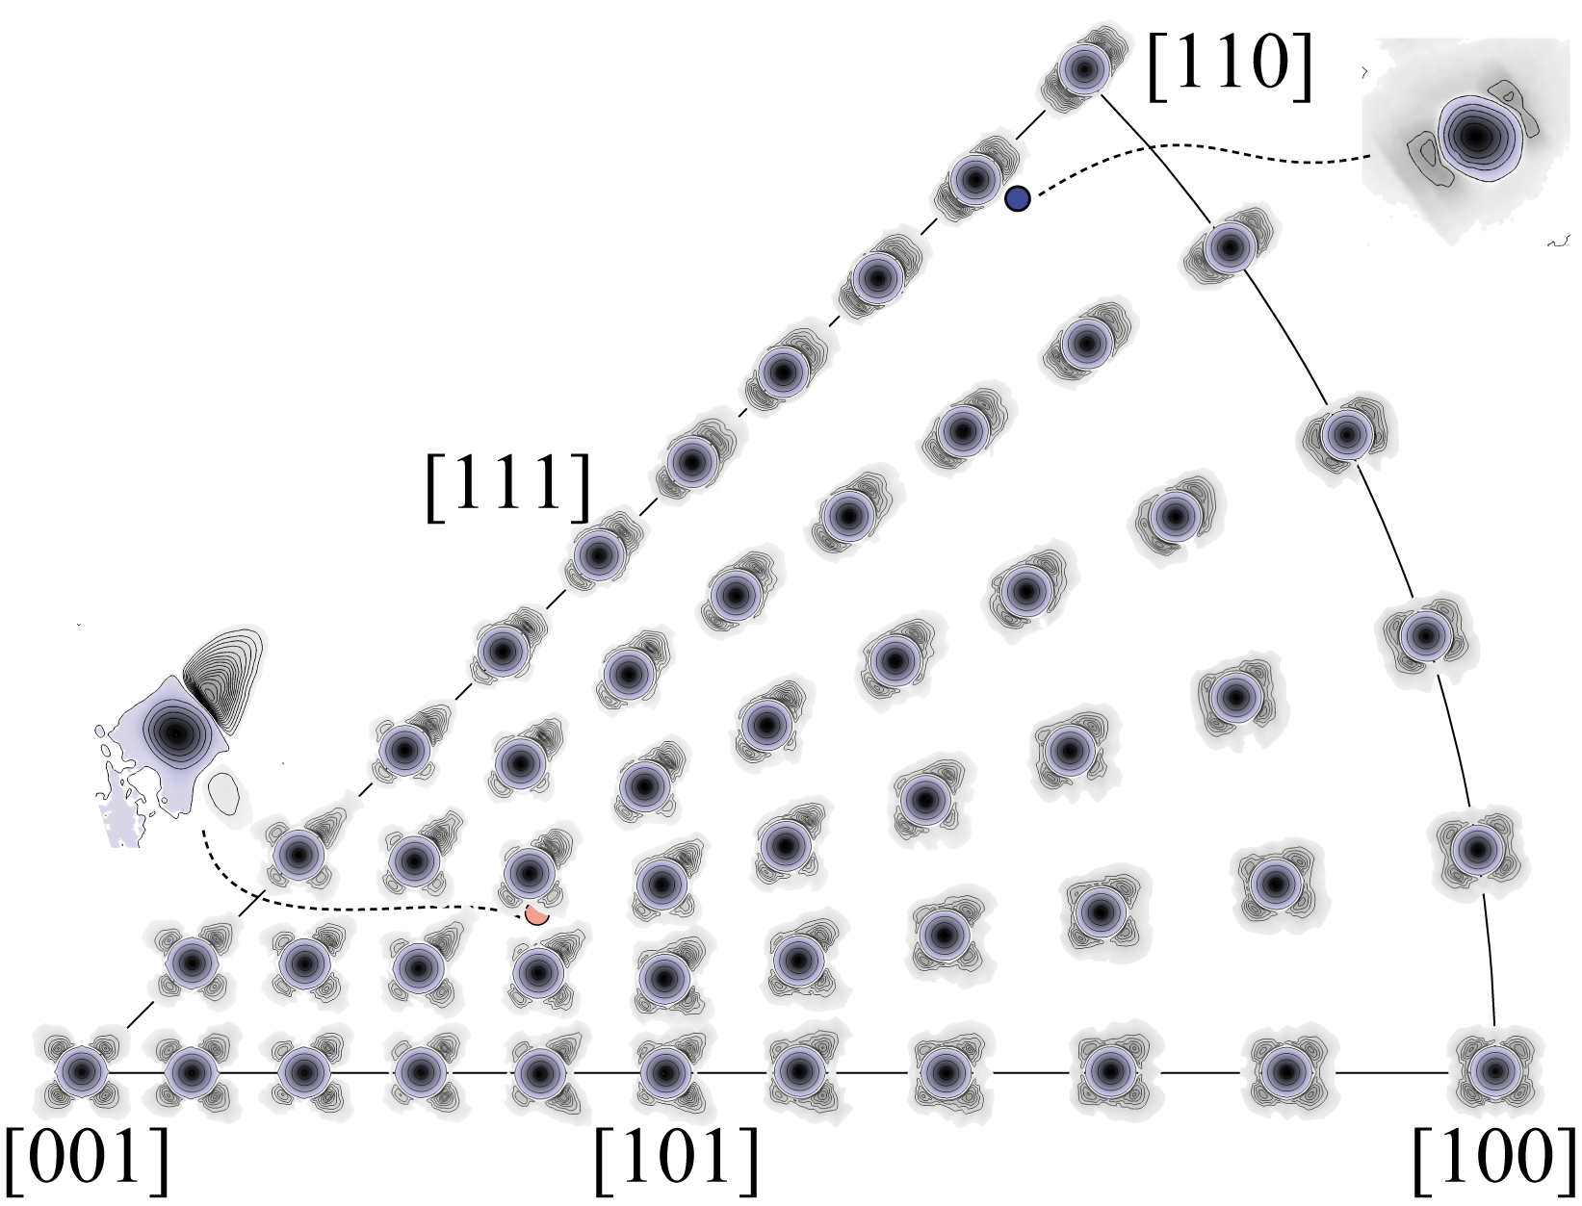
Simulated pile-up profiles
Pile-up IPF
from 51 orientations
approx. resol. 9°
Zambaldi & Raabe, Acta Mater. 2010

Slide 16
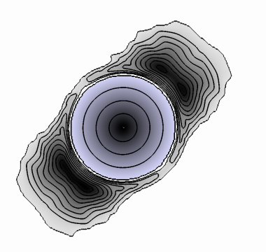
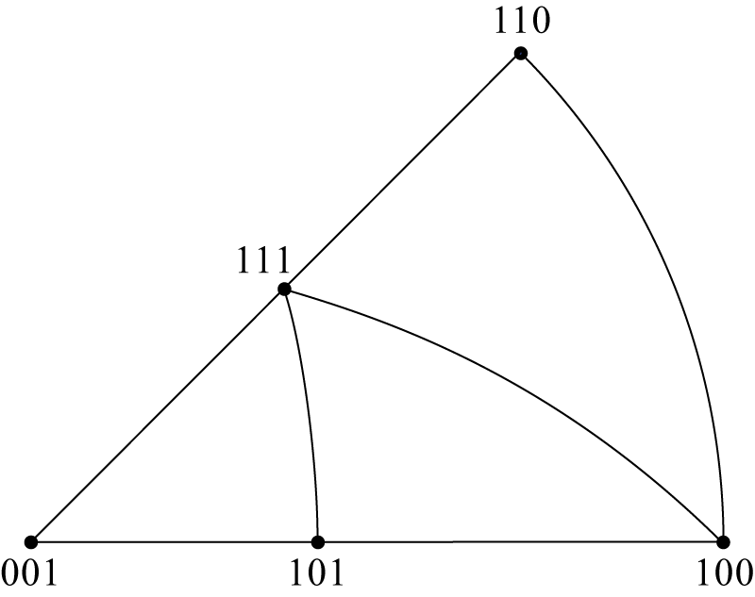
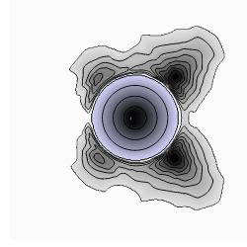
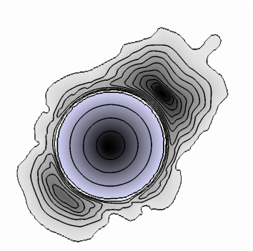
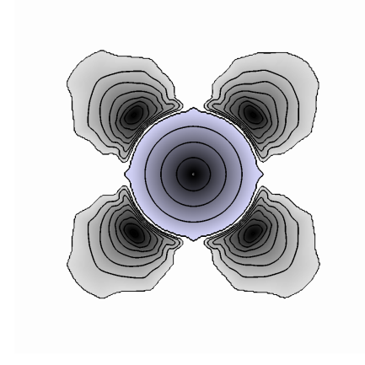
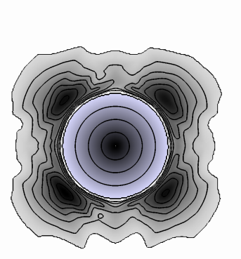
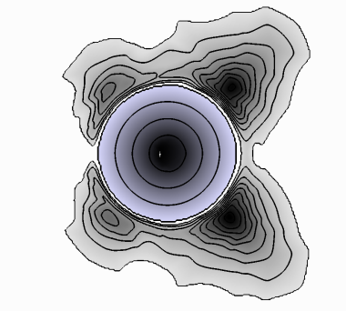
Simulated pile-up profiles
Pile-up IPF
High symmetry
orientations
[110]
[111]
[001]
[100]
[101]
Zambaldi & Raabe, Acta Mater. 2010

Slide 17
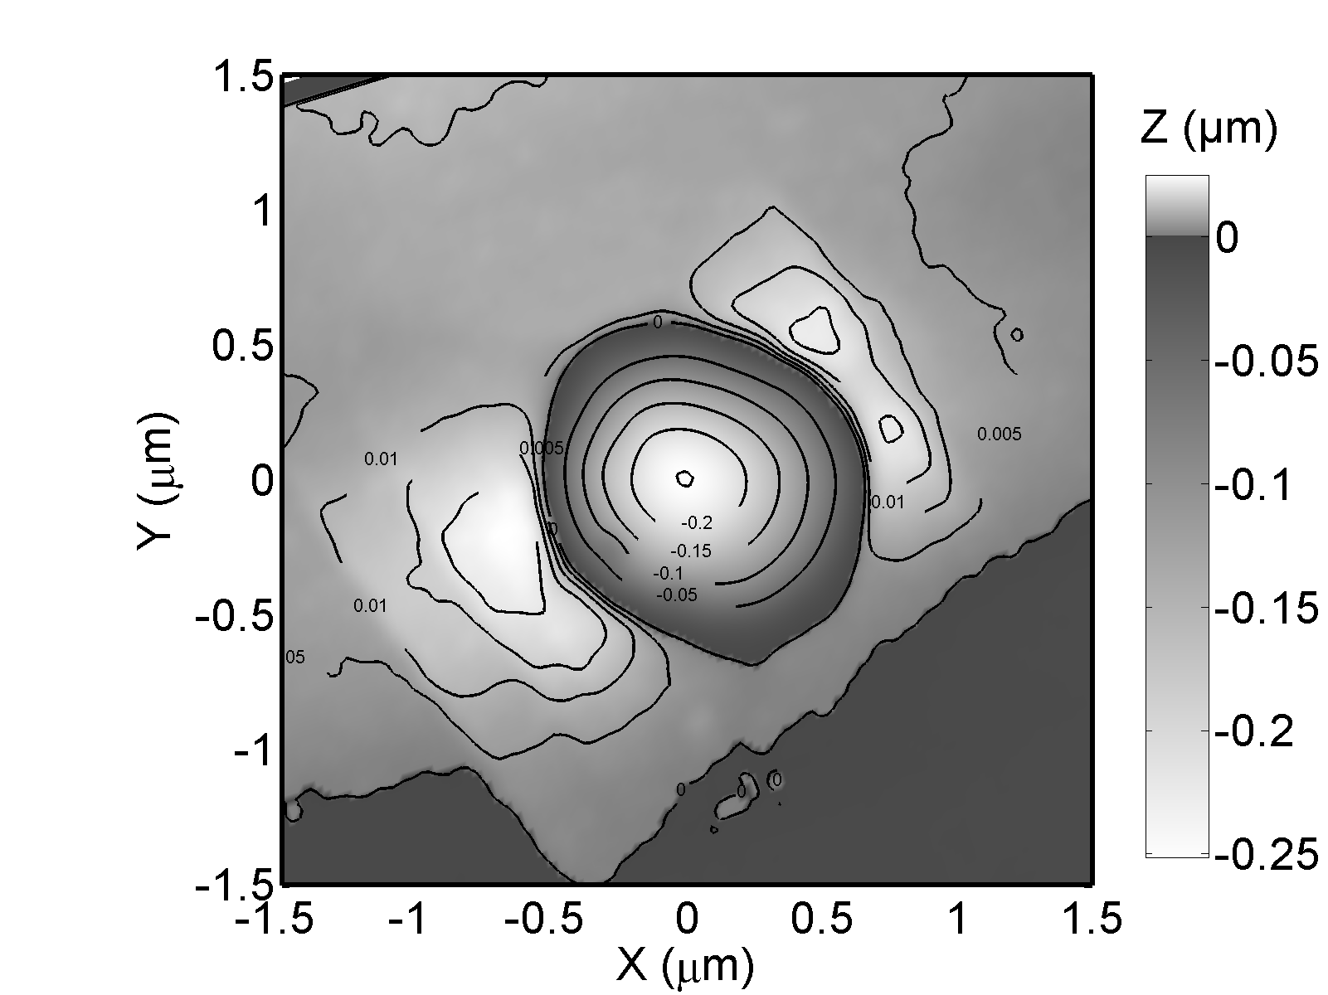
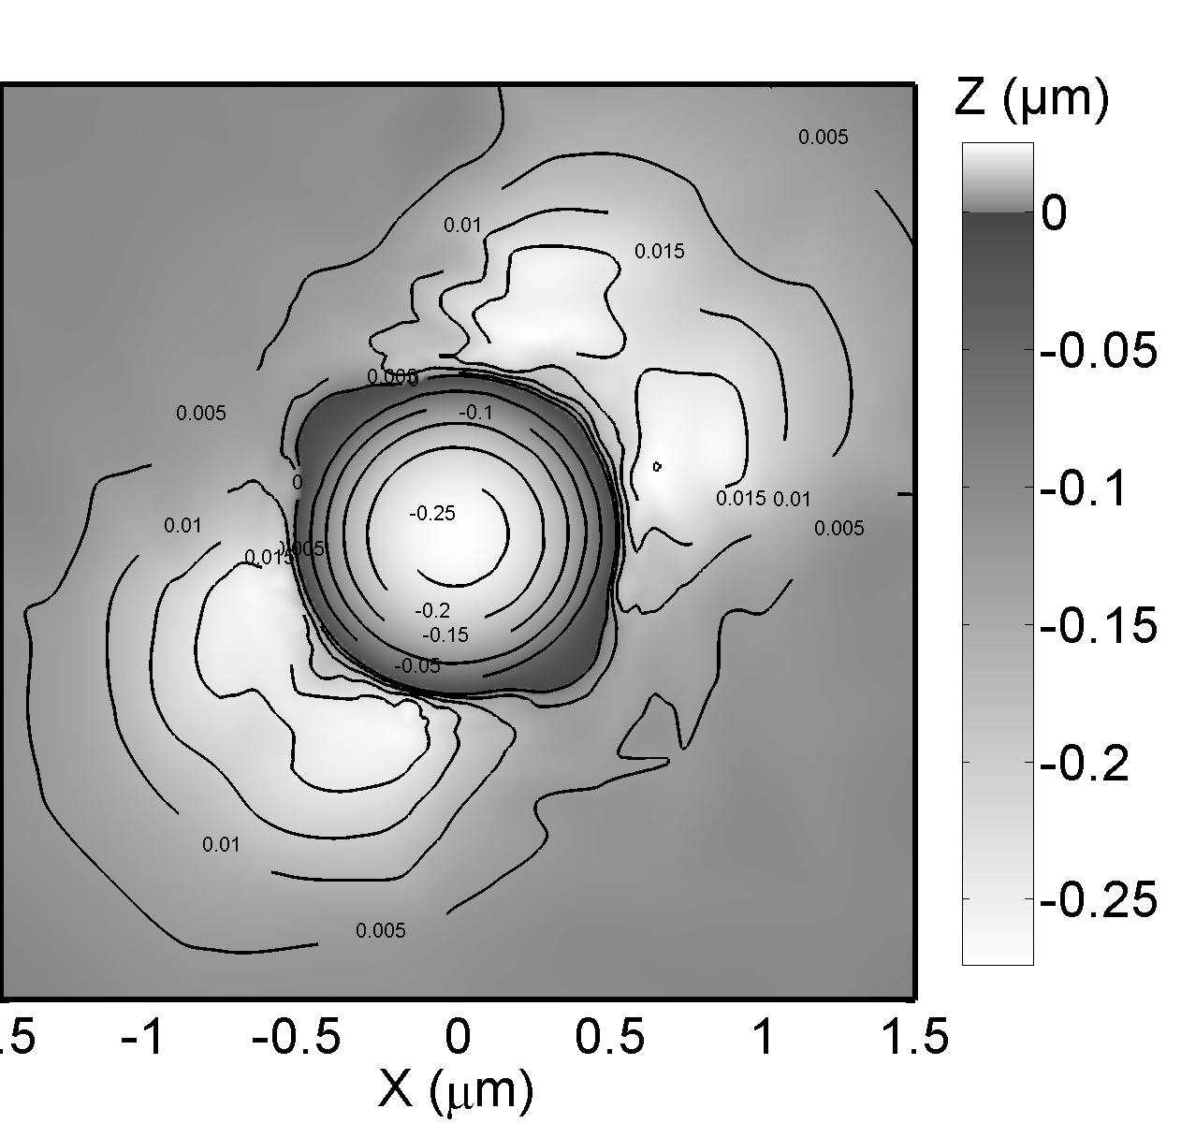
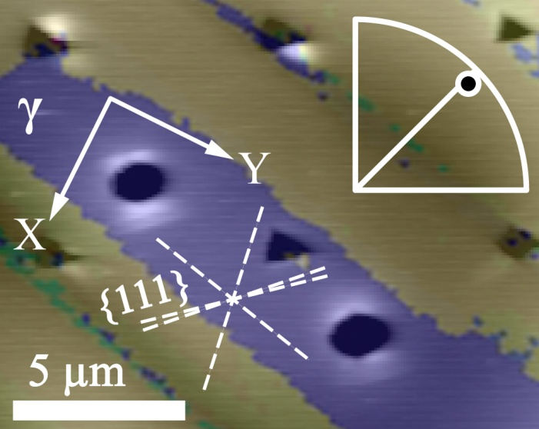
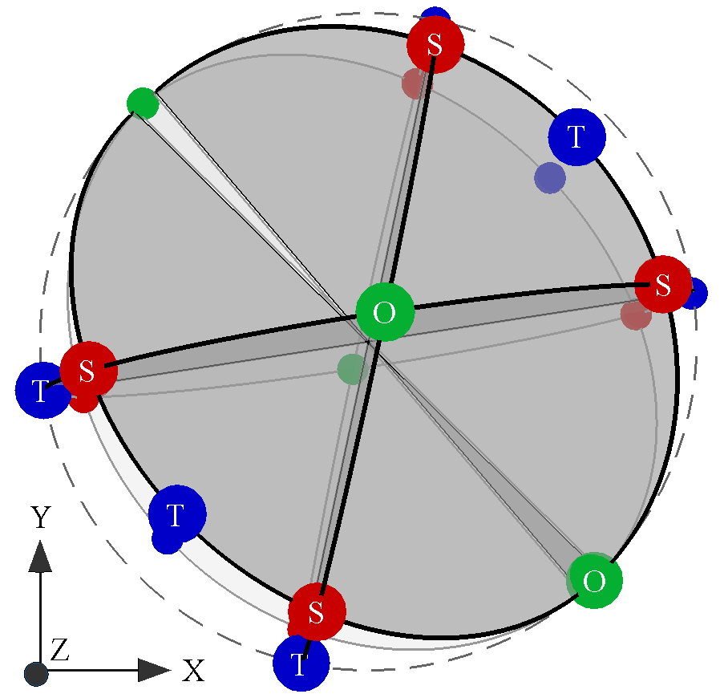
Comparison AFM / CP-FEM topography
Experiment
Simulation
Zambaldi, and Raabe: Acta Materialia 58 (2010) 3516

Slide 18
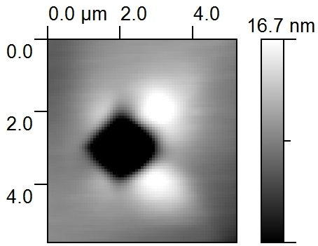
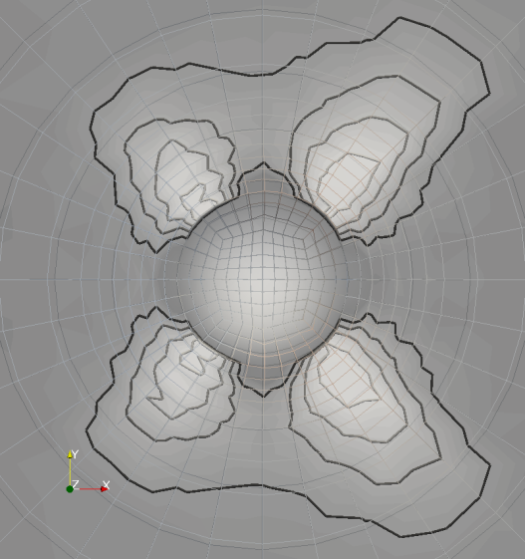
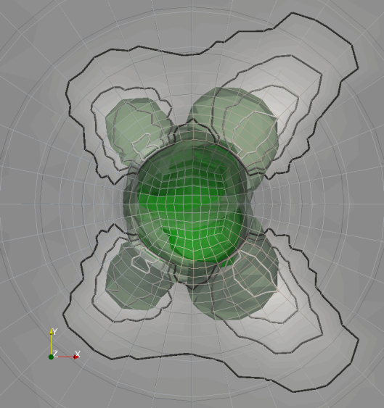
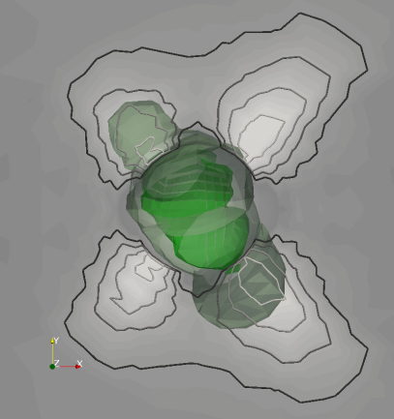
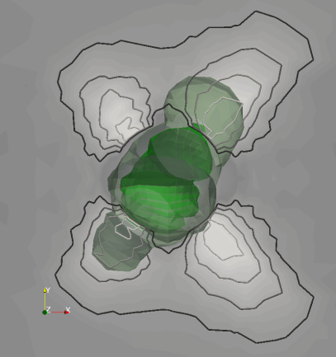
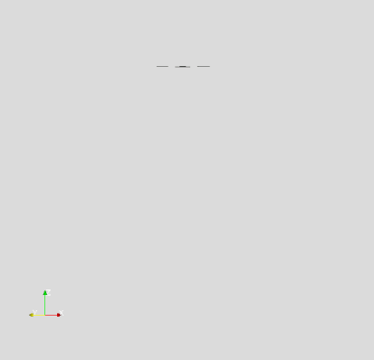
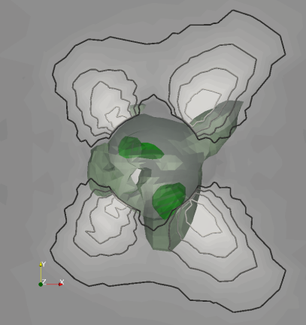
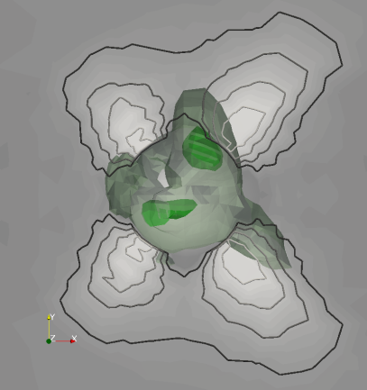
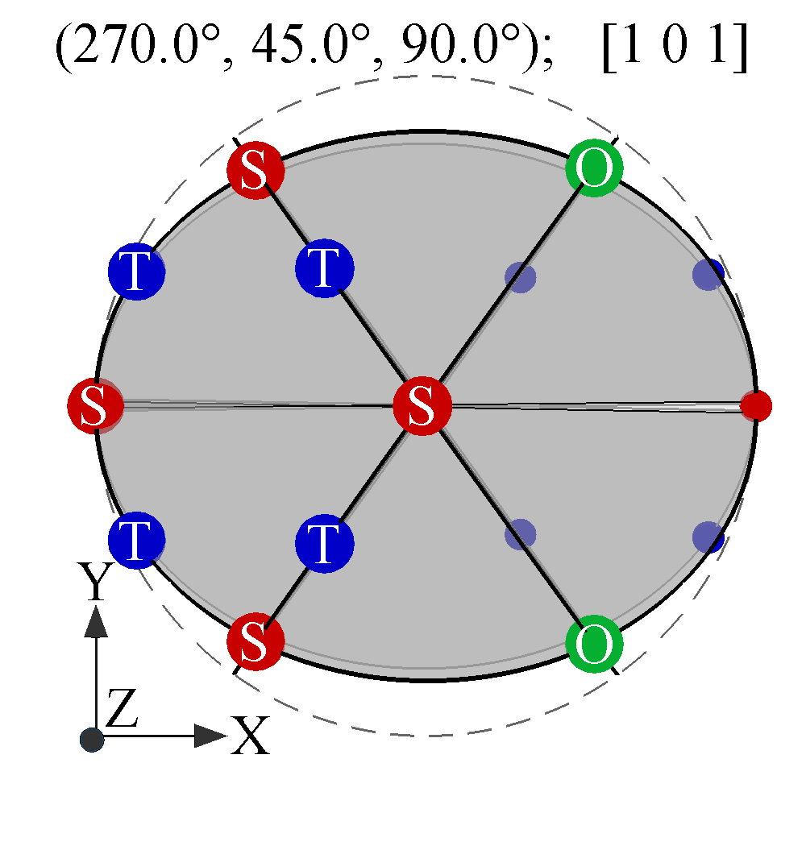
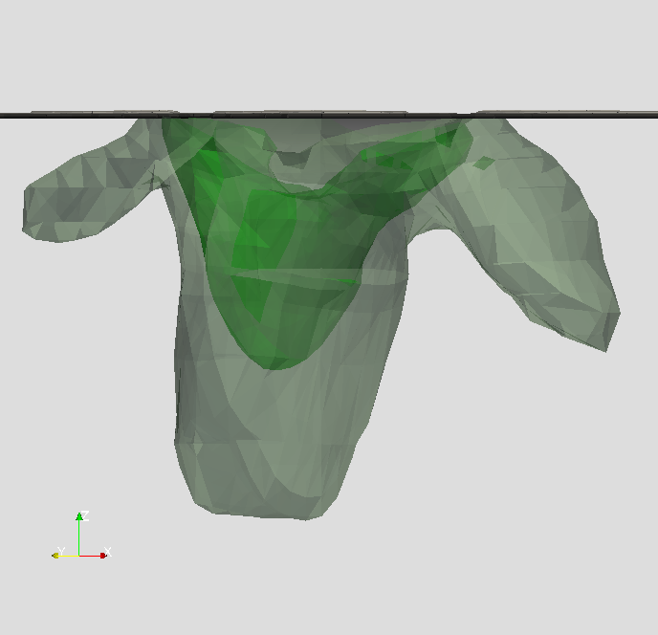
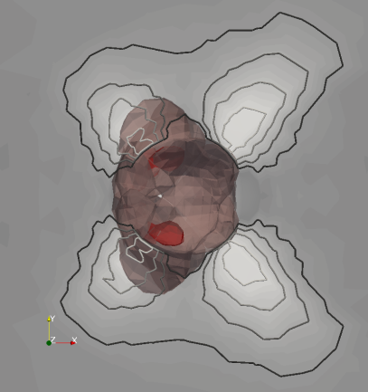
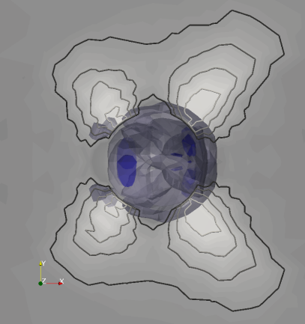



[101] indentation in γ-TiAl
Notes:
Video of the cross sectional view of the developing shear on a single ordinary dislocation slip system that is highly active.

Slide 19





Relative strengths of slip systems
(Ti-50Al)
Predicted
for Ti-55Al
Cu, Al, Au, Ag,…
[101] indentation indicates relative strengths of ordinary and super dislocation glide in TiAl
Demir et al. Acta Mater. 57 (2009) 559
Zaafarani et al. Acta Mat. 54 (2006) 1707; Wang et al. Acta Mat. 52 (2004) 2229
Notes:
[101] indentation in TiAl – a beam balance to compare ordinary with super dislocation glide

Slide 20

Extension to hexagonal α₂-Ti₃Al
22 orientations after the
developed convention
Prismatic <a>-slip is easy to activate ➔ 22 CPFEM simulations
Notes:
The approach can be extended to other crystal structures with different deformation systems, here example of Ti3Al (preliminary results, only one experimental topography)

Slide 21



Pile-up IPF & AFM result close to [2-1-1 0]
2 µm
α₂-Ti₃Al
Notes:
Dislocation line directions: Is it possible to analyse for the dislocation loop shape in the material and maybe cross-slip on basal plane? Further analysis necessary. ➔ because of the multiscale nature of the indentation you can choose to study dislocation character or bulk behavior, just depending on the choice of indentation load (here 6 mN)

Slide 22
Conclusions
Ordinary dislocation glide in near-stoichiometric γ-TiAl is an intrinsic property, i.e. not interface-related
Twinning contributes to deformation to a minor extent during single phase indentation of γ-TiAl
Nanoindentation combined with AFM, EBSD and CP-FEM can characterize activation of individual slip systems in single crystal indentation
Method based on highest accuracy values: P, h
Axisymmetric indenters need to be employed to make the method efficient

Slide 23



Samples were provided by
G. Behr, W. Löser (IFW Dresden)
U. Hecht (ACCESS e.V. Aachen)
Support by the European Union FP6 project IMPRESS (Intermetallic Materials Processing in Relation to Earth and Space Solidification)
is gratefully acknowledged.
Vielen Dank.

