Slide 1
Effect of strain path and texture on microstructure in
Fe–22 wt.% Mn–0.6 wt.% C TWIP steel
D. Raabe, I. Gutierrez-Urrutia
Düsseldorf, Germany
WWW.MPIE.DE
d.raabe@mpie.de
Dierk Raabe

Slide 2
Overview
Electron channeling contrast imaging
Twinning and texture
Strain path effects
Bauschinger effects
Conclusions
www.mpie.de

Slide 3
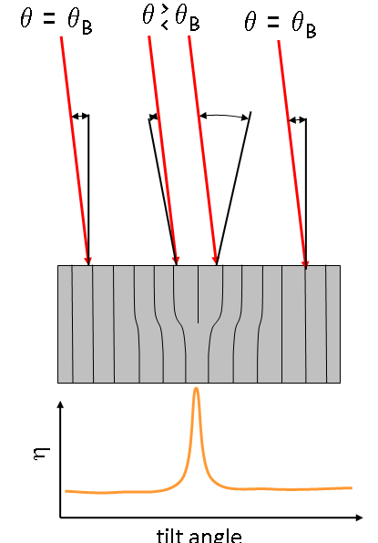
EBSD: Work hardening of TWIP steels, Fe-22Mn-0.6C (wt%)
Kippwinkel
I. Gutierrez-Urrutia, S. Zaefferer, D. Raabe; Scripta Materialia 61 (2009), 737
I. Gutierrez-Urrutia, S. Zaefferer, D. Raabe; Materials Science and Engineering A 527 (2010), 3552
C. Herrera et al. Acta Materialia 59 (2011) 4653
Dislocations in SEM

Slide 4
Overview
Electron channeling contrast imaging
Twinning and texture
Strain path effects
Bauschinger effects
Conclusions
www.mpie.de

Slide 5
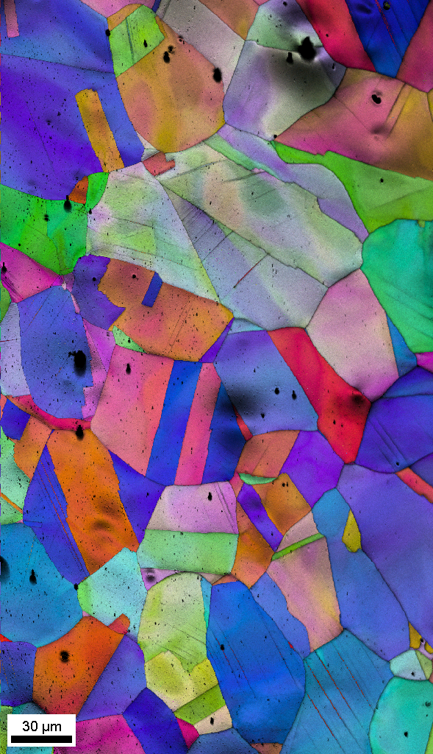
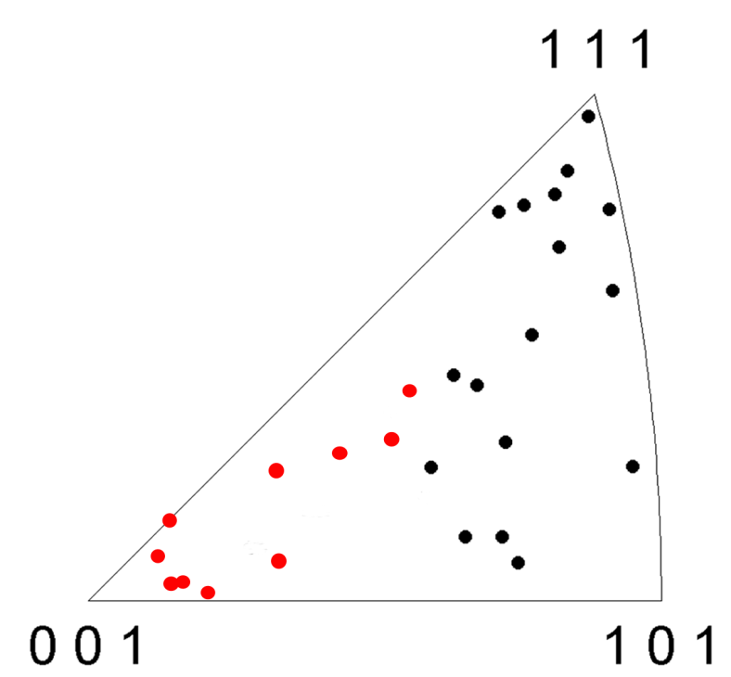
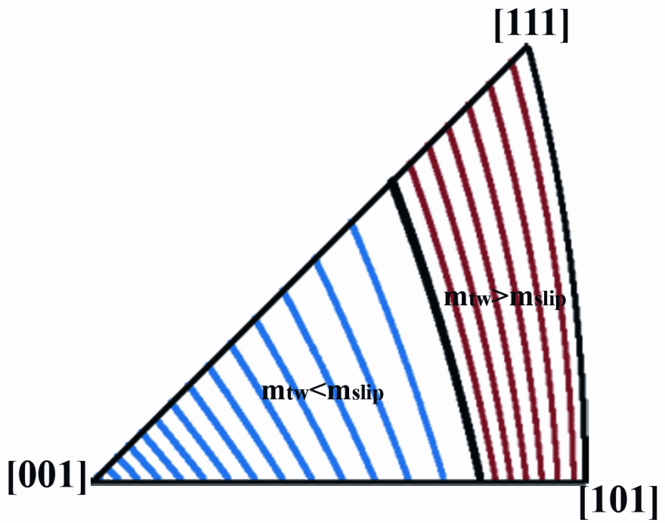
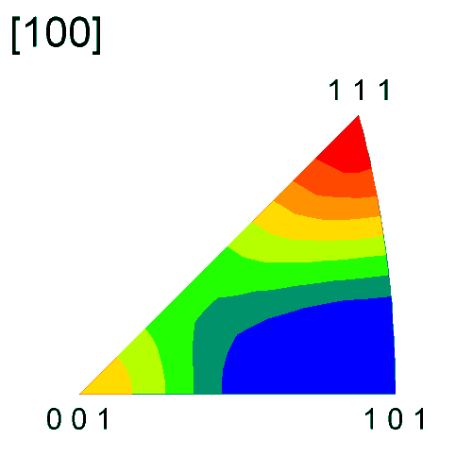
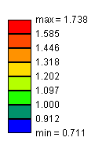
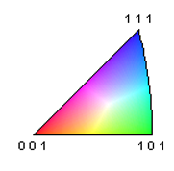
Influence of grain orientation on deformation twinning
Tensile test
σ: 380 MPa
ε: 0.1
Grain orientations
twins
no twins
IPF
TA
I. Gutierrez-Urrutia, S. Zaefferer, D. Raabe; Scripta Materialia 61 (2009), 737
I. Gutierrez-Urrutia, S. Zaefferer, D. Raabe; Materials Science and Engineering A 527 (2010), 3552

Slide 6
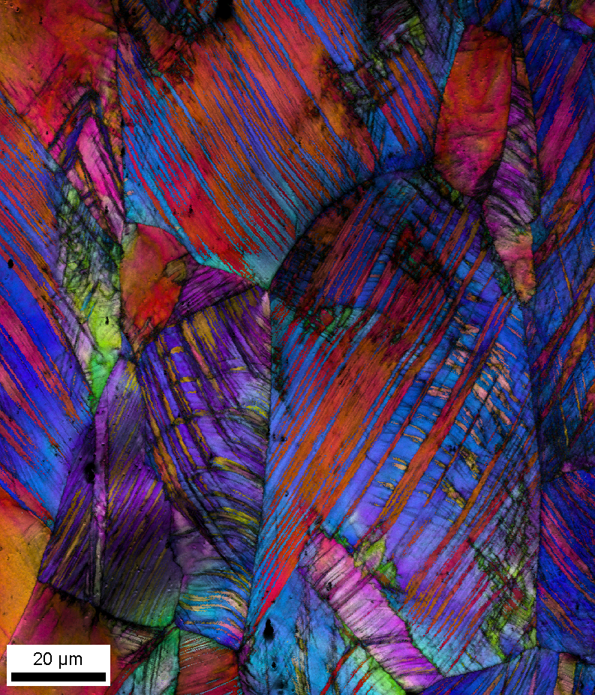
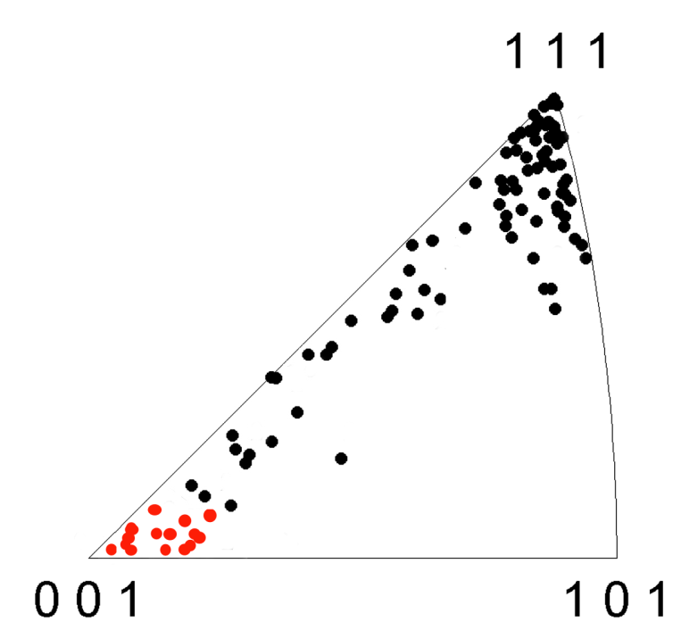
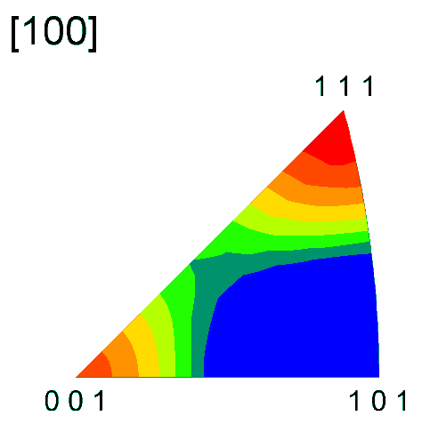

Influence of grain orientation on deformation twinning
Tensile test
σ: 950 MPa
ε: 0.4
Grain orientations
twins
no twins
IPF
TA

Slide 7
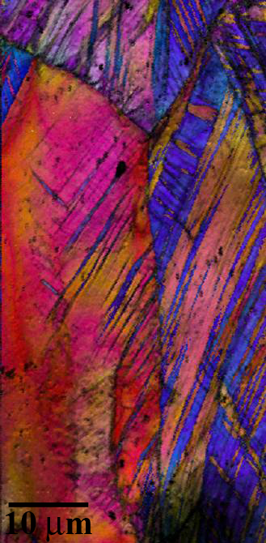
Influence of grain orientation on deformation twinning
Tensile test
σ: 950 MPa
ε: 0.4
Why twinning in these orientations?
Local stress concentrations at GB
Micromechanical B.C.
matter
twins
no twins
twin transfer
TA

Slide 8
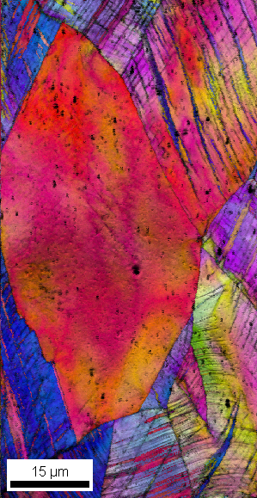
Influence of grain orientation on deformation twinning
Tensile test
σ: 950 MPa
ε: 0.4
twins
no twins
no twin transfer
TA

Slide 9
Overview
Electron channeling contrast imaging
Twinning and texture
Strain path effects
Bauschinger effects
Conclusions
www.mpie.de

Slide 10
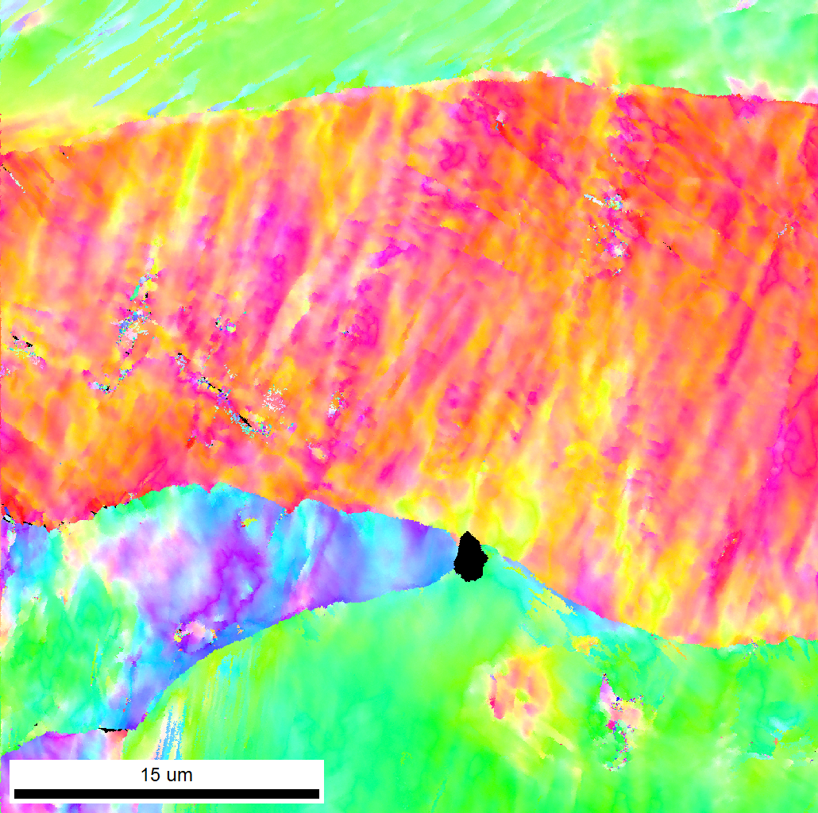
Influence of strain path: tensile vs shear on disloc. substructure
Cell Block formation
ε: 0.1
ND
SD
<001>//shear direction

Slide 11
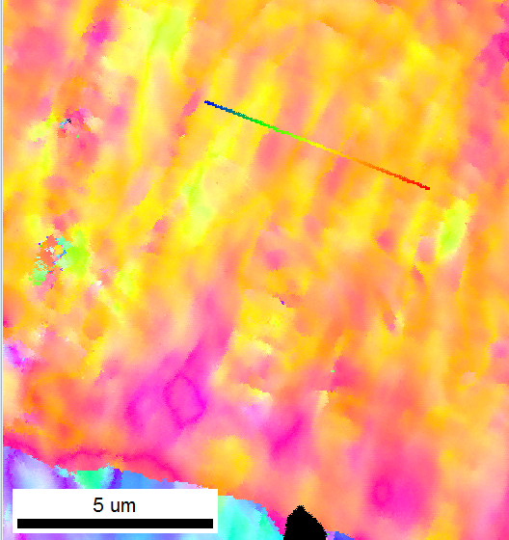
Influence of strain path: tensile vs shear on disloc. substructure
ε: 0.1
ND
SD
Misorientation profile
1.2
1.2
1.2
2.4
1.7
B
B
B
B
B
B
B
B
B
2.8
2.3
1.8
3.6

Slide 12
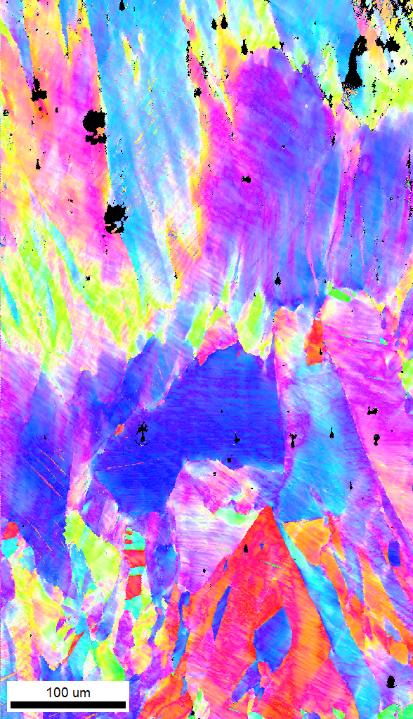
EBSD does not detect dislocation cells
Shear : ε:0.3
ND
SD

Slide 13
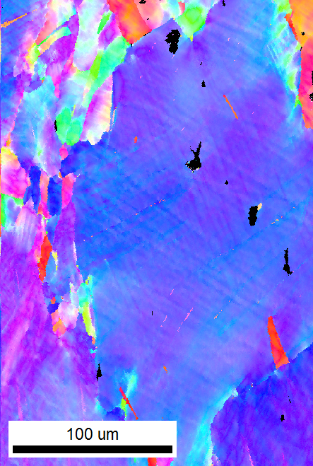
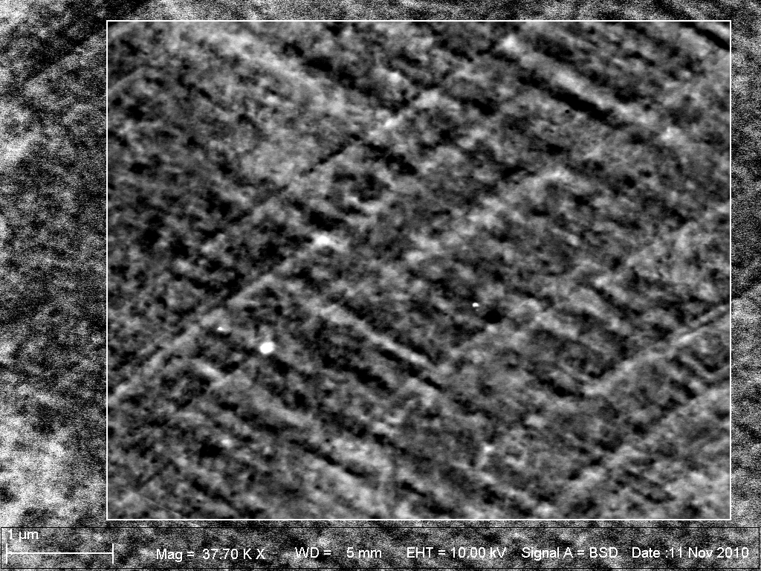
Influence of strain path: tensile vs shear on disloc. substructure
ECCI
Shear : ε:0.3
{111} traces of shear
Substructures with misorientation up to 2deg, hence, visible via EBSD
<111>//Shear direction
Misorientation profile
I. Gutierrez-Urrutia et al. Scripta Materialia 61 (2009), 737

Slide 14
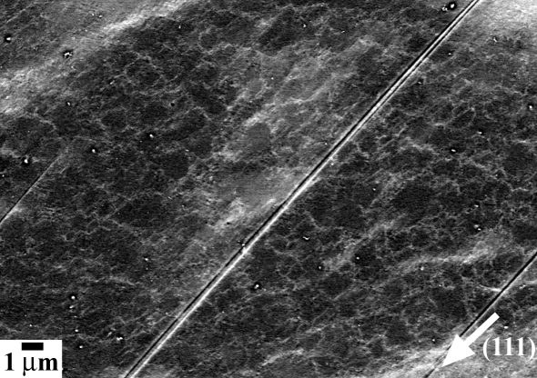
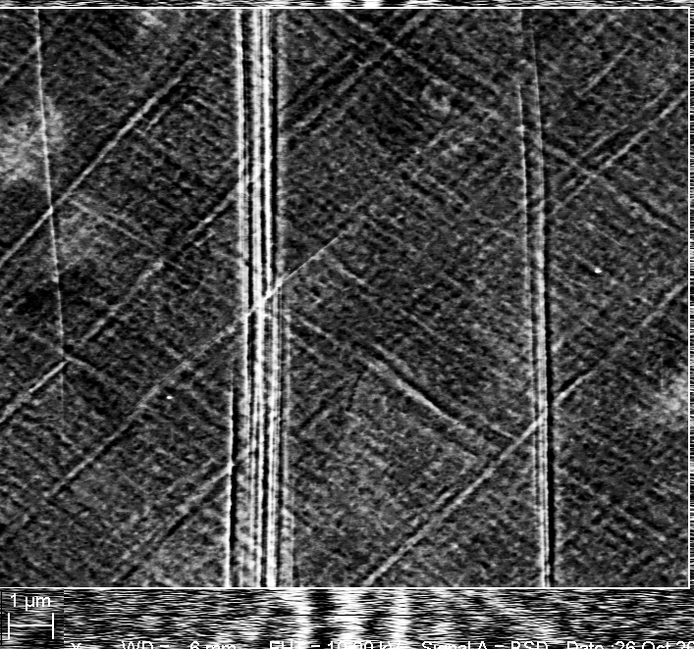
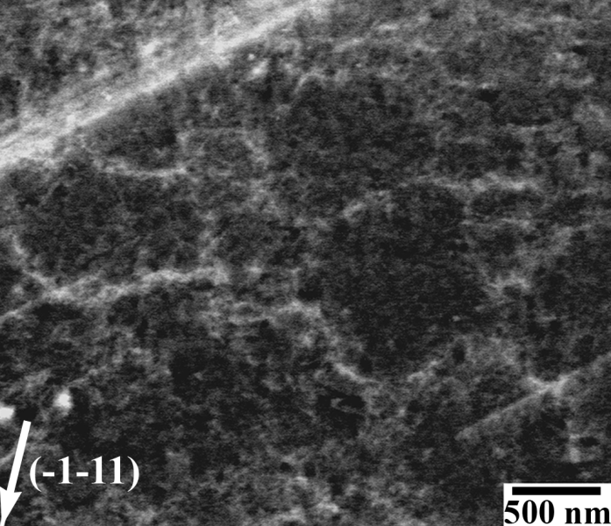
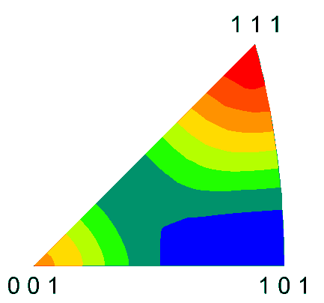

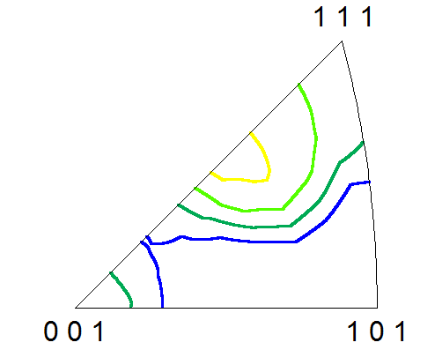
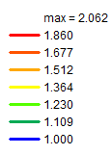
Influence of strain path: tensile vs shear on dislocation substructure
Tensile: dislocation cells
Shear: symmetric patterning, cell blocks, shear bands
ND
SD
Tensile axis
Shear direction
112
ε:0.3
I. Gutierrez-Urrutia et al. Scripta Materialia 61 (2009), 737

Slide 15
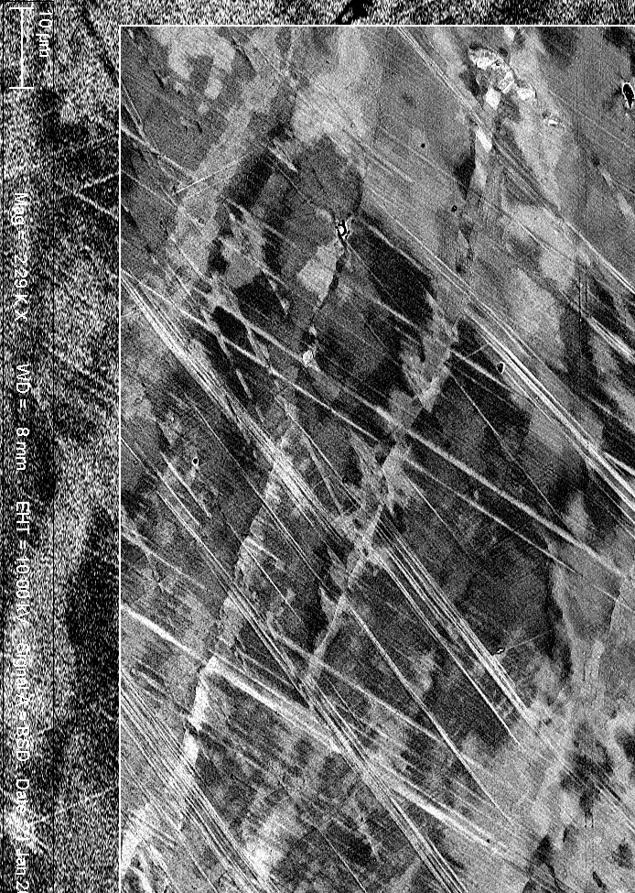
Influence of strain path: tensile vs shear on disloc. substructure
Tensile: dislocation cells
Shear: symmetric patterning, cell blocks, shear bands
ND
SD
Tensile axis
Shear
bands
ε:0.3
I. Gutierrez-Urrutia, S. Zaefferer, D. Raabe; Scripta Materialia 61 (2009), 737
I. Gutierrez-Urrutia, S. Zaefferer, D. Raabe; Materials Science and Engineering A 527 (2010), 3552
I. Gutierrez-Urrutia et al. Mater.Sc Eng. A 527 (2010) 3552

Slide 16
Overview
Electron channeling contrast imaging
Twinning and texture
Strain path effects
Bauschinger effects
Conclusions
www.mpie.de

Slide 17
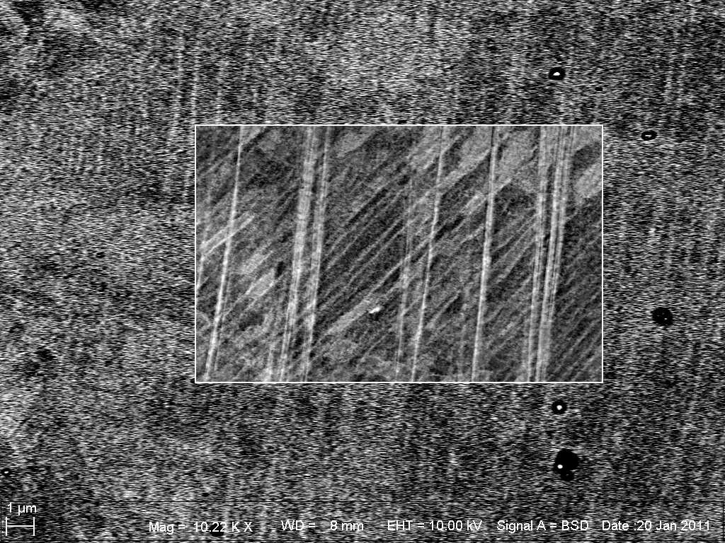
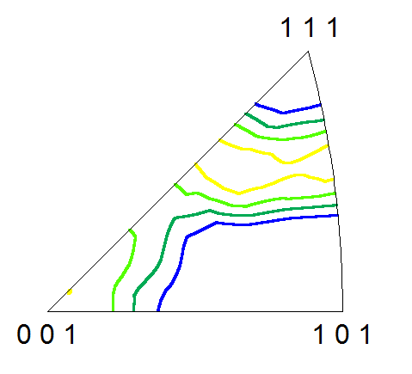
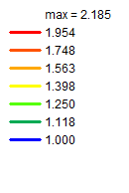
Strain reversion: Bauschinger test
ε: 0.1 + (-0.03)
Cell block formation is enhanced
112
I. Gutierrez-Urrutia et al. Mater.Sc Eng. A 527 (2010) 3552

Slide 18
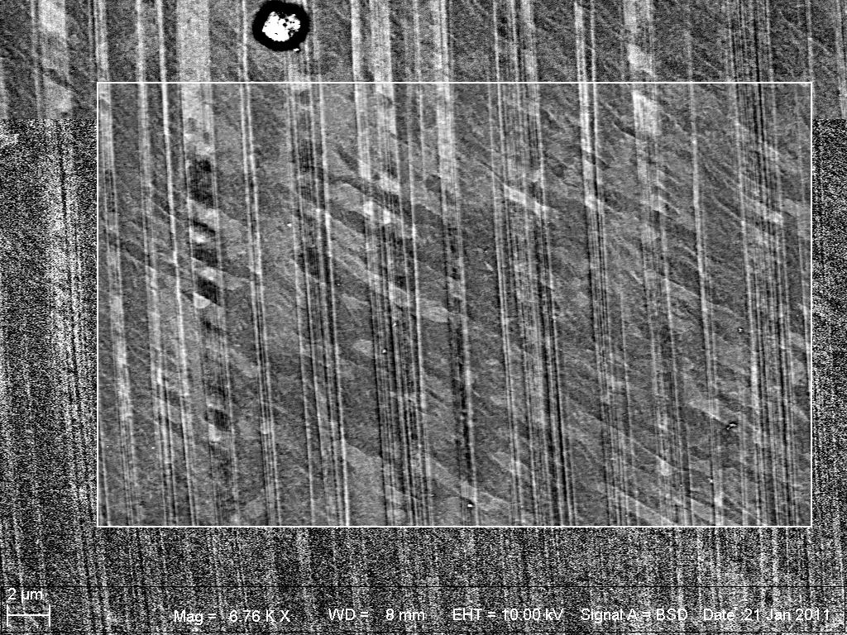
Strain reversion: Bauschinger test
ε: 0.1 + (-0.03)
Cell block formation is enhanced (leading to pronounced subgrain structure)
Strain reversal leads to higher misoriented dislocation substructures
I. Gutierrez-Urrutia et al. Mater.Sc Eng. A 527 (2010) 3552

Slide 19
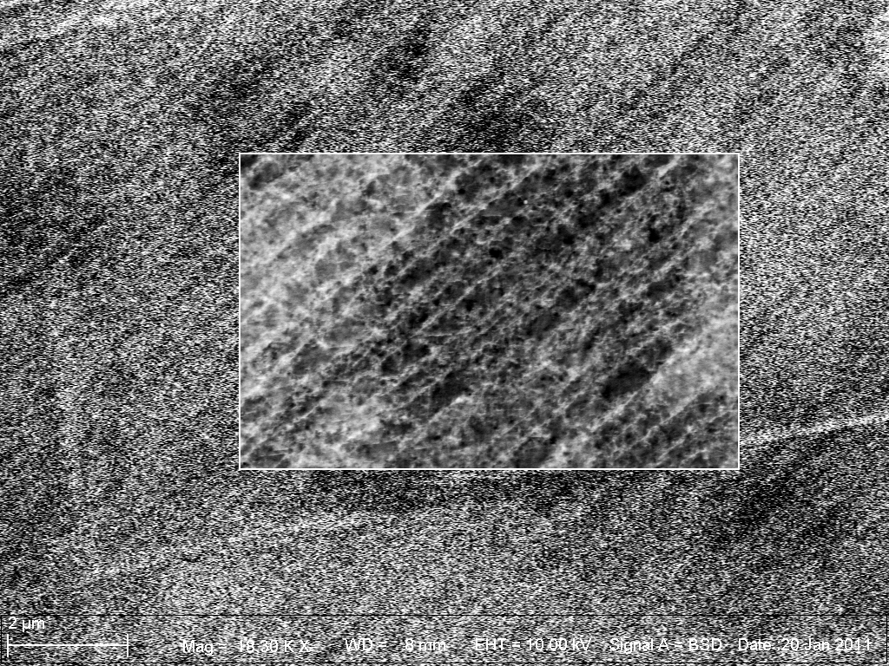
Strain reversion: Bauschinger test
ε: 0.1 + (-0.03)
ECCI image
(not TEM)
GN boundaries
{111} trace
We identify both GN and incidental boundaries!
stat. boundaries
I. Gutierrez-Urrutia et al. Mater.Sc Eng. A 527 (2010) 3552

Slide 20
Overview
Electron channeling contrast imaging
Twinning and texture
Strain path effects
Bauschinger effects
Conclusions
www.mpie.de

Slide 21
Conclusions
Joint use of ECCI & EBSD
Unexpected deformation twinning
Dependence of dislocation substructure on strain path and orientation
<111>//deformation axis leads to planar dislocation substructures: DDWs structures in tension and Taylor lattice in shear
<001>//deformation axis leads to wavy dislocation substructures: cells in tension and cell block in shear
Strain reversal promotes cell block/subgrain formation with increased misorientation
Cell blocks formed by geometrically necessary boundaries along {111} planes and incidental boundaries created by statistically stored dislocations are visible via ECCI. We can estimate boundary spacings and therefore, its contribution to work-hardening.
I. Gutierrez-Urrutia et al. Mater.Sc Eng. A 527 (2010) 3552

