Slide 1
Chemical gradients across martensite/austenite phase boundaries in precipitation hardened TRIP steel studied by atom probe tomography
O. Dmitrieva, D. Ponge, G. Inden, J. Millán, P. Choi, D. Raabe
Düsseldorf, Germany
WWW.MPIE.DE
d.raabe@mpie.de
Dierk Raabe

Slide 2
Overview
Motivation and alloy design
Atom probe tomography
Mechanical properties and microstructure
Mn partitioning and simulations
Conclusions
www.mpie.de

Slide 3
Fe-Mn based maraging TRIP steel development
TRIP: deformation-stimulated transformation of unstable austenite into martensite and accommodation plasticity (e.g. Mn, Ni, low C)
Maraging effect: hardening of heavily strained martensite via nano-sized (intermetallic) precipitates (Ni, Al, Ti, Mo)
(see also conventional Maraging steels)
What is maraging-TRIP ?
Quenched austenite: ductile low carbon martensite
Retained austenite (TRIP or TWIP)
Aging: austenite reversion (increase TRIP / TWIP volume)
Aging: controlled precipitation hardening
* TRIP: transformation-induced plasticity
* Maraging: martensite aging
Raabe, Ponge, Dmitrieva, Sander: Adv. Eng. Mat. 11 (2009) 547

Slide 4
Compositions in mass%
Steel | C | Ni | Co | Mo | Ti | Al | Mn | Fe
Maraging | 0.01 | 18 | 12 | 4 | 1.6 | 0.15 | 0.05 | Balance
09MnPH | 0.01 | 2 | - | 1 | 1.0 | 0.15 | 9 | Balance
12MnPH | 0.01 | 2 | - | 1 | 1.0 | 0.15 | 12 | Balance
15MnPH | 0.01 | 2 | - | 1 | 1.0 | 0.15 | 15 | Balance
PH
PH
PH
Low carbon: ductile martensite
Precipitation Hardenable
Mn (+Ni): austenite (TRIP)
Martensite aging after quenching at 450°C
D. Raabe et al. Scripta Materialia 60 (2009) 1141

Slide 5
Overview
Motivation and alloy design
Atom probe tomography
Mechanical properties and microstructure
Mn partitioning and simulations
Conclusions
www.mpie.de

Slide 6
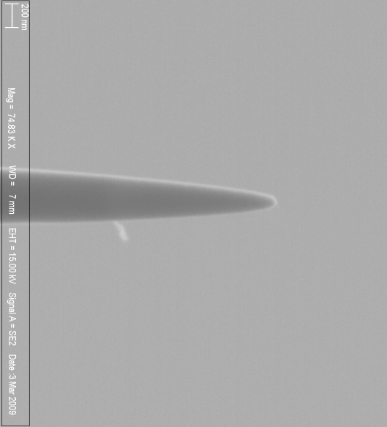
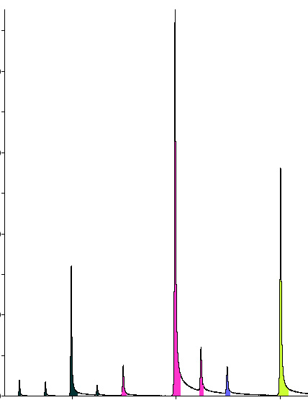
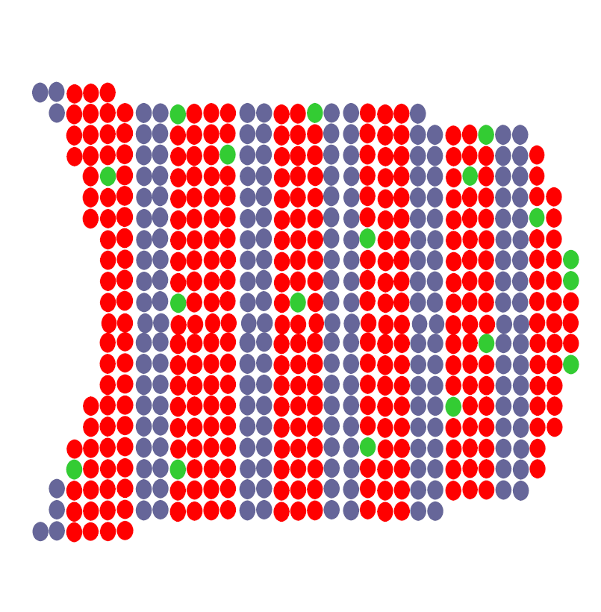
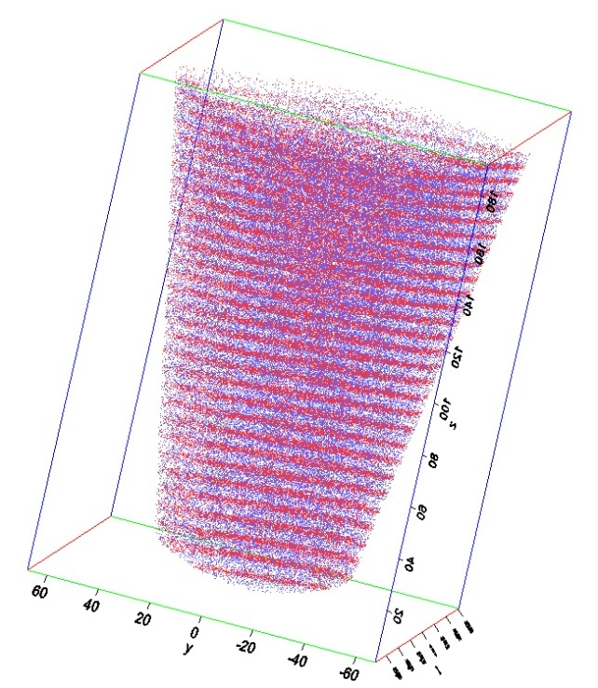
Atom Probe Tomography (APT)
Counts
Detector
200 nm
Tip-shaped sample
initiated evaporation by
Mass to charge ratio
or
3D atom map
+
_
~ 10 kV
APT: Time of flight measurement
(chemical identification)
+
Ion projection microscopy
(determination of position)

Slide 7
Overview
Motivation and alloy design
Atom probe tomography
Mechanical properties and microstructure
Mn partitioning and simulations
Conclusions
www.mpie.de

Slide 8
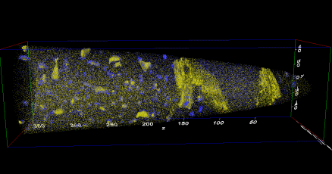
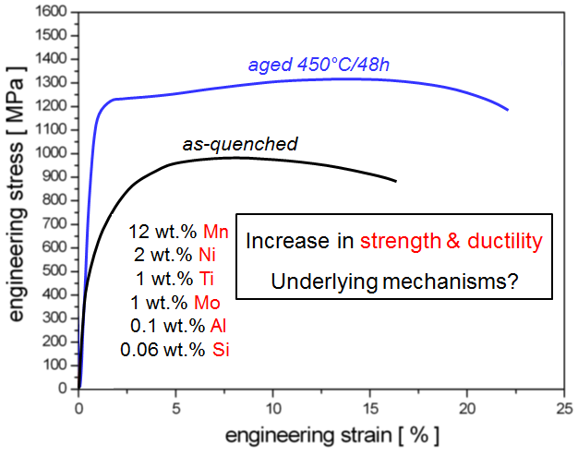
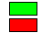
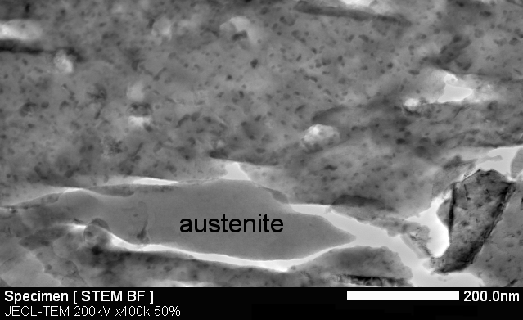
Hierarchy of maraging TRIP / TWIP steels
450°C/48h
ε = 0 %
450°C/48h
ε = 15 %
TRIP effect
hardness
+ ductility
martensite
10 µm
martensite
austenite
10 µm
martensite
austenite
10 µm
Al
Mn
Precipitation-hardening of
martensite → “maraging“
austenite
martensite
Dmitrieva et al. Acta Mater 59 (2011)

Slide 9
Overview
Motivation and alloy design
Atom probe tomography
Mechanical properties and microstructure
Mn partitioning and simulations
Conclusions
www.mpie.de

Slide 10
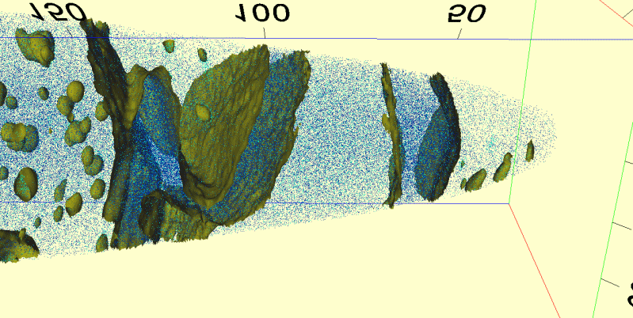
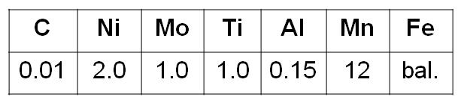
APT results: Atomic map (12MnPH aged 450°C/48h)
Martensite decorated by precipitations
Austenite
?
?
Mn atoms
Ni atoms
Mn iso-concentration: 18 at.%
70 million ions
Laser mode
(0.4nJ, 54K)
Dmitrieva et al. Acta Mater 59 (2011)

Slide 11
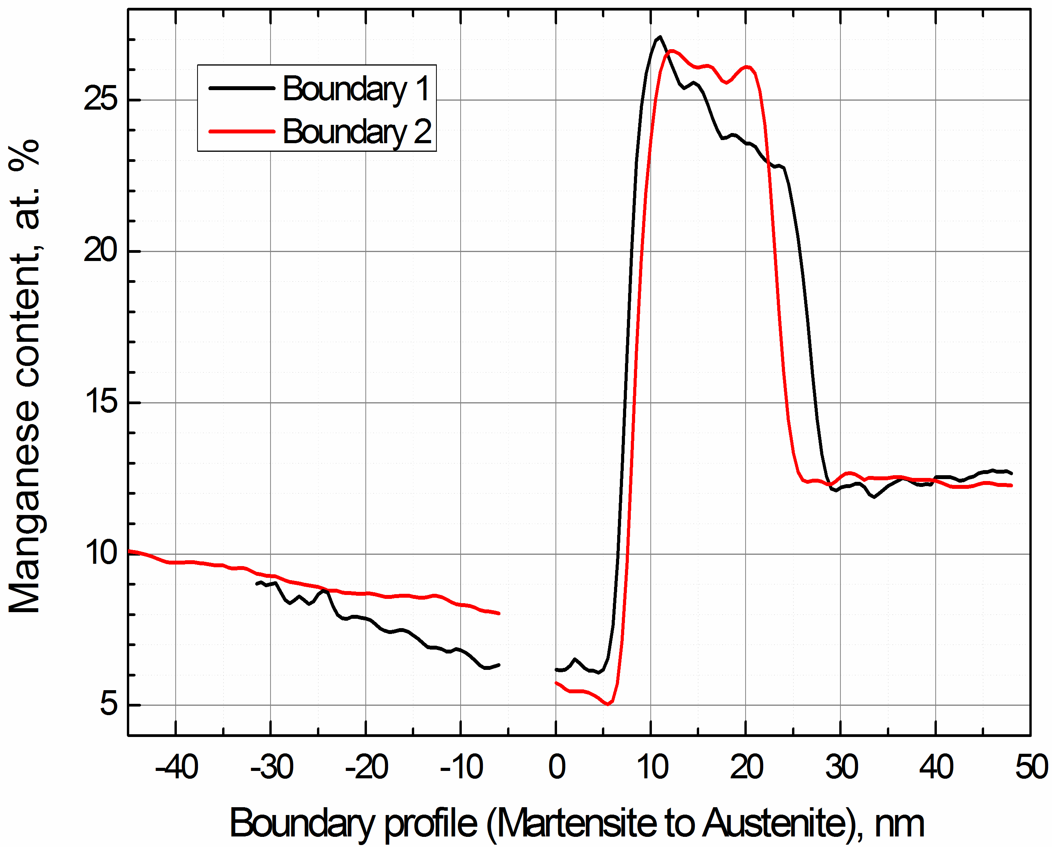
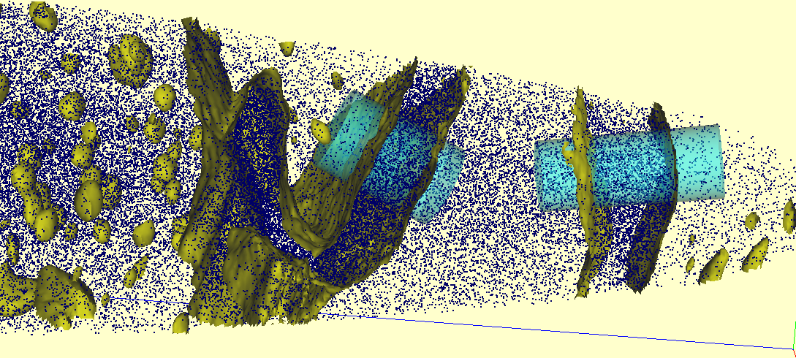
Aging-induced austenite reversion
Mn layer 1
Mn layer 2
Thermo-Calc ⇒
equilibrium Mn-conc.:
27 at. % Mn in austenite (A)
3 at. % Mn in ferrite (martensite) (M)
M
A
nominal 12 at.% Mn
depletion zone
Mn layer 2
Mn layer 1
M
A
M
Mn iso-concentration (18 at.% Mn)
Dmitrieva et al. Acta Mater 59 (2011)

Slide 12
12MnPH after aging (48h 450°C)
precipitates in α`
no precipitates in
Raabe, Ponge, Dmitrieva, Sander: Adv. Eng. Mat. 11 (2009) 547

Slide 13
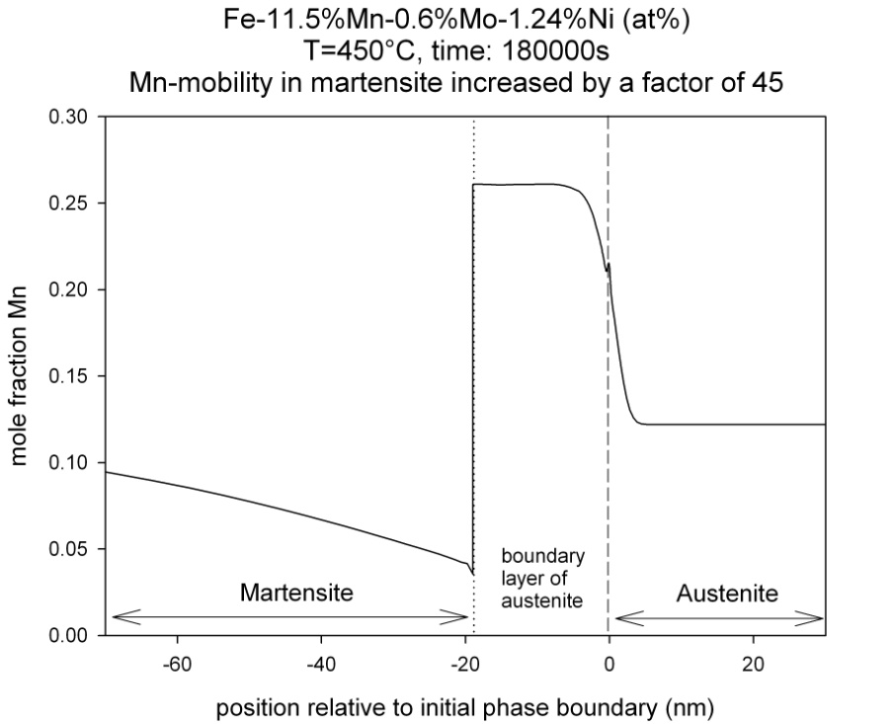
Aging-induced austenite reversion
Mn layer 1
Mn layer 2
Thermo-Calc ⇒
equilibrium Mn-conc.:
27 at. % Mn in austenite (A)
3 at. % Mn in ferrite (martensite) (M)
M
A
A
M
nominal 12 at.%
aging
Excellent agreement between
experiment & simulation !
phase boundary
DICTRA
Kinetic freezing and
associated austenite reversion !
Dmitrieva et al. Acta Mater 59 (2011)

Slide 14
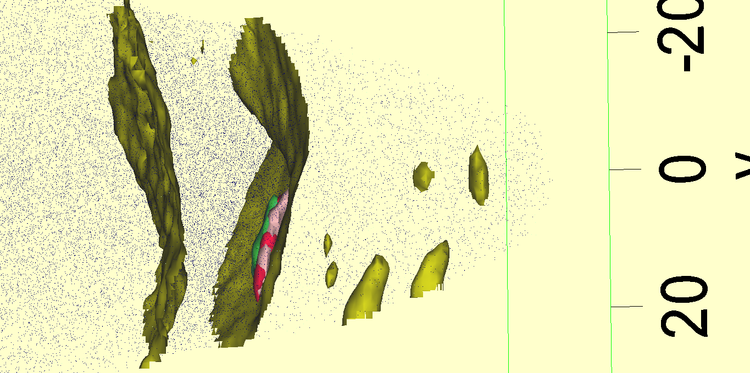
APT results and simulation: DICTRA/ThermoCalc
Mean diffusion path of Mn in austenite
(aging 450°C/48h) ≈ 2 nm
Mn-rich
layer
M
New
austenite
(formed during aging)
A
PB migration
Mn diffusion
final position
phase boundary
original position
phase boundary
10 nm
Dmitrieva et al. Acta Mater 59 (2011)
Notes:
In order to understand the dynamics of the formation of the Mn-enriched layers on the phase boundaries, we consider the phase equilibrium contents of Mn. The averaged content of Mn measured for the Mn-enriched layers is about 26 at. %. This content corresponds to the phase equilibrium content of this element in the austenite which is 26.7 at. %. As known, local phase equilibrium can be easily reached on the grain/phase boundaries. Thus, right on the phase boundary, the equilibrium composition in austenite is reached, and a local phase transformation from martensite to austenite within the Mn-enriched layer can be expected.
However, the
With the growth of the Mn-enriched layer towards the martensitic grain, the material within the layer becomes austenitic and, thus, the phase boundary moves. The final thickness of the Mn-enriched layer is about 20 nm, thus, the phase boundary moved 20 nm during the aging treatment.
The layer-to-austenite interface provides the information about the position of the original phase boundary between the retained austenite and the martensite before aging. Further diffusion of Mn into austenite during aging was suppressed just beyond the crystallographic BCC/FCC boundary. The martensite-to-layer interface, however, indicates the position of the final phase boundary when the Mn diffusion was stopped by the water quenching after the aging treatment. The Mn enriched area in-between these two layers therefore can be addressed as additional austenite formed during the aging.
The growth of the austenite leads to an enhancement of austenite volume fraction during aging. This can be correlated to the growth of the existing austenite grains where the phase boundaries serve as nucleation seeds. We assumed an epitaxial formation of reverted austenite on the phase boundary of the retained austenite.

Slide 15
Overview
Motivation and alloy design
Atom probe tomography
Mechanical properties and microstructure
Mn partitioning and simulations
Conclusions
www.mpie.de

Slide 16
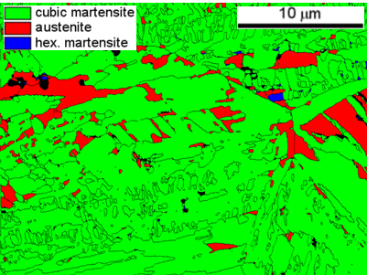
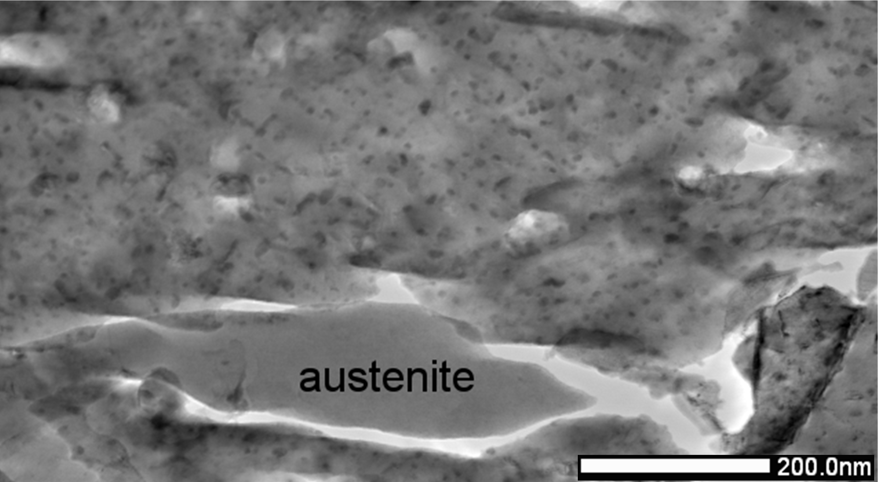
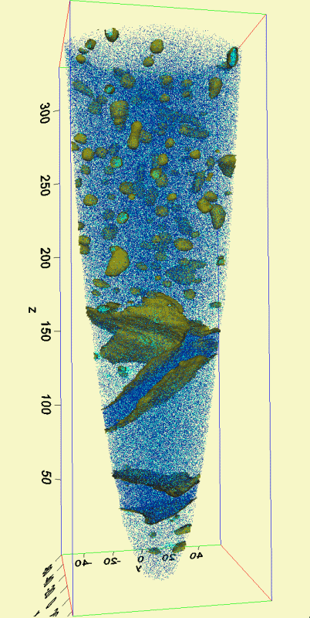
Conclusions
Maraging-TRIP as a new GPa steel design approach
Unexpected simultaneous increase in strength and elongation
Mn partitioning, predicted by ThermoCalc/DICTRA
Austenite stability predicted using ab initio methods (see talk of T. Hickel)
B2 and L21 nano-precipitates
Next steps: lean composition, interstitials, alloy variants, equilibrium partitioning, nano-precipitates
martensite with precipitates
martensite with precipitates
austenite
70 million ions
Laser mode
(0.4nJ, 54K)
martensite with precipitates
Mn atoms
Ni atoms
Mn iso-concentration surfaces at 18 at.%
Raabe, Ponge, Dmitrieva, Sander: Adv. Eng. Mat. 11 (2009) 547

