Slide 1
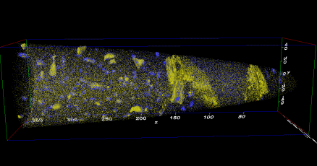
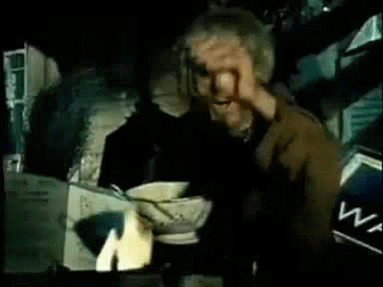
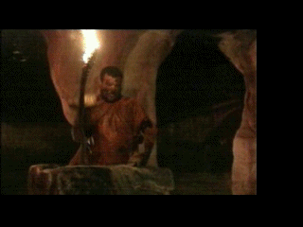
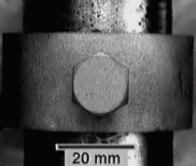
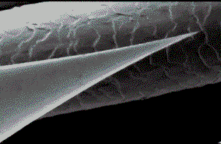
Nanostructuring of 100 thousand tons
D. Ponge, J. Millan, L. Yuan, S. Sandlöbes, A. Kostka, P. Choi, T. Hickel, J. Neugebauer, D. Raabe
Düsseldorf, Germany
WWW.MPIE.DE
d.raabe@mpie.de
30. Nov. 2011 Dierk Raabe GDCh Kolloquium Universität Duisburg-Essen

Slide 2
Nanostructures in 100 thousand tons
Agitation: metallic alloys in 10 minutes
Self-organized nanostructuring: partitioning, kinetic freezing, adsorption isotherm
www.mpie.de

Slide 3
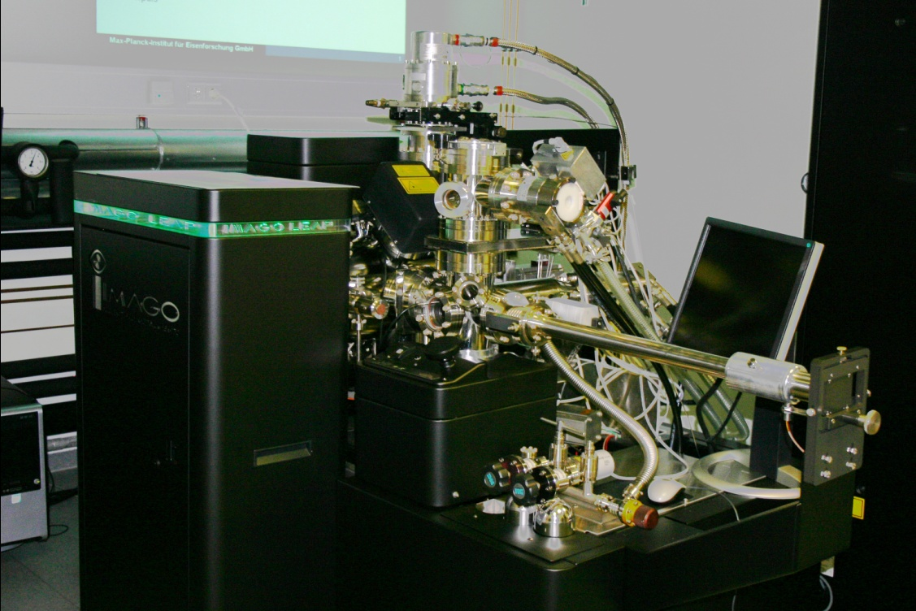
The Düsseldorf Local Electrode Atom Probe (LEAP) Laboratory
LEAP 3000X HR, IMAGO Sci. Instr.
(since February 2009)
High spatial resolution
(Δx ~ 0.2 nm, Δz ~ 0.1 nm)
High mass resolution
(Δm/m = 1100, FWHM at 27 Da)
Fast data acquisition rate
(max. ~ 2 Mio ions / min)
Large probed volumes
(max. ~ 200 x 200 x 1000 nm³)
High detection sensitivity
(min. ~ 10 ppm)
Pulsed laser
(λ = 532 nm, ~ 10 ps)
2/55

Slide 4

New materials for key technologies: Aero-space
Titanium
Aluminium
Magnesium
Nickel
Steels
Intermetallics

Slide 5

New materials for key technologies: mobility on land and water
Steels
Magnesium
Aluminium
Titanium

Slide 6
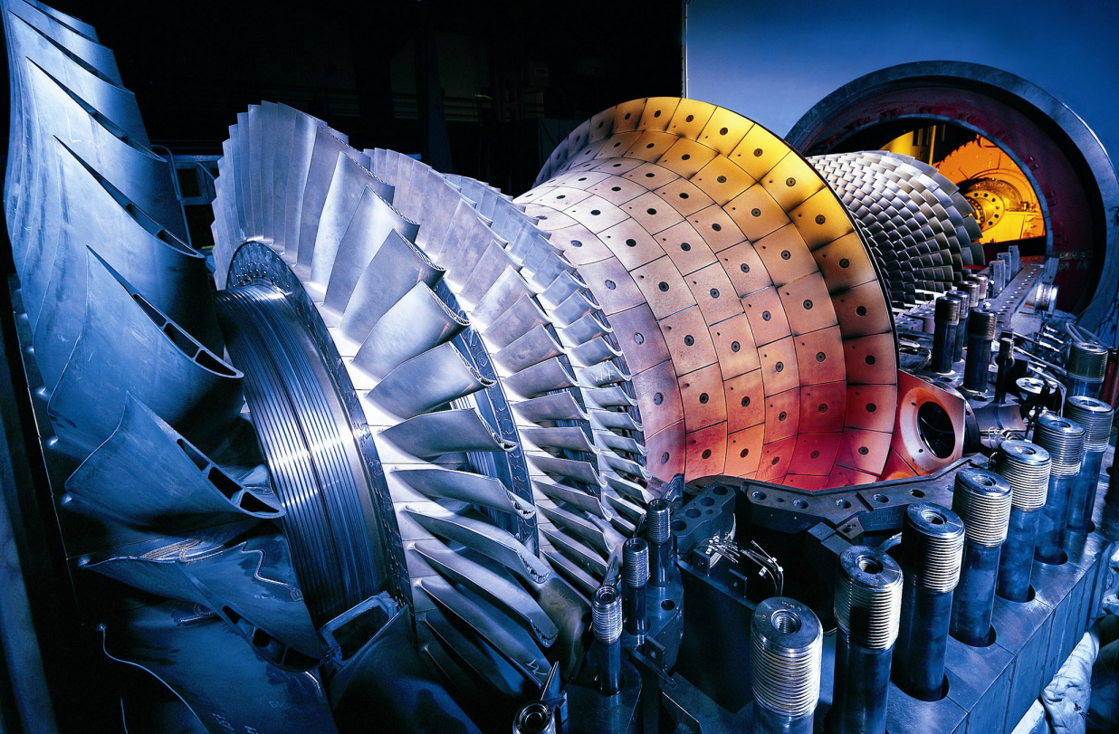
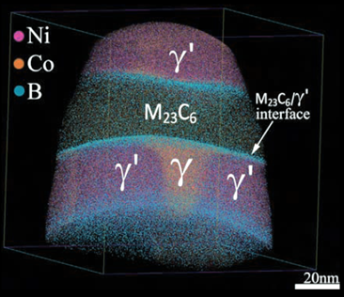
New materials for key technologies: Power plants
Steels
Nickel
Intermetallics

Slide 7

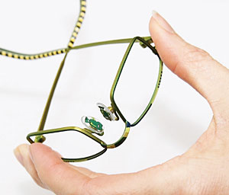
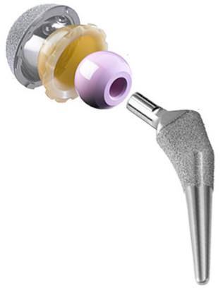
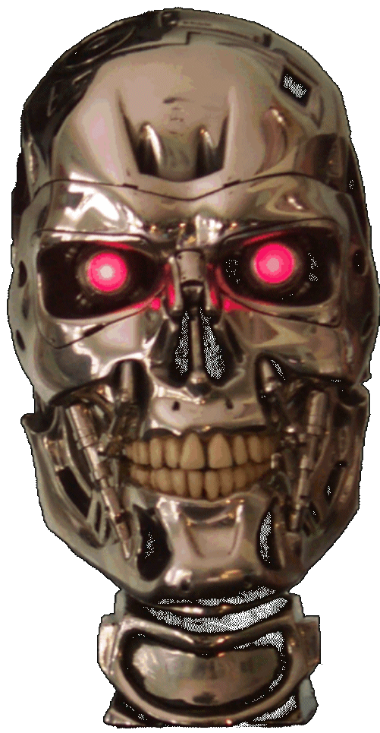
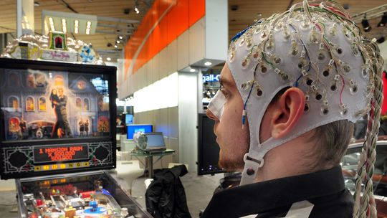
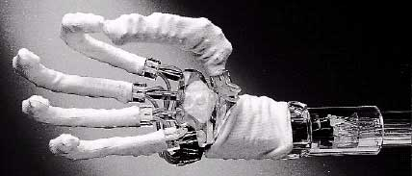
New materials for key technologies: Health
Titanium
Magnesium
Copper
steels

Slide 8
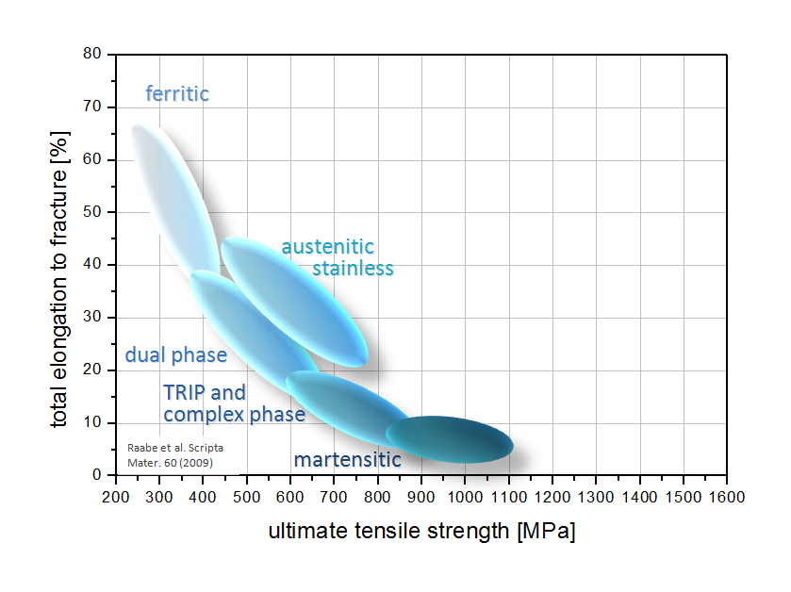
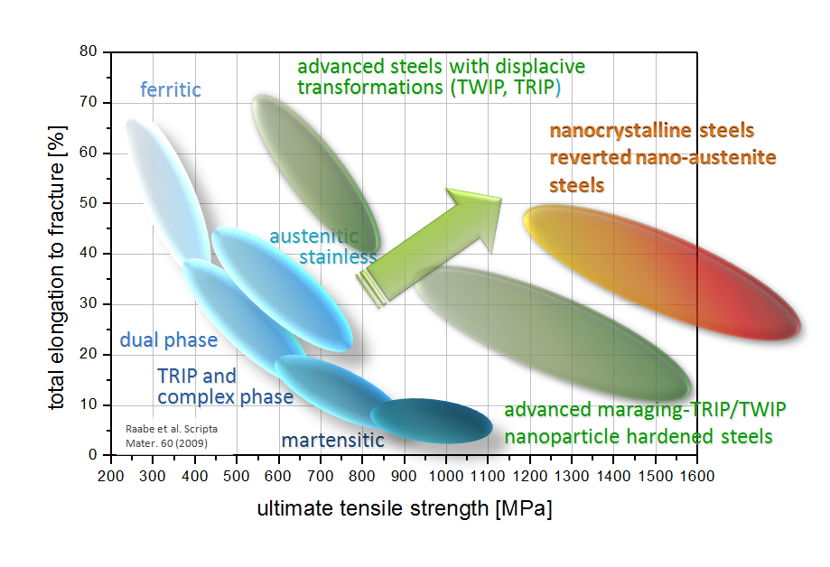

From atomistic understanding towards designing new materials
D. Raabe et al. Scripta Materialia 60 (2009) 1141

Slide 9
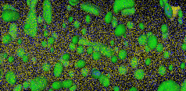
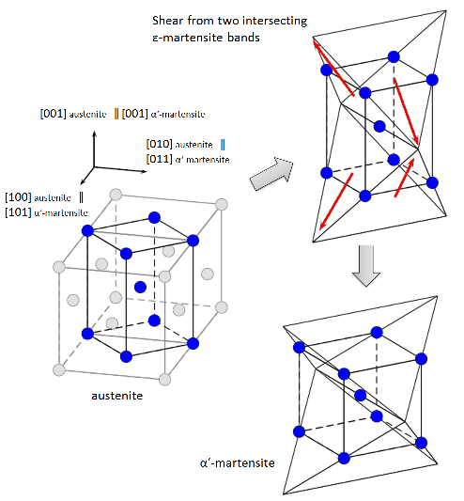
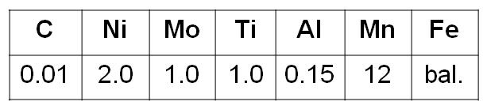
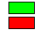
Effect of aging on ductility
aged 450°C/48h
2
Precipitation
hardening
as-quenched
increase of austenite
fraction during aging
?
1
strain 0%
2
strain 15%
1
α-Fe (Martensite)
γ-Fe (Austenite), vol. fraction 15-20%
D. Raabe et al. Scripta Materialia 60 (2009) 1141
Notes:
Stress- strain curves for the Maraging TRIP alloy. It has up to 15 vol. % retained austenite prior to deformation which is gradually reduced during straining and provide for a high dictility. After the aging heat treatment, the alloy shows an unexpected effect that the ultimate tensile strength and the total elongation simultaneously increase. The increase in the strength is mainly attributed to the formation of the nano-precipitates and to the following precipitation hardening of the martensite. However, as one of the possible reasons for the partial increase in ductility we consider a delayed austenitization, means that the volume fraction of austenite grows during the aging.
Other reasons: tempering of the as-quenched martensitic microstructure: reduced micro-strains; high strain hardening rate: local hardening due to Orowan loops formation, preventing the necking.

Slide 10
Effect of cold rolling after aging
12MnPH X-Ray
Why so much austenite 120 K below equilibrium transformation?
γ formation
during aging
450°C/48h
γ−>α’ (TRIP)
D. Raabe et al. Scripta Materialia 60 (2009) 1141
Notes:
X-ray: 12Mn PH:
90% a‘-martensite
4% e-martensite
7% retained austenite

Slide 11
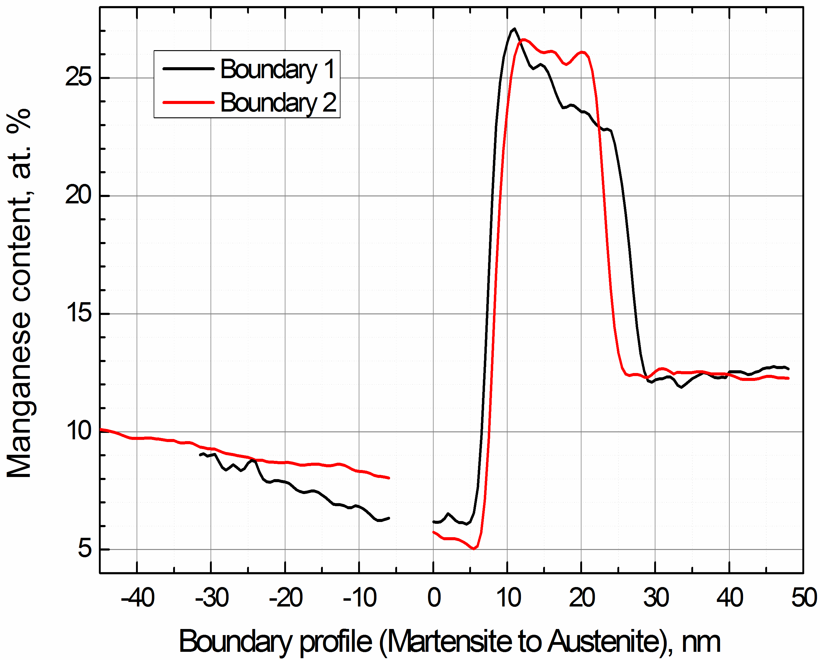
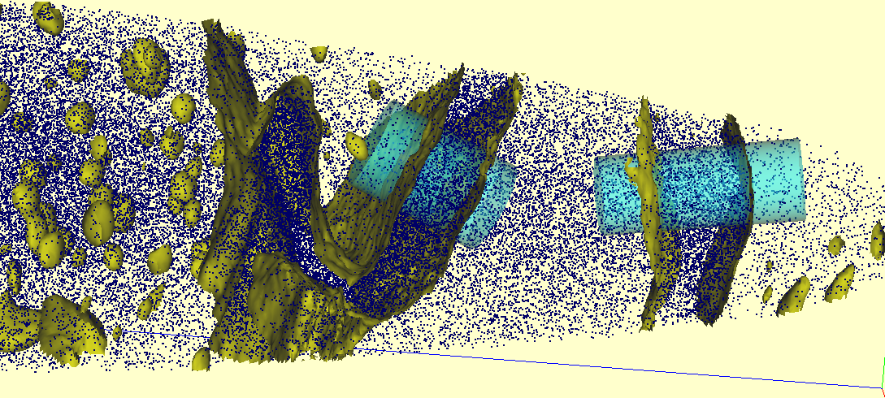
Aging-induced austenite reversion
Mn layer 1
Mn layer 2
Thermo-Calc ⇒
equilibrium Mn-conc.:
27 at. % Mn in austenite (A)
3 at. % Mn in ferrite (martensite) (M)
M
A
nominal 12 at.% Mn
depletion zone
Mn layer 2
Mn layer 1
M
A
M
Mn iso-concentration (18 at.% Mn)
Dmitrieva et al. Acta Mater 59 (2011)

Slide 12
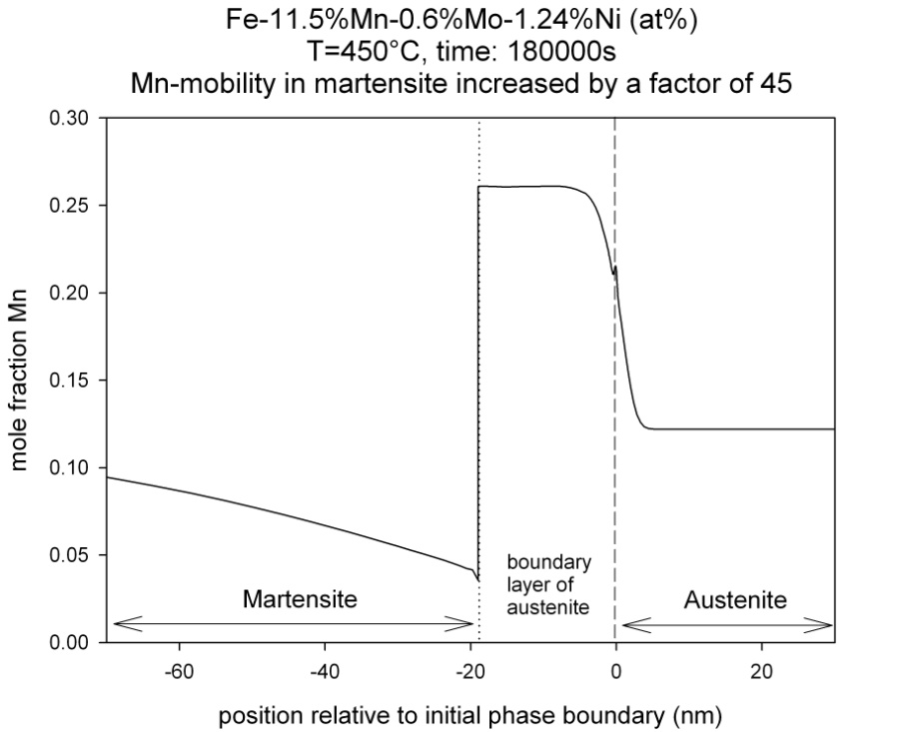
Aging-induced austenite reversion
Mn layer 1
Mn layer 2
Thermo-Calc ⇒
equilibrium Mn-conc.:
27 at. % Mn in austenite (A)
3 at. % Mn in ferrite (martensite) (M)
Can I push this idea further ?
M
A
A
M
nominal 12 at.%
aging
Excellent agreement between
experiment & simulation !
phase boundary
DICTRA
Kinetic freezing and
associated austenite reversion !
Dmitrieva et al. Acta Mater 59 (2011)

Slide 13
Martensite relaxation & aging & nanoscale austenite reversion
650 MPa to 2 GPa
Ultra high strength and corrosion resistance
400°C aging: Ms-relaxation + prec. (aging) + austenite reversion
Fe-13.6Cr-0.44C (wt.%)

Slide 14
Martensite relaxation & aging & nanoscale austenite reversion
at 5.45 at.% C, austenite forms at 400°C
C has ‘/\’ shape in austenite layer: inheritance from austenite, Gibbs adsorption isotherm;
C on martensite grain boundaries
C has ‘V’ shape in austenite layer: austenite reversion through partitioning and kinetic freezing

Slide 15
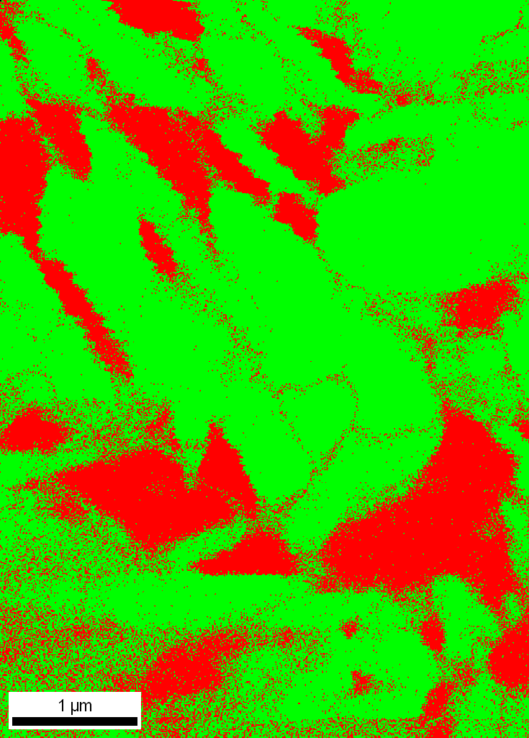
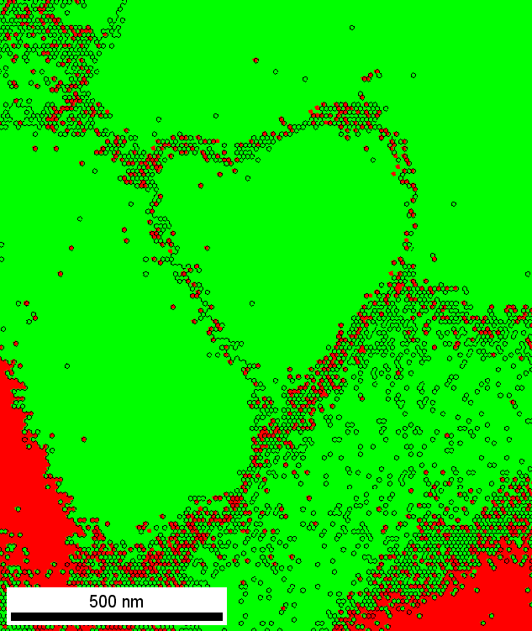
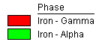
Self-repair steels

Slide 16
Answering societies' grand challenges with complex alloys
70% of all industrial innovations are associated with progress in
materials science and engineering
Specifically, metallic materials occupy key roles
(energy, transportation, health, safety, infrastructure)
Our mission: Designing new metallic alloys from first principles
Multiscale simulation
Multiscale characterization starting from the atomic scale
Synthesis, processing, testing
www.mpie.de

