Slide 1
Using ab-initio based multiscale models and experiments for alloy design
D. Raabe, F. Roters, P. Eisenlohr, H. Fabritius, S. Nikolov, M. Petrov
O. Dmitrieva, T. Hickel, M. Friak, D. Ma, J. Neugebauer
Düsseldorf, Germany
WWW.MPIE.DE
d.raabe@mpie.de
IHPC - Institute for High Performance Computing Singapore 1. Nov 2010 Dierk Raabe

Slide 2
Overview
Ab initio in materials science: what for ?
Ab initio to continuum models (mechanics)
Titanium (ab initio and continuum)
Mn-steels (identify mechanisms)
Steel with Cu precipitates (atom scale experiments)
Mg-Li alloy design (ab initio property maps)
Singapore crab (ab initio and homogenization)
Conclusions and challenges
Raabe: Adv. Mater. 14 (2002), Roters et al. Acta Mater.58 (2010)

Slide 3
Ab initio and crystal modeling
Most exact known materials theory
Combine to atomic scale experiments
Obtain data not accessible otherwise
Can be used at continuum scale
Electronic rules for alloy design: Add electrons rather than atoms
Counts, Friák, Raabe, Neugebauer: Acta Mater. 57 (2009) 69

Slide 4
Time-independent Schrödinger equation
h/(2π)
Square |ψ(r)|² of wave function ψ(r) of a particle at given position r = (x,y,z) is a measure of probability to observe it there
Many particles (stationary formulation)
Raabe: Adv. Mater. 14 (2002)

Slide 5
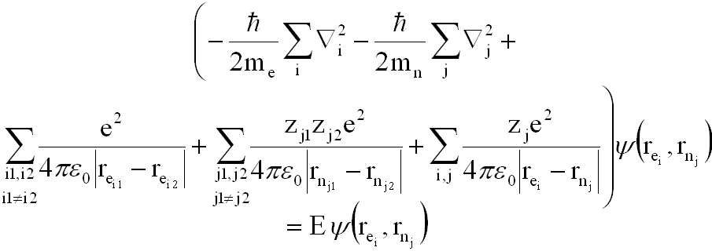
Time-independent Schrödinger equation for many particles
i electrons: mass m_{e} ; charge q_{e} = -e ; coordinates r_{ei}
j atomic cores: mass m_{n} ; charge q_{n} = ze ; coordinates r_{nj}
Raabe: Adv. Mater. 14 (2002)

Slide 6
Adiabatic Born-Oppenheimer approximation
Decoupling of core and electron dynamics
Electrons
Atomic cores
Raabe: Adv. Mater. 14 (2002)

Slide 7
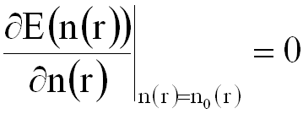
Hohenberg-Kohn-Sham theorem:
Ground state energy of a many body system definite function of its particle density
Functional E(n(r)) has minimum with respect to variation in particle position at equilibrium density n₀(r)
Chemistry Nobelprice 1998
Hohenberg Kohn, Phys. Rev. 136 (1964) B864

Slide 8
Total energy functional
T(n) kinetic energy
E^{H}(n) Hartree energy (electron-electron repulsion)
E^{xc}(n) Exchange and correlation energy
U(r) external potential
Exact form of T(n) and E^{xc}(n) unknown
Hohenberg Kohn, Phys. Rev. 136 (1964) B864

Slide 9
Local density approximation – Kohn-Sham theory
Parametrization of particle density by a set of ‘One-electron-orbitals‘
These form a non-interacting reference system (basis functions)
Calculate T(n) without consideration of interactions
Determine optimal basis set by variational principle
Hohenberg Kohn, Phys. Rev. 136 (1964) B864

Slide 10
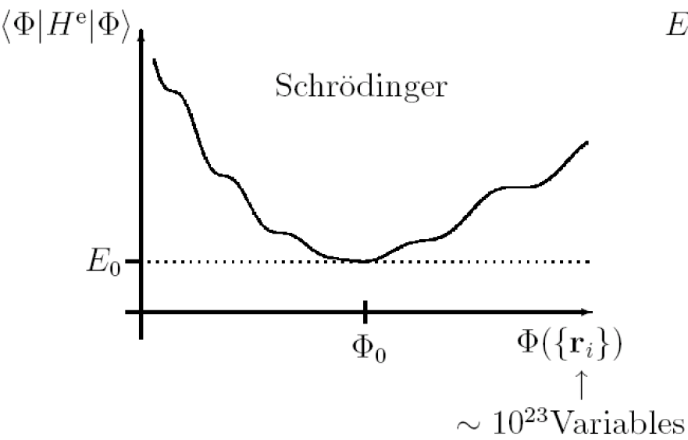
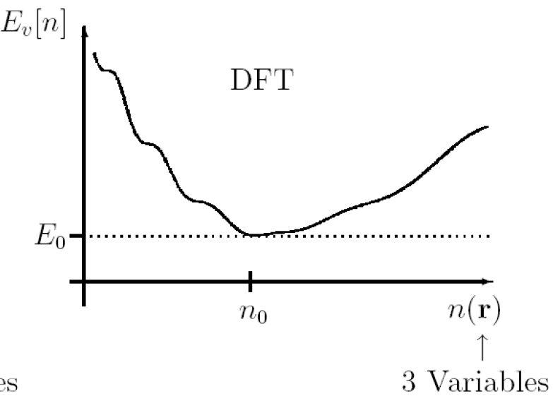
Ab initio: theoretical methods
Density functional theory (DFT), generalized gradient approximation (GGA); also LDA
Vienna ab-initio simulation package (VASP) code or SPHINX; different pseudo-potentials, Brillouin zone sampling, supercell sizes, and cut-off energies, different exchange-correlation functions, M.-fit
Entropy: non-0K, dynamical matrix, configuational analytical
Hohenberg Kohn, Phys. Rev. 136 (1964) B864

Slide 11
Ab initio: typical quantities of interest in materials mechanics
Lattice structures (e.g. Polymers, carbides, Laves)
Lattice parameter (e.g. alloys, solute limits)
Ground state energies of phases, free energies
Elastic properties
Simple defect structures and formation energies, e.g. vacancies, interstitials, dislocation cores
Energy landscapes for athermal transformations
Raabe: Adv. Mater. 14 (2002)

Slide 12
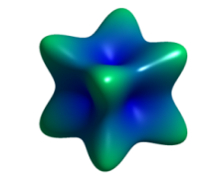
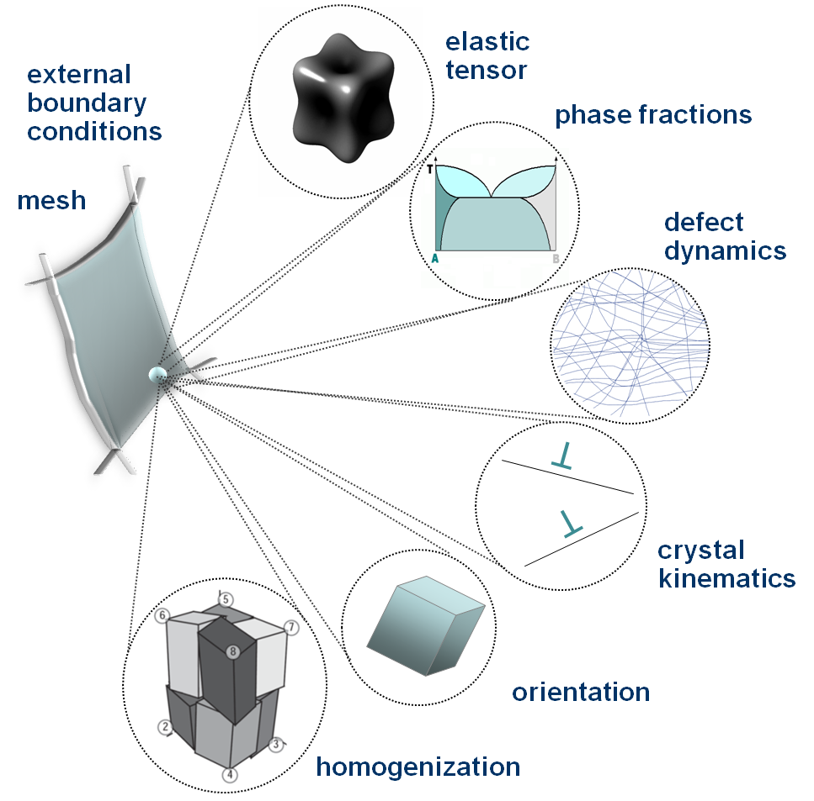
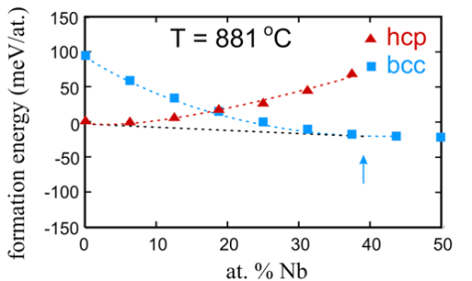
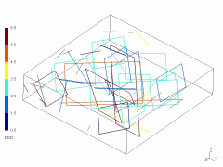
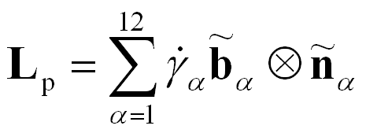
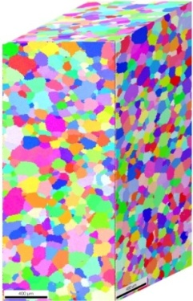
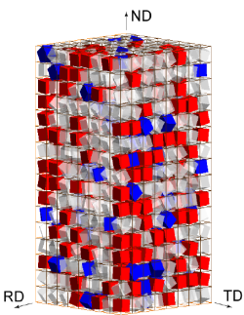
Theory and Simulation: Multiscale crystal mechanics
Raabe, Zhao, Park, Roters: Acta Mater. 50 (2002) 421

Slide 13
Overview
Ab initio in materials science: what for ?
Ab initio to continuum models (mechanics)
Titanium (ab initio and continuum)
Mn-steels (identify mechanisms)
Steel with Cu precipitates (atom scale experiments)
Mg-Li alloy design (ab initio property maps)
Singapore crab (ab initio and homogenization)
Conclusions and challenges
Raabe: Adv. Mater. 14 (2002), Roters et al. Acta Mater.58 (2010)

Slide 14
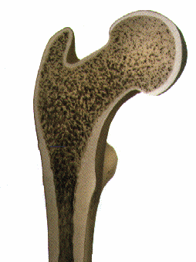
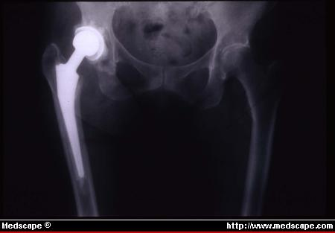
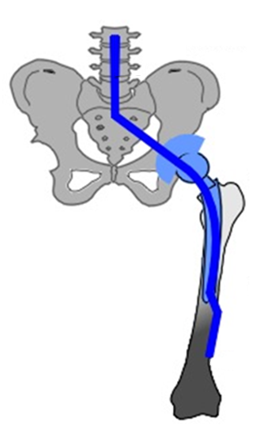
BCC Ti biomaterials design
115 GPa
20-25 GPa
Stress shielding
Elastic Mismatch:
Bone degeneration, abrasion, infection
Raabe, Sander, Friák, Ma, Neugebauer: Acta Mater. 55 (2007) 4475

Slide 15
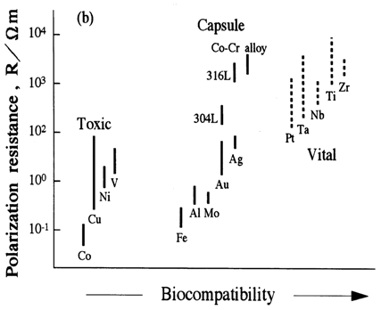
BCC Ti biomaterials design
Design-task: reduce elastic stiffness
Bio-compatible elements
From hex to BCC structure: Ti-Nb, …
M. Niinomi, Mater. Sci. Eng. 1998
Raabe, Sander, Friák, Ma, Neugebauer: Acta Mater. 55 (2007) 4475

Slide 16
Construct binary alloys in the hexagonal phase
Raabe, Sander, Friák, Ma, Neugebauer: Acta Mater. 55 (2007) 4475

Slide 17
Construct binary alloys in the cubic phase
Raabe, Sander, Friák, Ma, Neugebauer: Acta Mater. 55 (2007) 4475

Slide 18
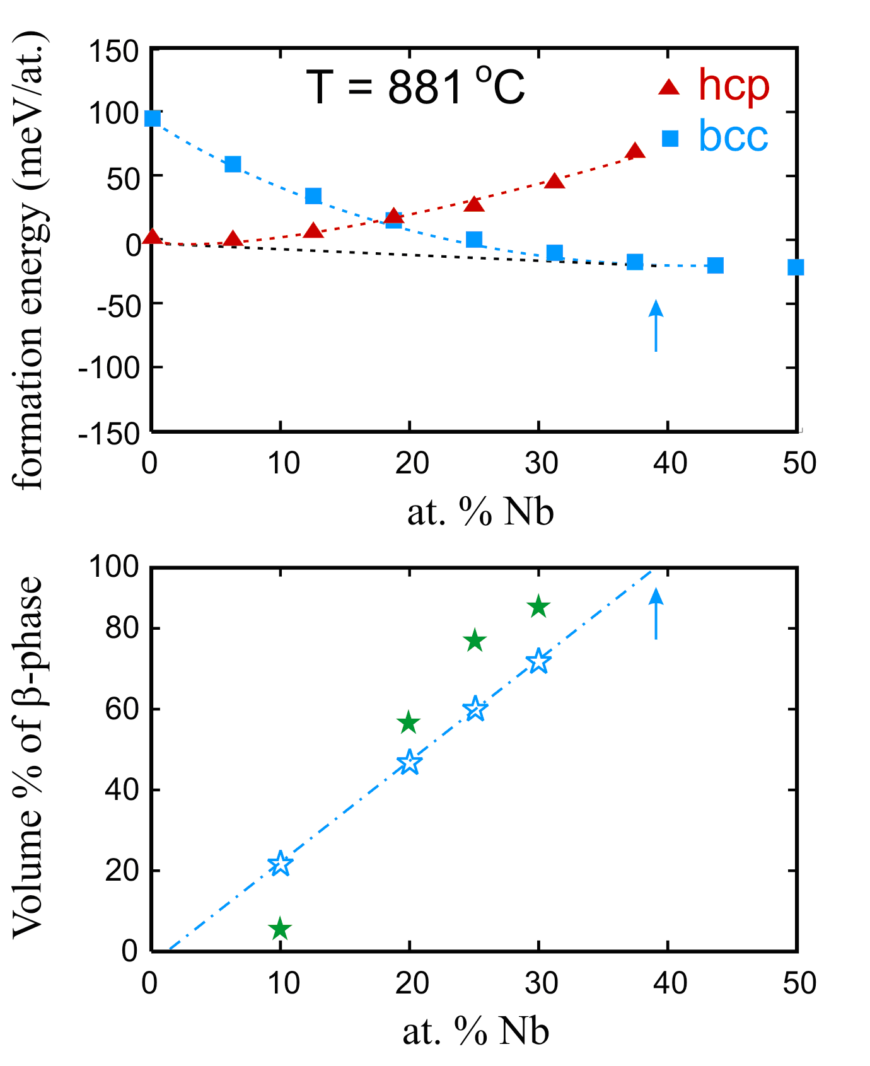
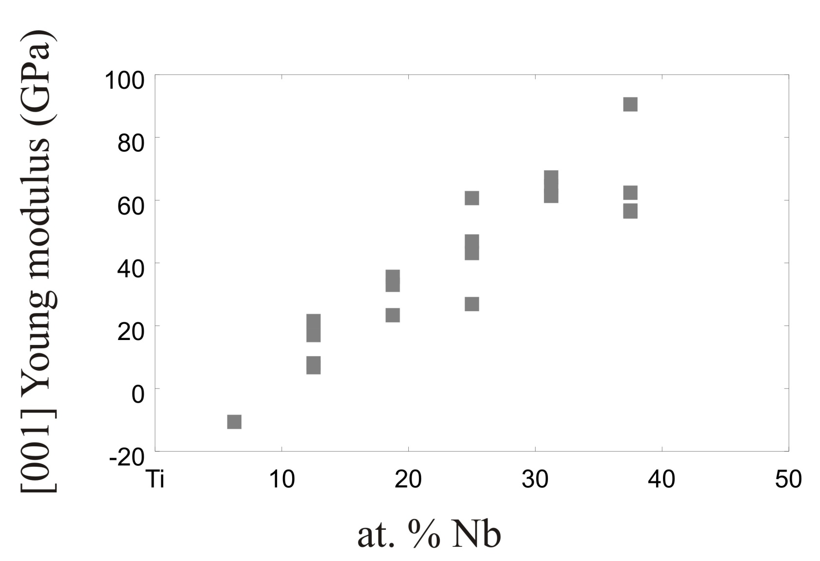
Elastic properties / Hershey homogenization
Ti-hex: 117 GPa
hex
bcc
Ultra-sonic measurement
exp. polycrystals
bcc+hcp phases
theory: bcc
polycrystals
polycrystal Young`s modulus (GPa)
MECHANICAL
INSTABILITY!!
XRD
DFT
Raabe, Sander, Friák, Ma, Neugebauer, Acta Materialia 55 (2007) 4475

Slide 19
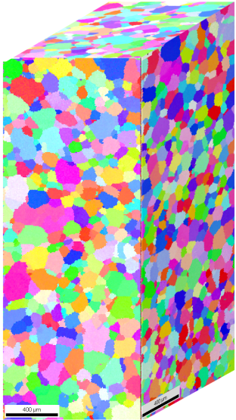
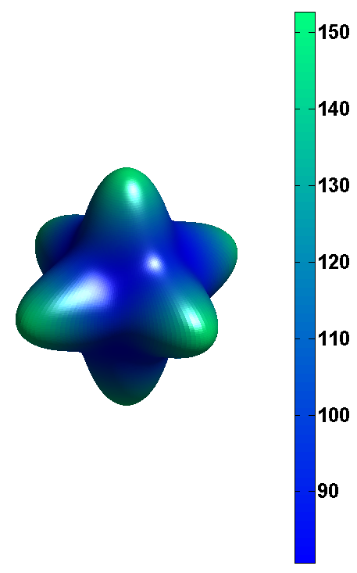
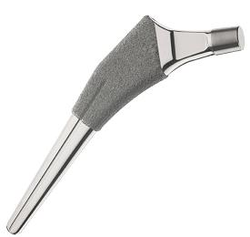
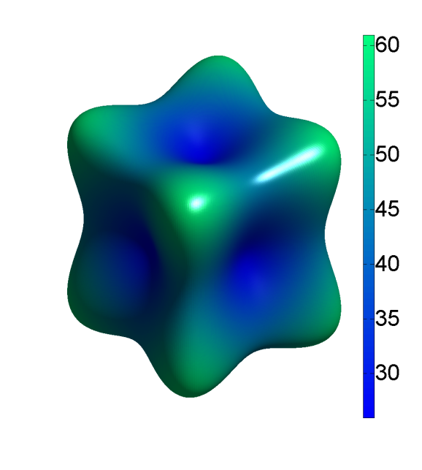
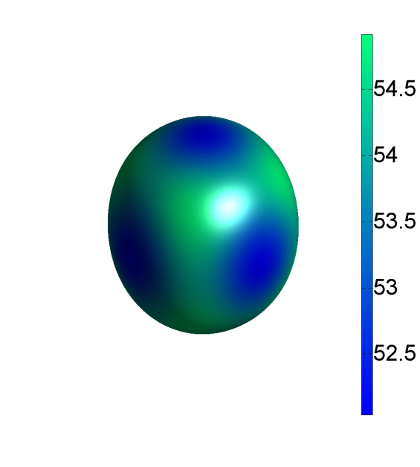
Ab initio alloy design: Elastic properties: Ti-Nb system
Young‘s modulus surface plots
A_{z}= 2 C₄₄/(C₁₁ − C₁₂)
Ti-18.75at.%Nb
Ti-25at.%Nb
Ti-31.25at.%Nb
Pure Nb
[001]
Hershey
FEM
FFT
[100]
[010]
A_{z}=3.210
A_{z}=2.418
A_{z}=1.058
A_{z}=0.5027
Ma, Friák, Neugebauer, Raabe, Roters: phys. stat. sol. B 245 (2008) 2642

Slide 20
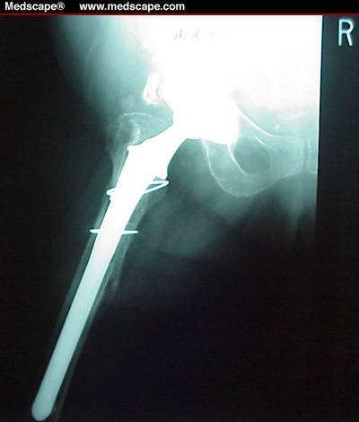
Take-home message
More than one million hip implants per year:
elastically compliant Titanium-alloys can reduce surgery
www.mpie.de

Slide 21
Overview
Ab initio in materials science: what for ?
Ab initio to continuum models (mechanics)
Titanium (ab initio and continuum)
Mn-steels (identify mechanisms)
Steel with Cu precipitates (atom scale experiments)
Mg-Li alloy design (ab initio property maps)
Singapore crab (ab initio and homogenization)
Conclusions and challenges
Raabe: Adv. Mater. 14 (2002), Roters et al. Acta Mater.58 (2010)

Slide 22
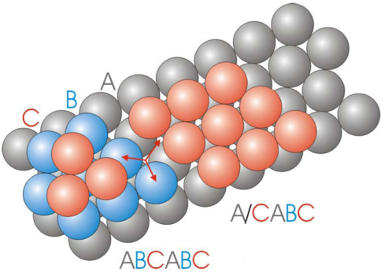
Ab-initio methods for the design of high strength steels
martensite
formation
1000
800
600
400
200
0
TRIP
steel
twin formation
Stress σ [MPa]
TWIP steel
0 20 40 60 80 100
Strain ε [%]
Hickel, Dick, Neugebauer
www.mpie.de

Slide 23
Ab-initio methods for the design of high strength steels
C
B
B
C
A
Hickel, Dick, Neugebauer
www.mpie.de

Slide 24
Develop new materials via ab-initio methods
Ab initio in materials science: what for ?
Ab initio to continuum models (mechanics)
Titanium (ab initio and continuum)
Mn-steels (identify mechanisms)
Steel with Cu precipitates (atom scale experiments)
Mg-Li alloy design (ab initio property maps)
Singapore crab (ab initio and homogenization)
Conclusions and challenges
www.mpie.de

Slide 25
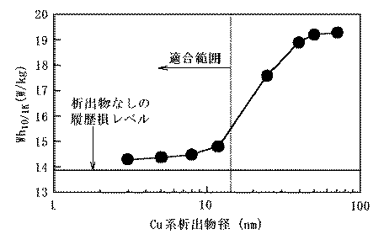
Nano-precipitates in soft magnetic steels
magnetic loss (W/kg)
15 nm
size Cu precipitates (nm)
{JP 2004 339603}
nanoparticles too small for Bloch-wall interaction but
effective as dislocation obstacles
mechanically very strong soft magnets for motors
Fe-Si steel with Cu nano-precipitates

Slide 26
Fe-Si-Cu, LEAP 3000X HR analysis
Cu 2 wt.%
120 min
450°C aging
6000 min
Iso-concentration surfaces for
Cu 11 at.%
20 nm
20 nm
Fe-Si steel with Cu nano-precipitates

Slide 27
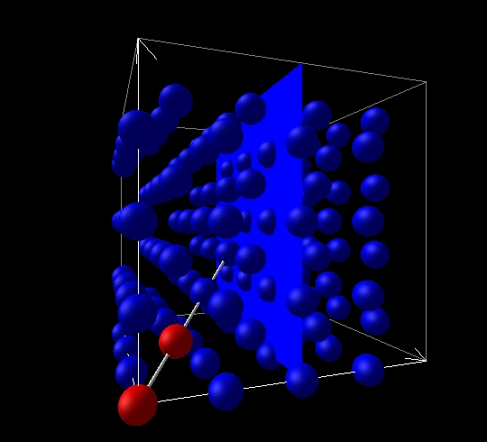
Modeling: ab-initio, DFT / GGA, binding energies
Fe-Si steel with Cu nano-precipitates
Notes:
26

Slide 28
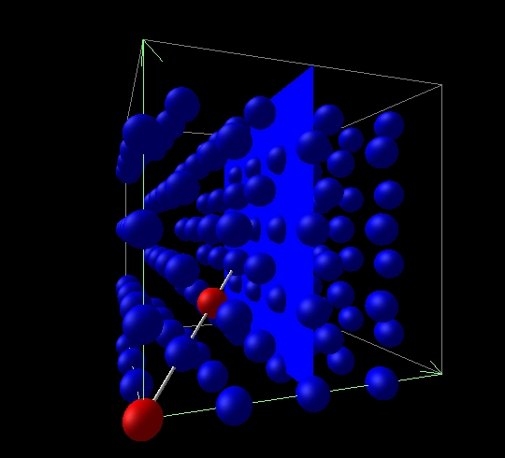
Modeling: ab-initio, DFT / GGA, binding energies
Fe-Si steel with Cu nano-precipitates
Notes:
27

Slide 29
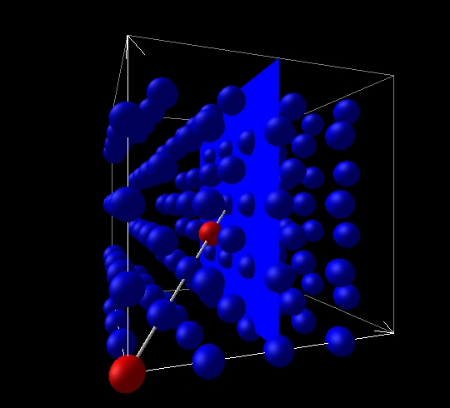
Modeling: ab-initio, DFT / GGA, binding energies
Fe-Si steel with Cu nano-precipitates
Notes:
28

Slide 30
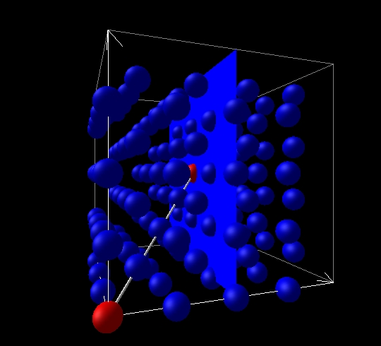
Modeling: ab-initio, DFT / GGA, binding energies
Fe-Si steel with Cu nano-precipitates
Notes:
29

Slide 31
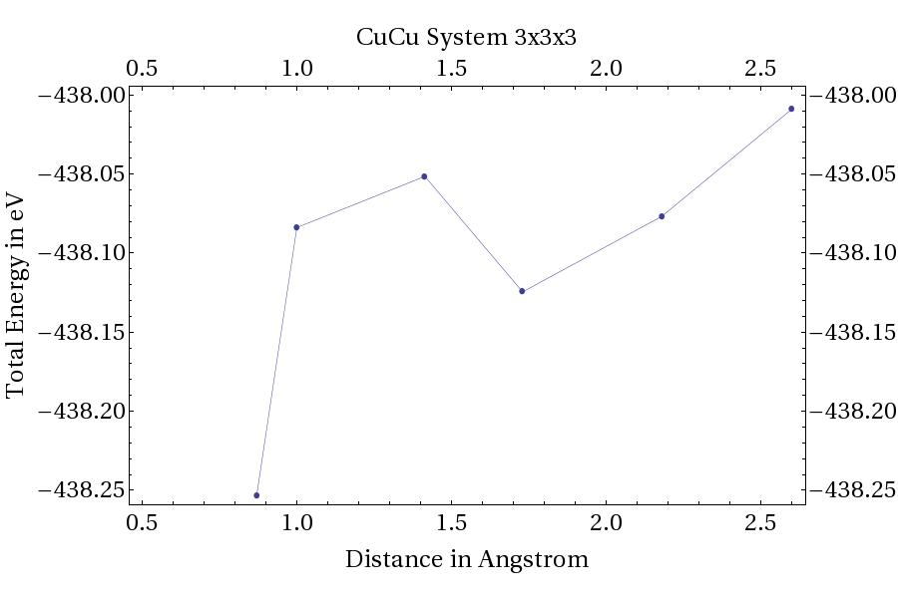
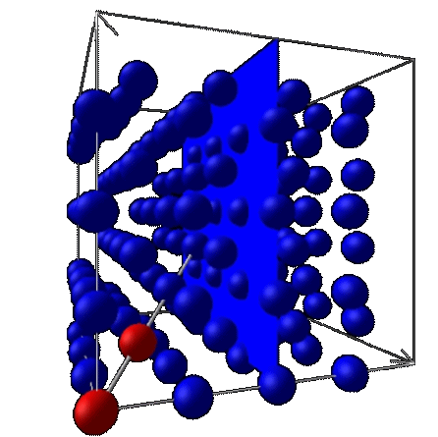
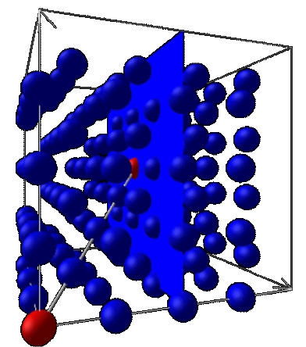
Ab-initio, binding energies: Cu-Cu in Fe matrix
Fe-Si steel with Cu nano-precipitates

Slide 32
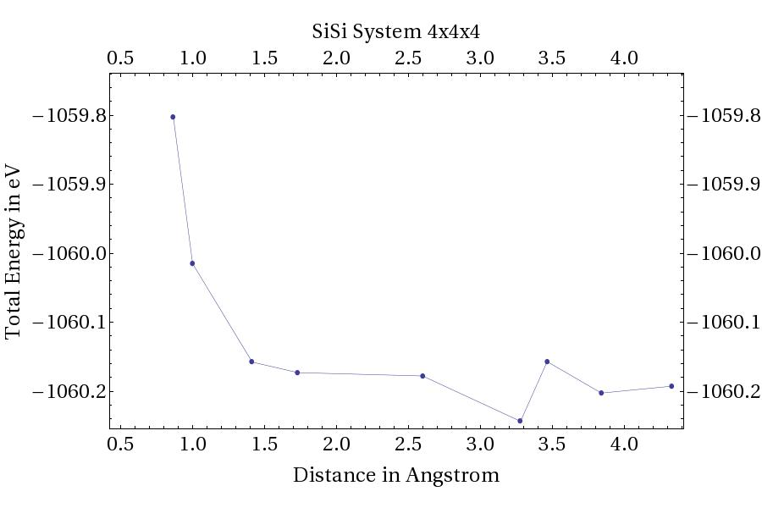
Ab-initio, binding energies: Si-Si in Fe matrix
Fe-Si steel with Cu nano-precipitates

Slide 33
Ab-initio, binding energies
For neighbor interaction energy take difference (in eV)‏
(repulsive) = 0.390
(attractive) = -0.124
(attractive) = -0.245
Fe-Si steel with Cu nano-precipitates

Slide 34
Ab-initio, use binding energies in kinetic Monte Carlo model

Slide 35
Develop new materials via ab-initio methods
Ab initio in materials science: what for ?
Ab initio to continuum models (mechanics)
Titanium (ab initio and continuum)
Mn-steels (identify mechanisms)
Steel with Cu precipitates (atom scale experiments)
Mg-Li alloy design (ab initio property maps)
Singapore crab (ab initio and homogenization)
Conclusions and challenges
www.mpie.de

Slide 36
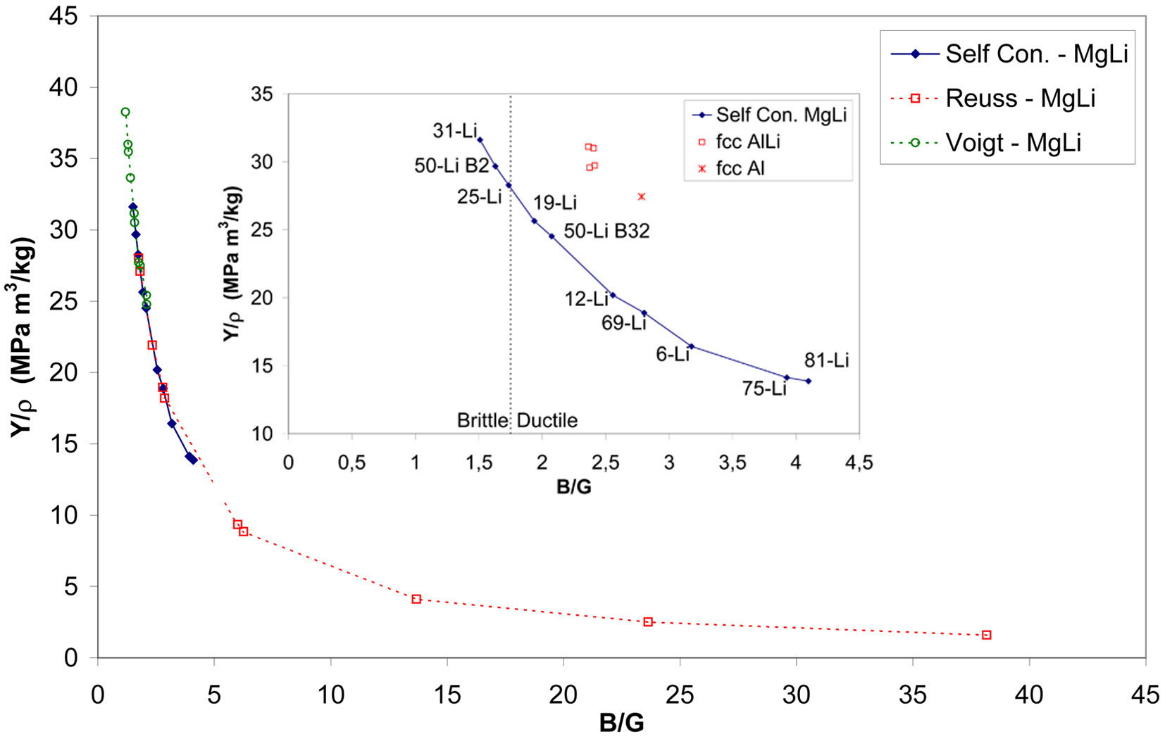
Ab-initio design of Mg-Li alloys
Weak under normal load
Weak under
shear load
Y: Young‘s modulus
ρ: mass density
B: compressive modulus
G: shear modulus
Counts et al.: phys. stat. sol. B 245 (2008) 2630
Counts, Friák, Raabe, Neugebauer: Acta Mater. 57 (2009) 69

Slide 37
Develop new materials via ab-initio methods
Ab initio in materials science: what for ?
Ab initio to continuum models (mechanics)
Titanium (ab initio and continuum)
Mn-steels (identify mechanisms)
Steel with Cu precipitates (atom scale experiments)
Mg-Li alloy design (ab initio property maps)
Singapore crab (ab initio and homogenization)
Conclusions and challenges
www.mpie.de

Slide 38
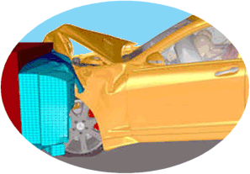
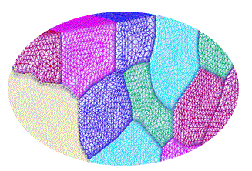
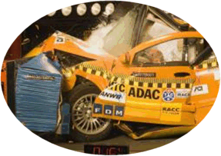
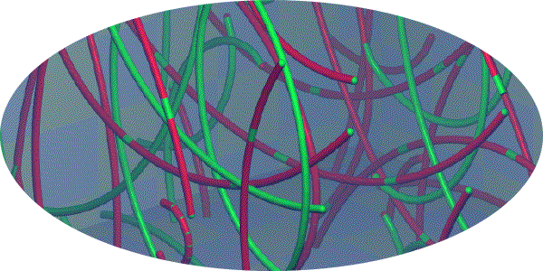
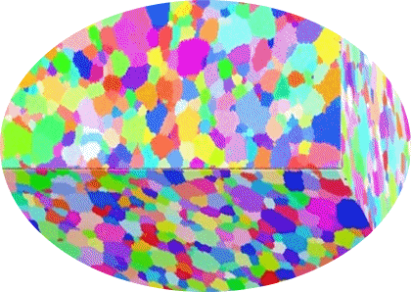
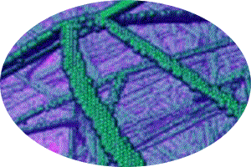
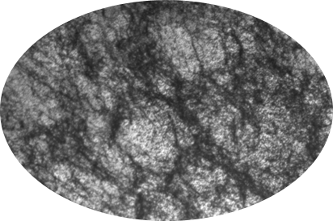
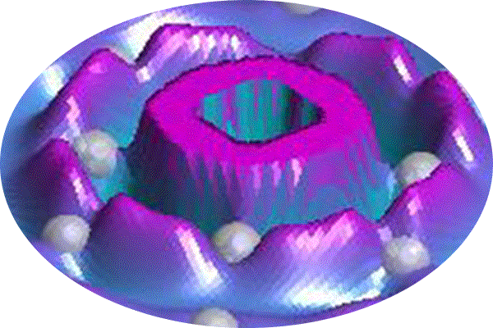
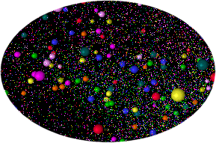
Scales in computational crystal plasticity
Length [m]
Boundary conditions
10⁰
Crystals and anisotropy
Kinetics of defects
10⁻³
Structure of defects
Structure
of matter
10⁻⁶
10⁻⁹
10⁻¹⁵
10⁻⁹
10⁻³
10³
Time [s]
D. Raabe: Advanced Materials 14 (2002) p. 639

Slide 39
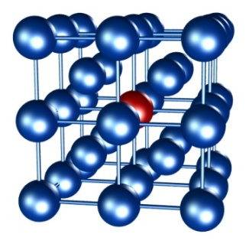
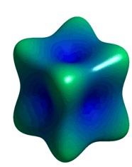
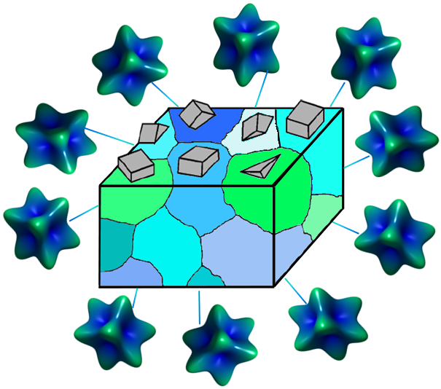
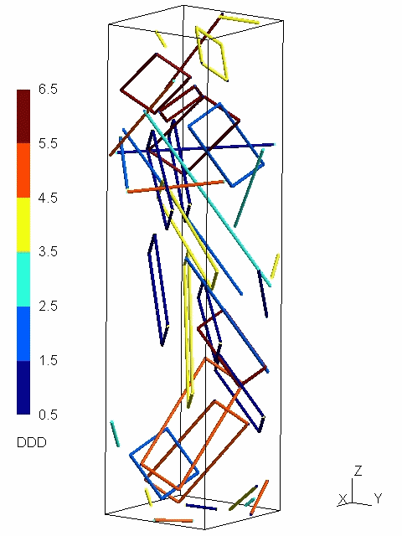
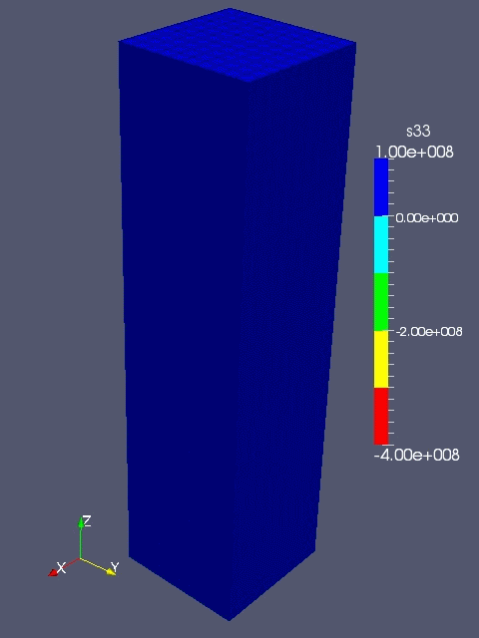
From ab-initio to polycrystal mechanics
<E>
Gb, Gb² , ...
* DFT: density functional theory
Raabe, Sander, Friák, Ma, Neugebauer: Acta Mater. 55 (2007) 4475

