Slide 1
3D EBSD: Tomographic orientation microscopy in a FIB SEM
D. Raabe, S. Zaefferer, P. Konijnenberg, E. Demir, A. Khorashadizadeh,
N. Zaafarani, G. Rohrer, A. D. Rollett
Düsseldorf, Germany
WWW.MPIE.DE
d.raabe@mpie.de
7. June 2010, E-MRS Strassbourg

Slide 2
Overview
Motivation and Features
Methods
Experimental set-up
Data analysis (GND; interface textures;
simulation: CPFEM, phase field, MC, CA)
Examples
Indentation: GND
DP steels: GND
ECAP processing: interface textures
Conclusions
Zaefferer et al., Met. Mater. Trans. 39A (2008) 374

Slide 3
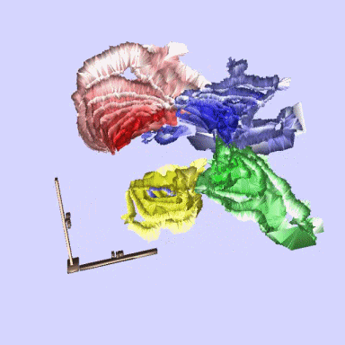
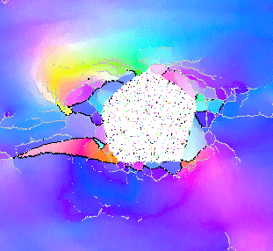
Special 3D features of FIB-EBSD tomography
Increase phase space of microstructure analysis
6D (ϕ₁,φ,ϕ₂,x,y,z): Crystallography and texture with morphology
8D (ϕ₁,φ,ϕ₂,h,k,x,y,z): Interface crystallography (interface texture)
Spatial texture and phase correlations (connectivity, percolation, correlations)
Connection to 3D microstructure modeling
Recent reviews:
Uchic et al., MRS Bulletin 32 (2007) 408
Zaefferer et al., Met. Mater. Trans. 39A, (2008) 374
Konrad et al. Acta Mater. 54 (2006) 1369

Slide 4
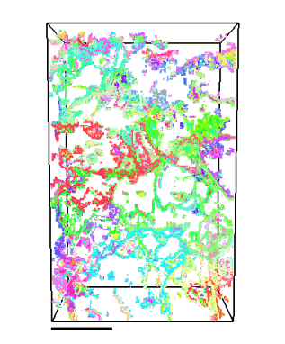

Advantages of FIB-EBSD tomography (3D EBSD)
Sectioning by FIB
  accurate depth definition
  flat and parallel sections (< 1° deviation )
  high resolution (< 50 nm)
Observation by EBSD
  well-defined contrast on crystalline material
  ideal for reconstruction of grains in 2D and 3D
  quantitative description of microstructure
  high resolution (~ 50 nm)
Combination of FIB and EBSD
  high measurement speed
  fully automatic
Bastos et al.: J. of Microscopy 230 (2008) 487

Slide 5
Overview
Motivation and Features
Methods
Experimental set-up
Data analysis (GND; interface textures;
simulation: CPFEM, phase field, MC, CA)
Examples
Indentation: GND
DP steels: GND
ECAP processing: interface textures
Conclusions
Roters et al. Acta Mater.58 (2010)

Slide 6
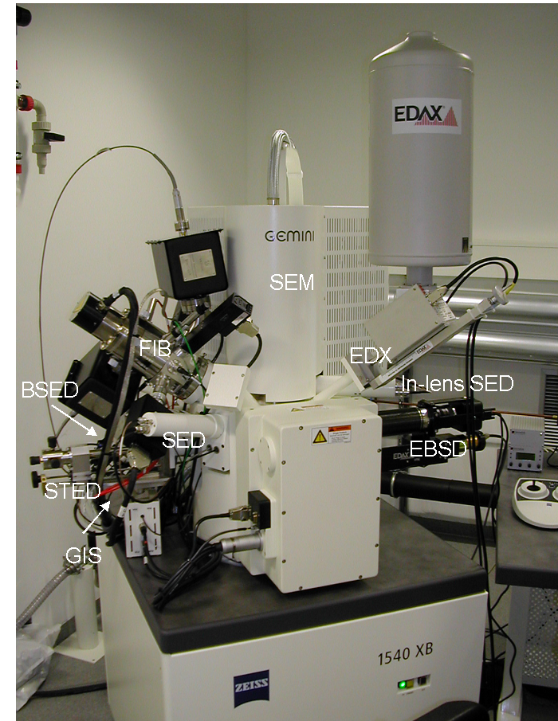
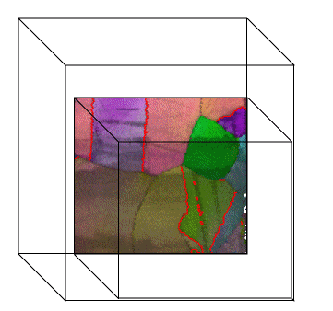
Instrument overview
Scanning electron microscope (SEM)
  observation of microstructure
Scanning Ga⁺-ion microscope (FIB = focused ion beam)
  sputtering of material for serial sectioning
Quantitative images with EBSD and EDX
  quantitative characterisation of microstructure
EBSD system:
TSL with
Hikari camera
SEM & FIB:
Zeiss
Crossbeam 1540
Zaefferer et al., Met. Mater. Trans. 39A (2008) 374

Slide 7
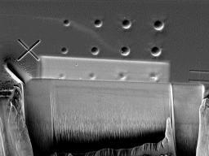
Principle of serial sectioning & orientation microscopy
ion milling
electron
beam
alignment marker
SEM objective lens
e⁻
EDX detector
tilt 34 °
FIB column
Ga⁺
x-rays
to EBSD detector
sample in cutting position
(36° tilt)
e⁻
EBSD camera
sample in EBSD position
(70° tilt)
Konrad et al. Acta Mater. 54 (2006) 1369

Slide 8
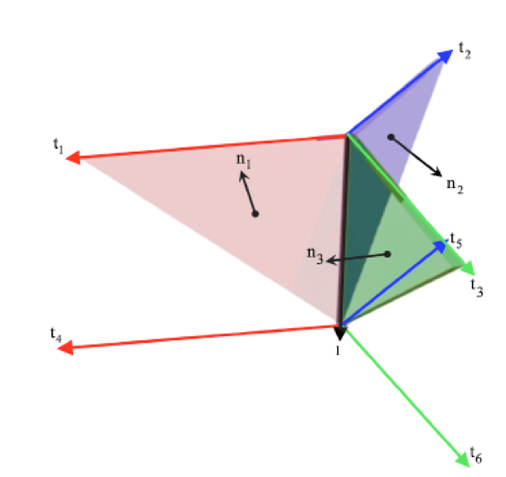
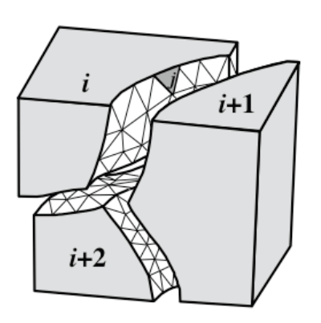
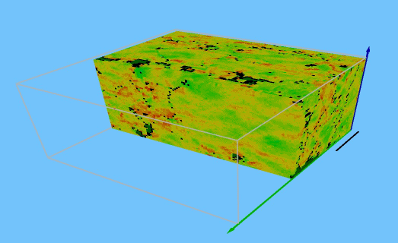
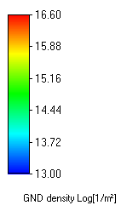
Approaches to 8D interface analysis and 3D GND analysis
Plane boundaries defined by triple junctions in two adjacent layers
Triangulation the interfaces for defining the grain boundaries
Greg Rohrer
Tony Rollett
GND (Kröner-Nye)
Demir, Raabe, Zaafarani, Zaefferer: Acta Mater. 57 (2009) 559

Slide 9
Overview
Motivation and Features
Methods
Experimental set-up
Data analysis (GND; interface textures;
simulation: CPFEM, phase field, MC, CA)
Examples
Indentation: GND
DP steels: GND
ECAP processing: interface textures
Conclusions
Zaefferer et al., Met. Mater. Trans. 39A (2008) 374

Slide 10
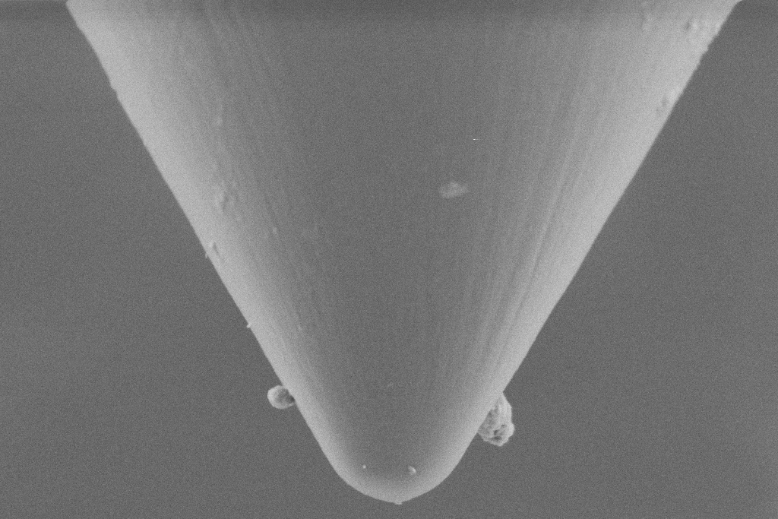
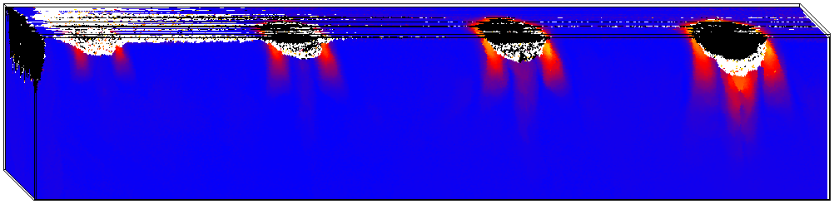
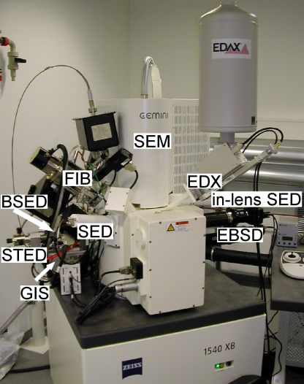
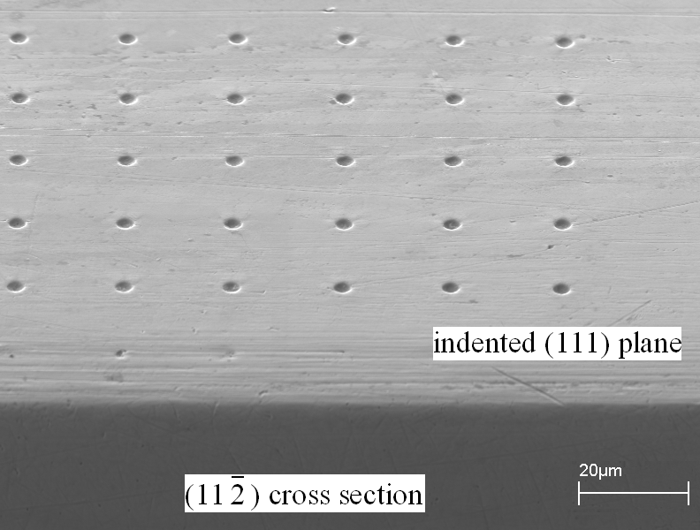
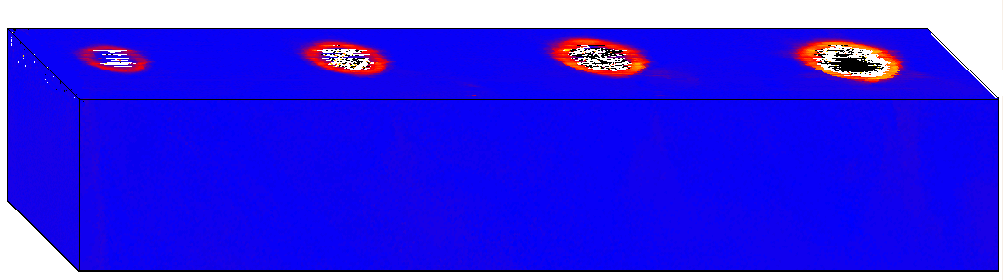
Nanoindentation (smaller is stronger): 3D EBSD and CPFEM
Cu, 60° conical, tip radius 1μm, loading rate 1.82mN/s, loads: 4000μN, 6000μN, 8000μN, 10000μN
Hardness and GND* in one experiment
Higher GND density at smaller scales?
20°
[111]
0°
Misorientation angle
[-110]
[11-2]
[111]
[-110]
[11-2]
* GND: geometrically necessary dislocations (accomodate curvature)
Zaafarani et al. Acta Mat. 54 (2006) 1707; Wang et al. Acta Mat. 52 (2004) 2229

Slide 11
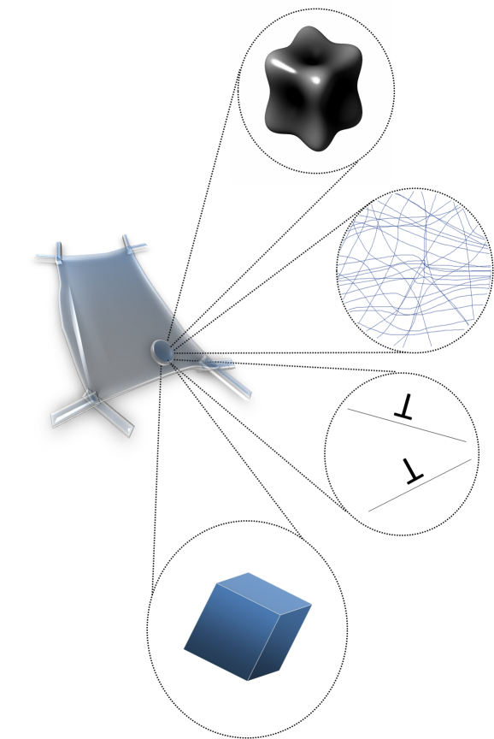
Nanoindentation (smaller is stronger): 3D EBSD and CPFEM
Cu, 60° conical, tip radius 1μm, loading rate 1.82mN/s, loads: 4000μN, 6000μN, 8000μN, 10000μN
20°
0°
T
T
T
* GND: geometrically necessary dislocations (accomodate curvature)
Zaafarani et al. Acta Mat. 54 (2006) 1707; Wang et al. Acta Mat. 52 (2004) 2229

Slide 12
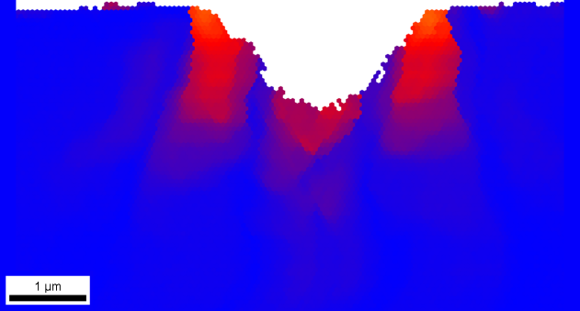
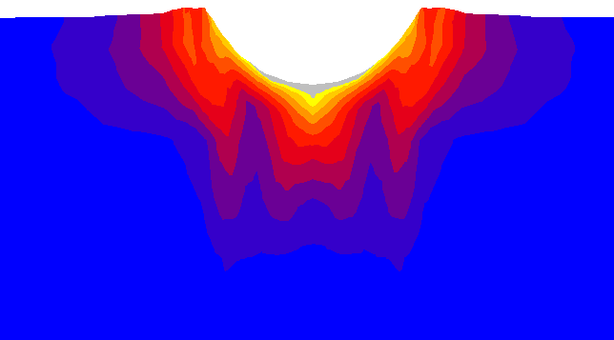
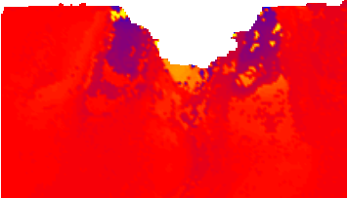
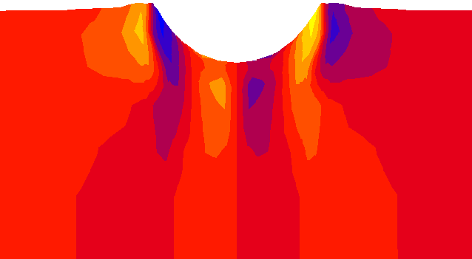

Comparison, crystal rotations (absolute, about [11-2] axis)
Absolute rotations
25°
20°
15°
10°
experiment
CPFEM, dislocation-based
5°
[111]
[-110]
0
[11-2]
experiment
simulation
<11-2> rotations
+
-
-
+
+
-
experiment
CPFEM, dislocation-based
[111]
[-110]
[11-2]
Zaafarani, Raabe, Roters, Zaefferer: Acta Mater. 56 (2008) 31

Slide 13
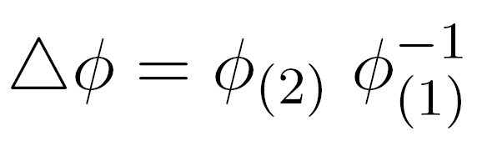
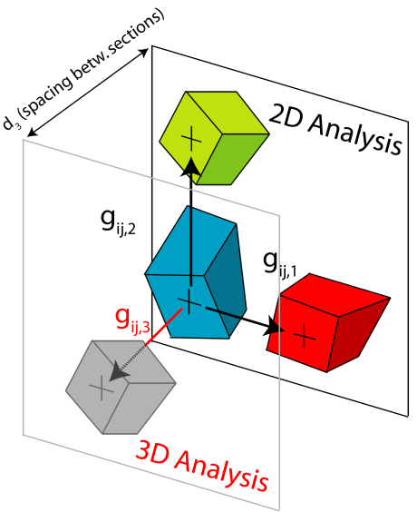
From local misorientations to GNDs
20°
0°
misorientation angle
misorientation
orientation difference
orientation gradient
(spacing d from EBSD scan)
Demir, Raabe, Zaafarani, Zaefferer: Acta Mater. 57 (2009) 559

Slide 14
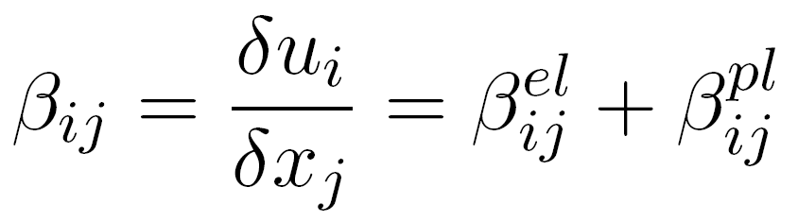
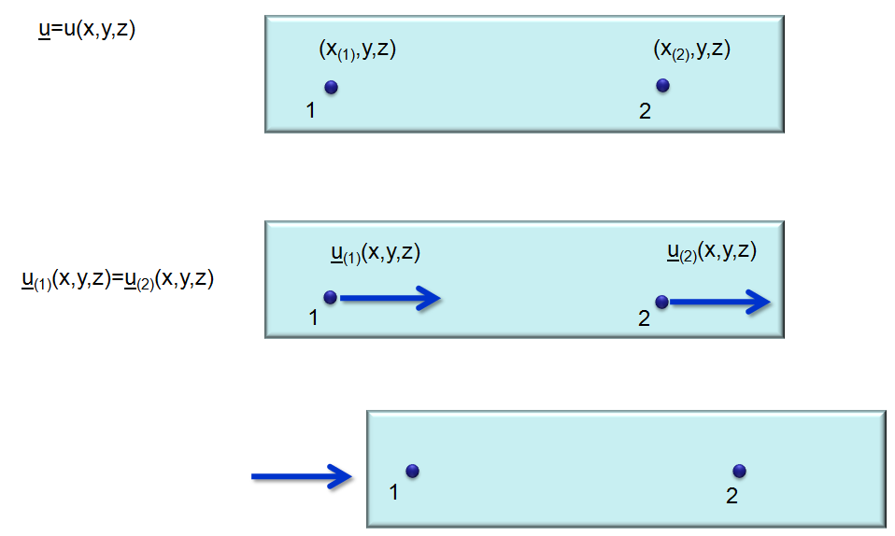
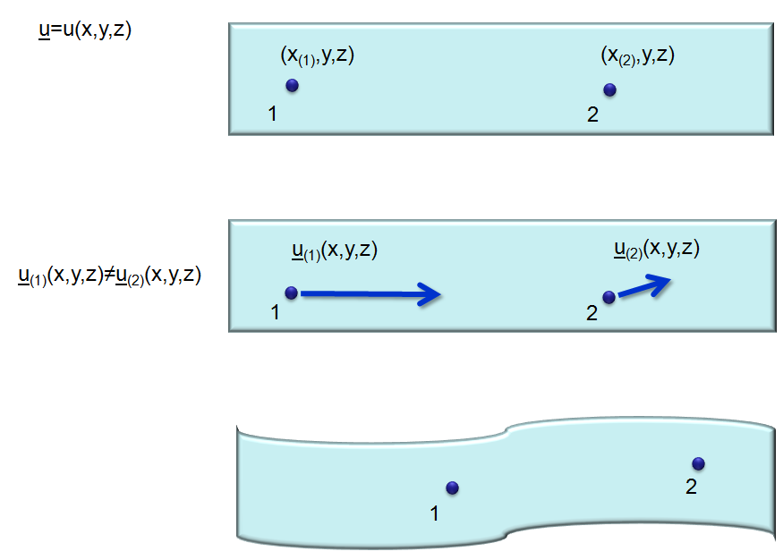
From local misorientations to GNDs
distortion
(sym, a-sym)
Demir, Raabe, Zaafarani, Zaefferer: Acta Mater. 57 (2009) 559

Slide 15
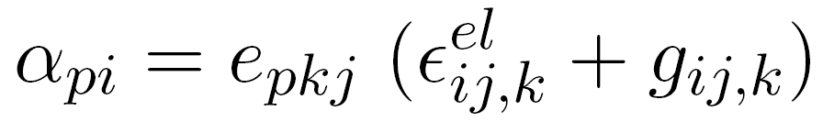
From local misorientations to GNDs
distortion
(sym, a-sym)
dislocation tensor (GND)
J. F. Nye. Some geometrical relations in dislocated crystals. Acta Metall. 1:153, 1953.
E. Kröner. Kontinuumstheorie der Versetzungen und Eigenspannungen (in German). Springer, Berlin, 1958.
E. Kröner. Physics of defects, chapter Continuum theory of defects, p.217. North-Holland Publishing, Amsterdam, Netherlands, 1981.
Demir, Raabe, Zaafarani, Zaefferer: Acta Mater. 57 (2009) 559

Slide 16
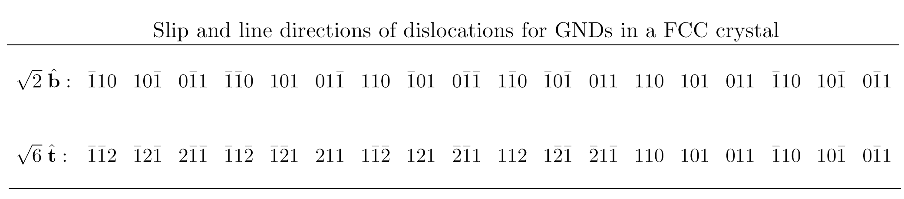

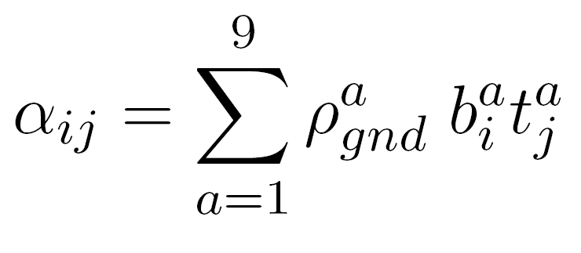
From local misorientations to GNDs
Frank loop through area r
18 b,t combinations
9 b,t combinations
T
T
T
Demir, Raabe, Zaafarani, Zaefferer: Acta Mater. 57 (2009) 559

Slide 17
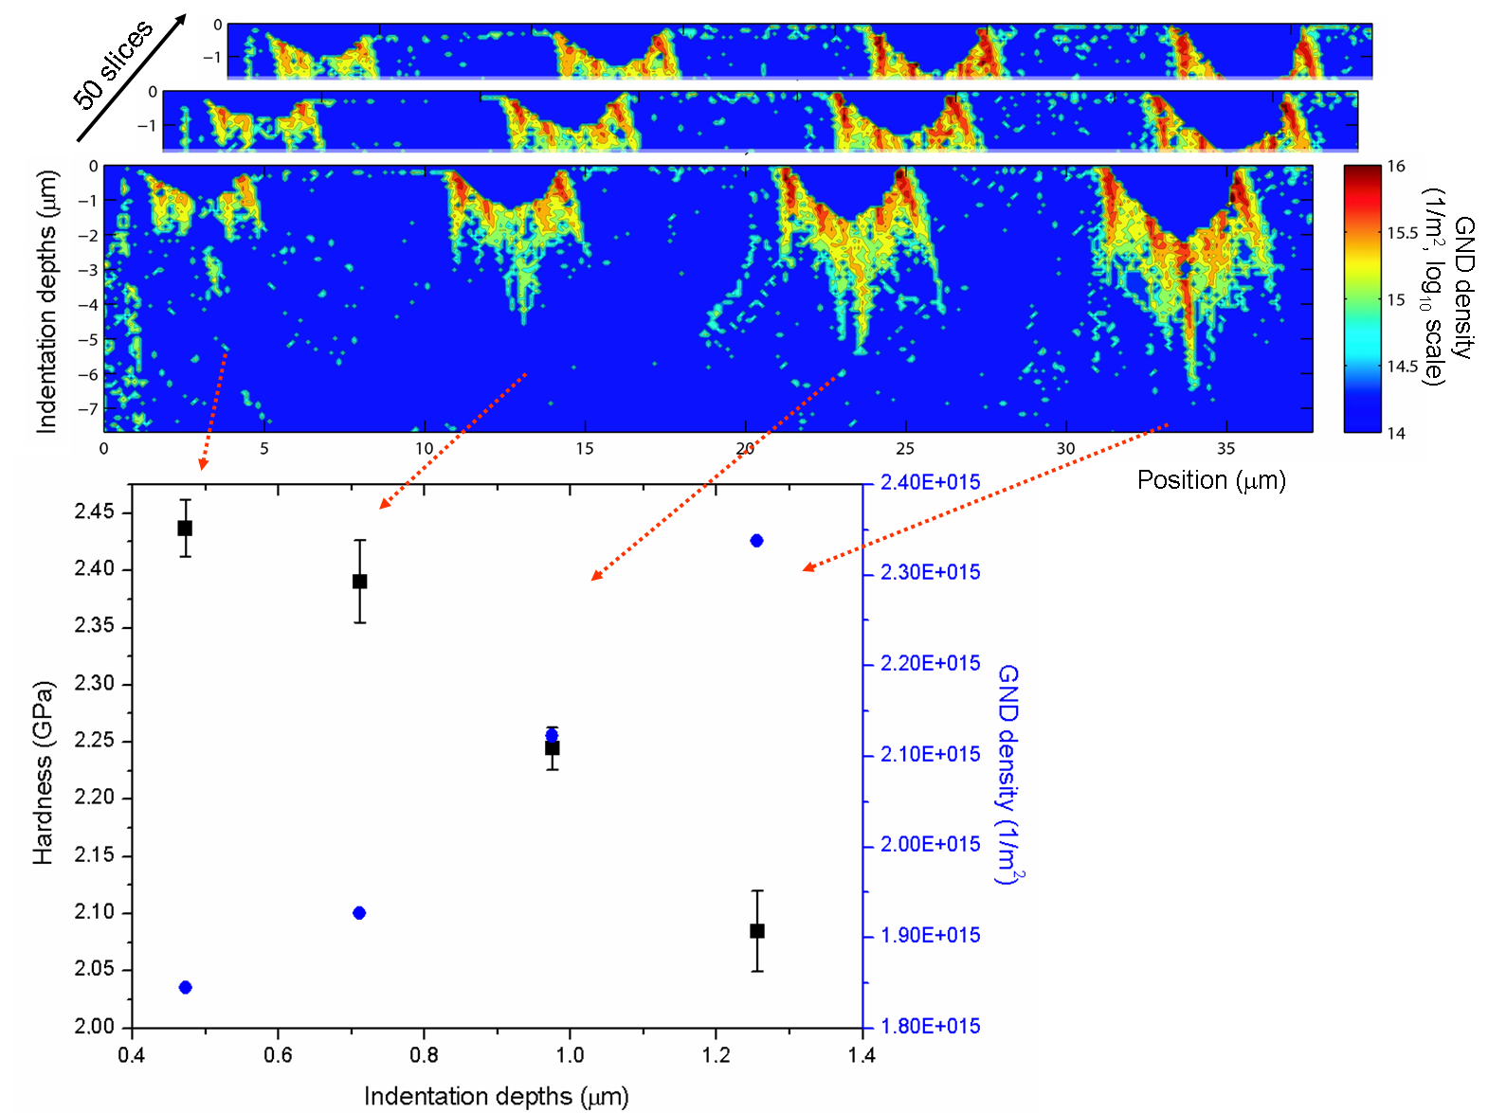
Extract geometrically necessary dislocations
Demir, Raabe, Zaafarani, Zaefferer: Acta Mater. 57 (2009) 559

Slide 18
Overview
Motivation and Features
Methods
Experimental set-up
Data analysis (GND; interface textures;
simulation: CPFEM, phase field, MC, CA)
Examples
Indentation: GND
DP steels: GND
ECAP processing: interface textures
Conclusions
Zaefferer et al., Met. Mater. Trans. 39A (2008) 374

Slide 19
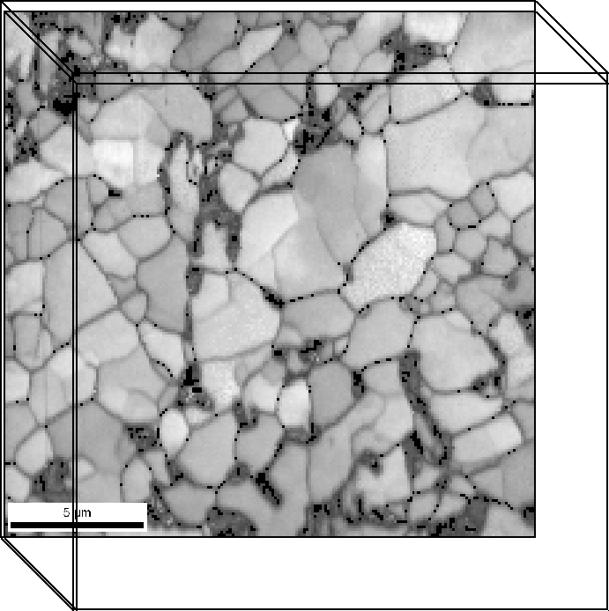
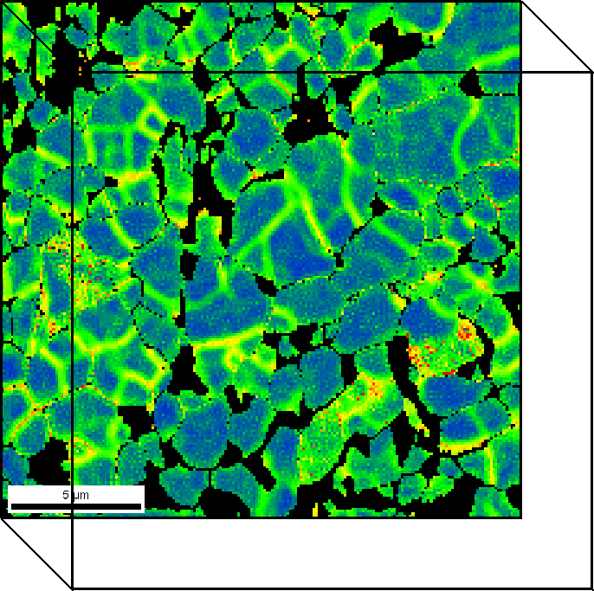
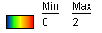
3D-EBSD - results
Image Quality
Kernel Average Misorientation (martensite highlighted in black)
Calcagnotto et al. ISIJ 48 (2008) 1096
Zaefferer et al., Met. Mater. Trans. 39A (2008) 374
Notes:
DP Steel studied by 3D EBSD;
data reveal phase distribution and percolation
between ferrite and martensite.

Slide 20
DP steel micromechanics
ferrite-martensite interfaces
ferrite-ferrite interfaces
Calcagnotto et al. Mater. Sc. Engin. A 527 (2010) 2738
Notes:
Strengthening in DP steels:
Orientation gradients and hence geometrically necessary dislocations
at ferrite-martensite interfaces are twice as large as
at ferrite-ferrite interfaces

Slide 21
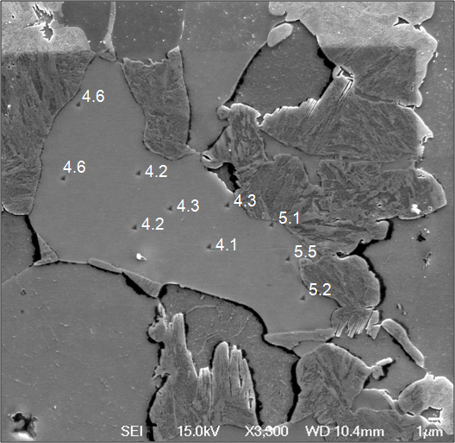
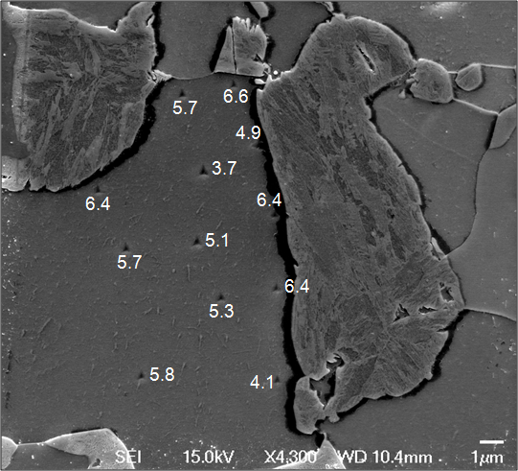
DP steel: effect of GNDs on local hardness?
Coarse grained DP (12.4 µm), Berkovich 50 nm, 500 µN
fine grained DP (2.4 µm)
Calcagnotto et al. Mater. Sc. Engin. A 527 (2010) 2738

Slide 22
Overview
Motivation and Features
Methods
Experimental set-up
Data analysis (GND; interface textures;
simulation: CPFEM, phase field, MC, CA)
Examples
Indentation: GND
DP steels: GND
ECAP processing: interface textures
Conclusions
Zaefferer et al., Met. Mater. Trans. 39A (2008) 374

Slide 23
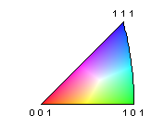
ECAP processing: 3D microstructure and interface analysis
Cu-0.17wt%Zr – as deformed
4 ECAP passes
8 ECAP passes
color: crystal direction parallel to ECAP direction (ED)
Khorashadizadeh Mater. Sc. For. 584 (2008) 434

Slide 24
ECAP processing: 3D microstructure and interface analysis
Cu-0.17wt%Zr – 8 ECAP passes and heat treated at 650°C, 10 min.
experiment: interfaces
experiment: texture
color: crystal direction parallel to ECAP direction (ED)
Khorashadizadeh Mater. Sc. For. 584 (2008) 434

Slide 25
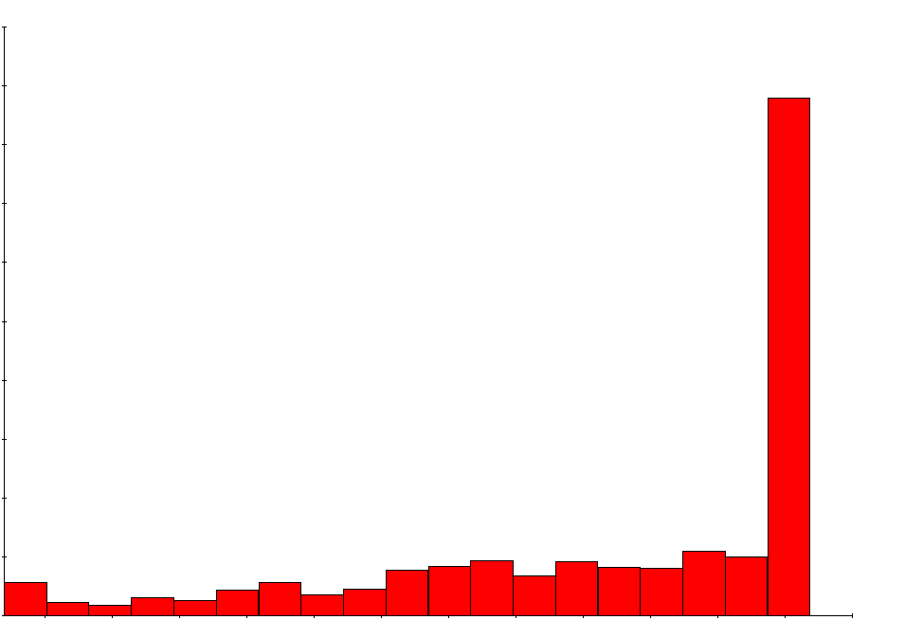
650°C 10 min, Approaches to 8D interface analysis
Cu-0.17wt%Zr – 8 ECAP passes and heat treated at 650°C, 10 min.
highest fraction
50
40
30
Number fraction [%]
Misorientation angles of grain boundaries
20
10
0
10
20
30
40
50
60
Misorientation angle [degrees]
Khorashadizadeh Mater. Sc. For. 584 (2008) 434

Slide 26
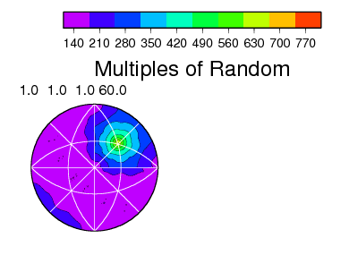
650°C 10 min, interface stereology
Cu-0.17wt%Zr – 8 ECAP passes and heat treated at 650°C, 10 min.
60° [111]
Max. 818.70
Resolution: 8.18°
CLS method: Rollett
Khorashadizadeh Mater. Sc. For. 584 (2008) 434

Slide 27
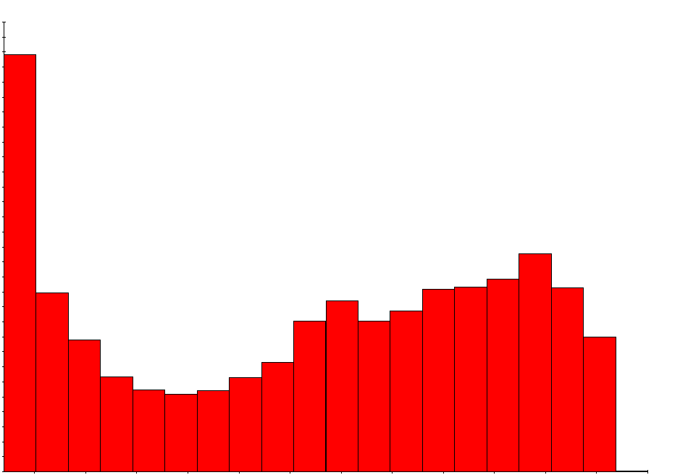
ECAP processing: 3D microstructure and interface analysis
Cu-0.17wt%Zr – as deformed after 8 passes
14
Area fraction of ∑3 ~ 3%
8 ECAP passes
12
10
8
Misorientation angles of grain boundaries
Number fraction [%]
6
4
2
0
10
20
30
40
50
60
Misorientation angle [degrees]
Khorashadizadeh Mater. Sc. For. 584 (2008) 434

Slide 28
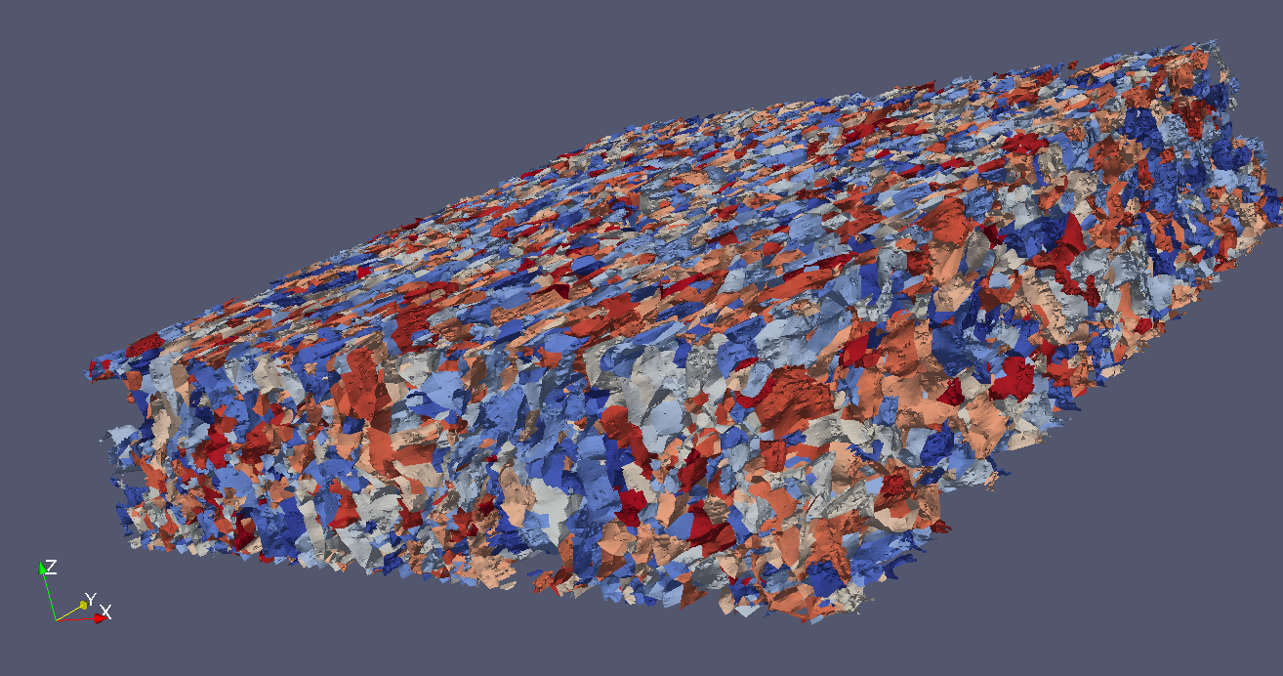
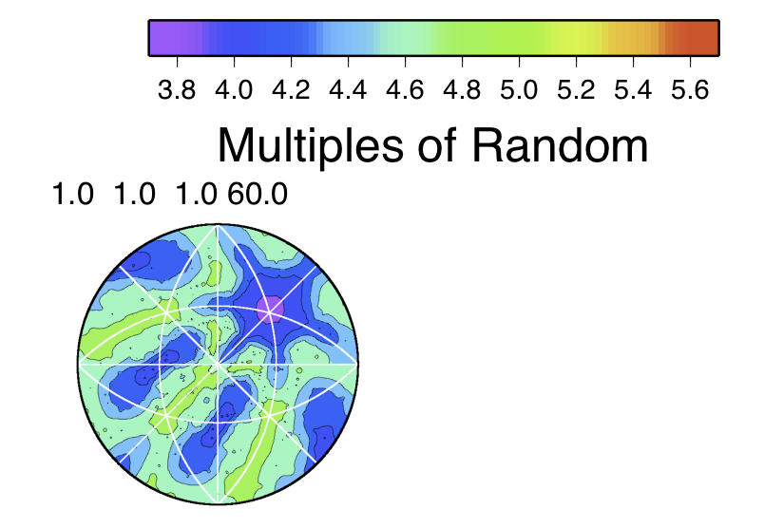
ECAP processing: 3D microstructure and interface analysis
Cu-0.17wt%Zr – as deformed after 8 passes
Resolution: 8.18°
Max. 5
Khorashadizadeh Mater. Sc. For. 584 (2008) 434

Slide 29
Overview
Motivation and Features
Methods
Experimental set-up
Data analysis (GND; interface textures;
simulation: CPFEM, phase field, MC, CA)
Examples
Indentation: GND
DP steels: GND
ECAP processing: interface textures
Conclusions
Zaefferer et al., Met. Mater. Trans. 39A (2008) 374

Slide 30
Conclusions
A multi-dimensional microstructure vector is obtained at each 3D spatial position
  phase, orientation, defect density, elemental composition
Spatial resolution: 50 x 50 x 50 nm³
Observable volume: ≈ 50 x 50 x 50 µm³
Angular resolution: 0.5° (precision of tilt)
Time per cut: 15 … 60 min /cycle
Examples: Size effect, interface crystallography, interface strengthening
Zaefferer et al., Met. Mater. Trans. 39A (2008) 374

