Slide 1

shortened version
Understanding structure and mechanical properties of the arthropod cuticle using multiscale simulation: Example of Homarus Americanus
H. Fabritius, S. Nikolov, C. Sachs, M. Friak, P. Romano,
M. Petrov, J. Neugebauer, D. Raabe
Düsseldorf, Germany
WWW.MPIE.DE
d.raabe@mpie.de
Dierk Raabe, 19. October 2012

Slide 2
Overview
Motivation
Structure and property overview
Ab initio prediction of chitin (structure, stiffness)
Ab initio prediction of calcite (dopant effects on structure)
Multiscale modeling of stiffness
Summary and conclusions
Raabe: Adv. Mater. 14 (2002)

Slide 3
The materials science of chitin composites: motivation
Chitin: Exoskeleton component of >90% of all animals on earth:
Arthropods: insects; crustaceans (lobsters, crabs, shrimp); chelicerates (spiders, scorpions)
Arthropods have adapted to every habitat on earth: adaptive material → candidate for bio-inspired material
Chitin basics unknown → ab initio
Influence of dopants on biominerals → ab initio
Common feature: hierarchical cuticle → composite design
Good mechanical properties → multiscale modeling and bioinspired carbon-based compounds
Nikolov et al. :Adv. Mater. 22 (2010) 519

Slide 4
Building units
Organic matrix in most parts of the cuticle
the organic material (chitin, proteins) is combined with inorganic nano-particles
Inorganic nano-particles
consists of amorphous or crystalline (calcite) CaCO₃
CaCO₃ doped by Mg
arrangement according to the organisation of the chitin-protein fibres
Cuticle
is a hierarchical composite material that combines high mechanical strength with a high functional versatility
Sachs, Fabritius, Raabe: Journal of Structural Biology 161 (2008) 120

Slide 5
Overview
Motivation
Structure and property overview
Ab initio prediction of chitin (structure, stiffness)
Ab initio prediction of calcite (dopant effects on structure)
Multiscale modeling of stiffness
Summary and conclusions
Raabe: Adv. Mater. 14 (2002)

Slide 6
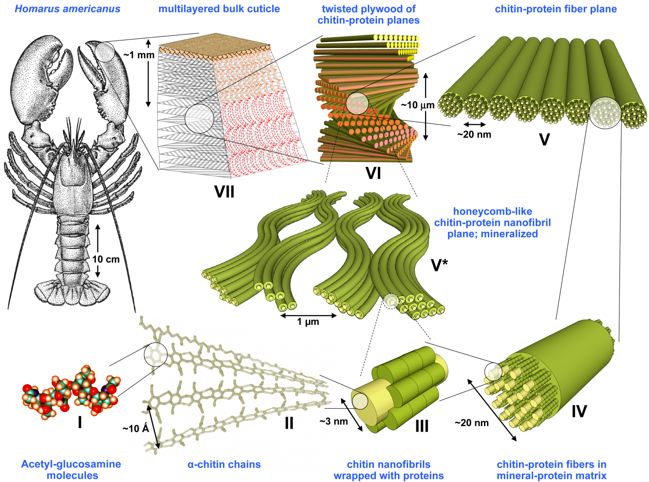
Structure hierarchy of chitin-compounds
Nikolov et al.: Adv. Mater. 22 (2010) p. 519; Al-Sawalmih et al.: Adv. Funct. Mater. 18 (2008) 3307
Sachs et al.: J Structural Biology 161 (2008) 120

Slide 7
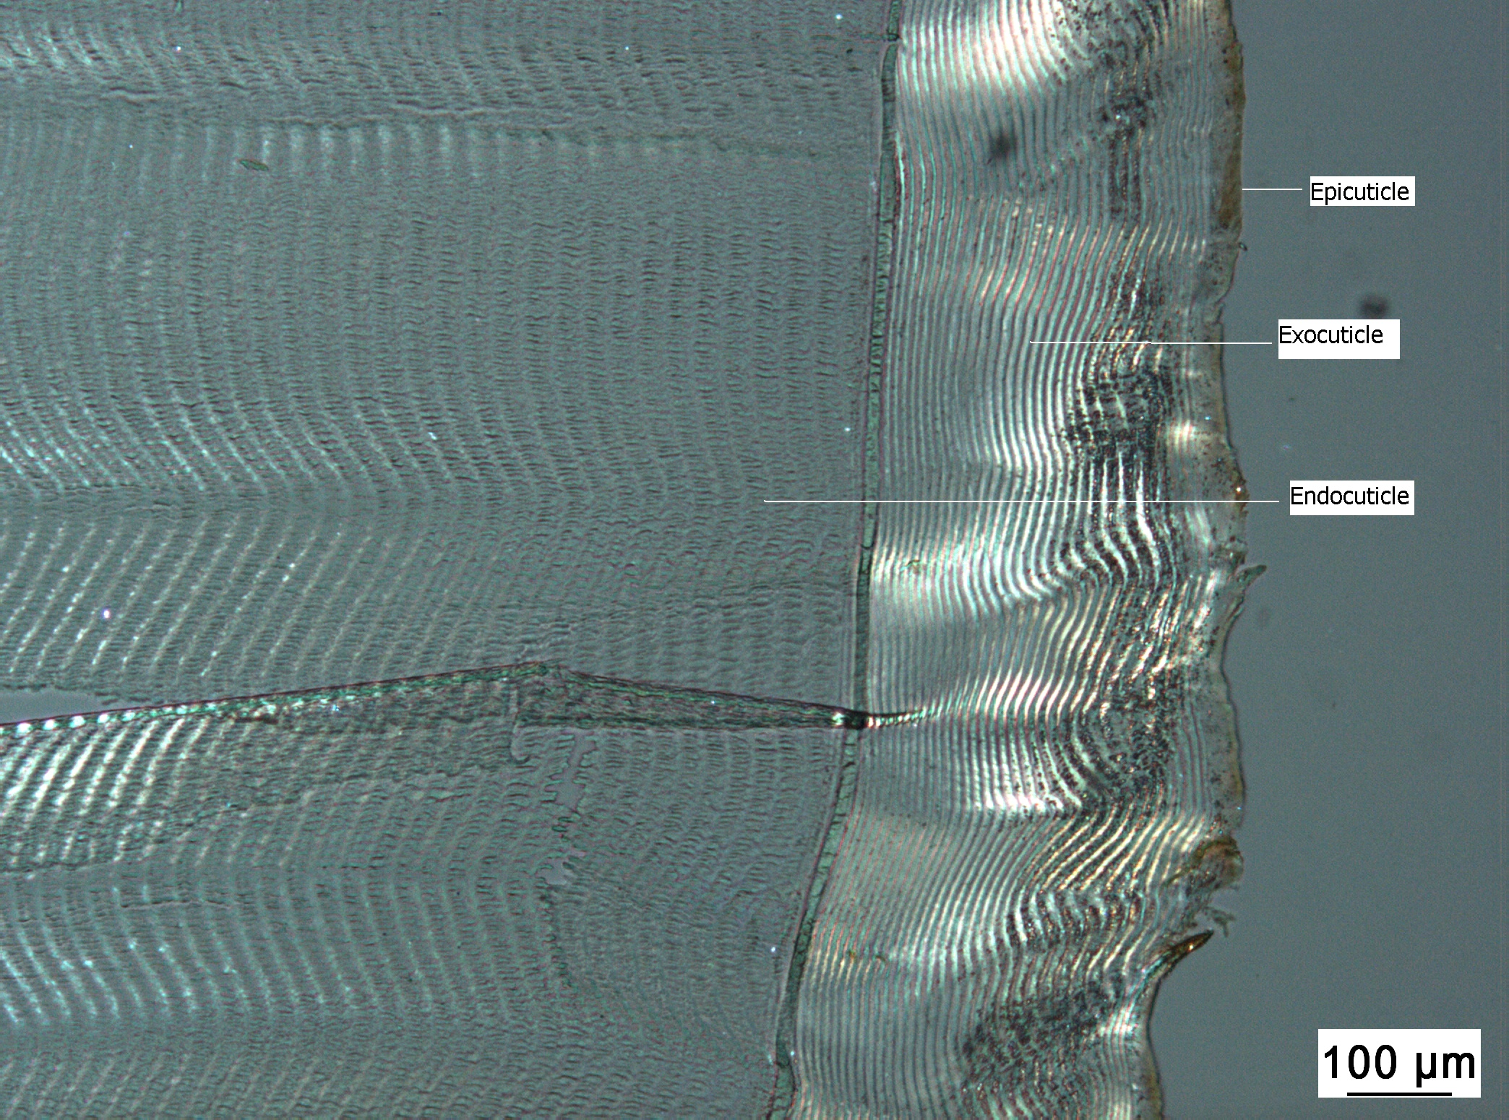
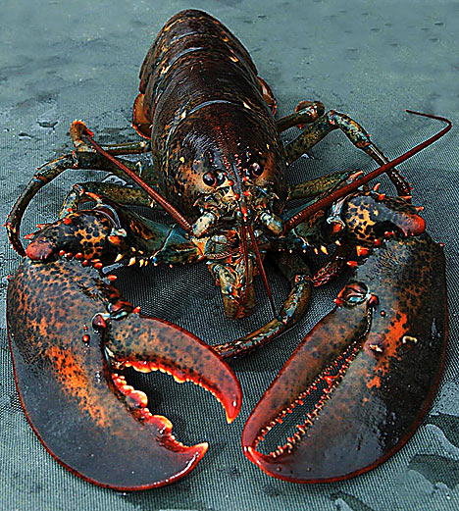
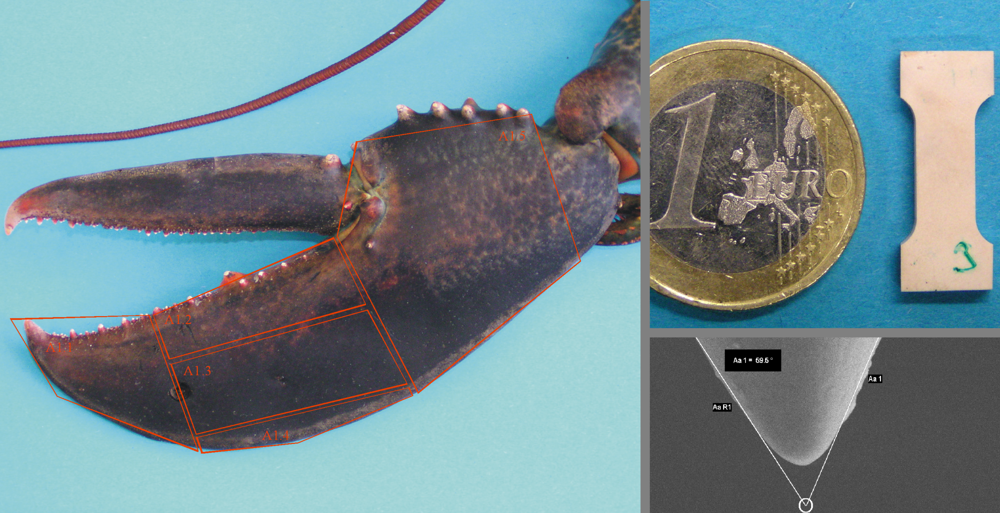
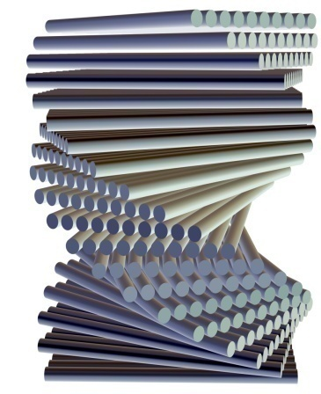
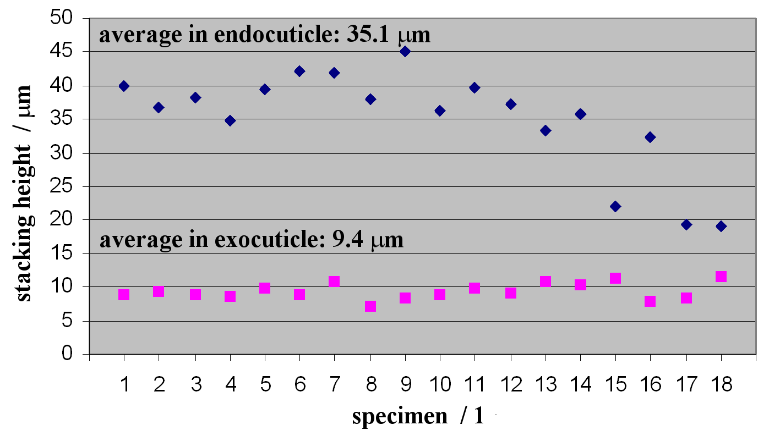
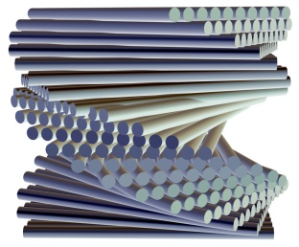
The materials science of chitin composites
6
Fabritius, Sachs, Romano, Raabe : Adv. Mater. 21 (2009) 391

Slide 8
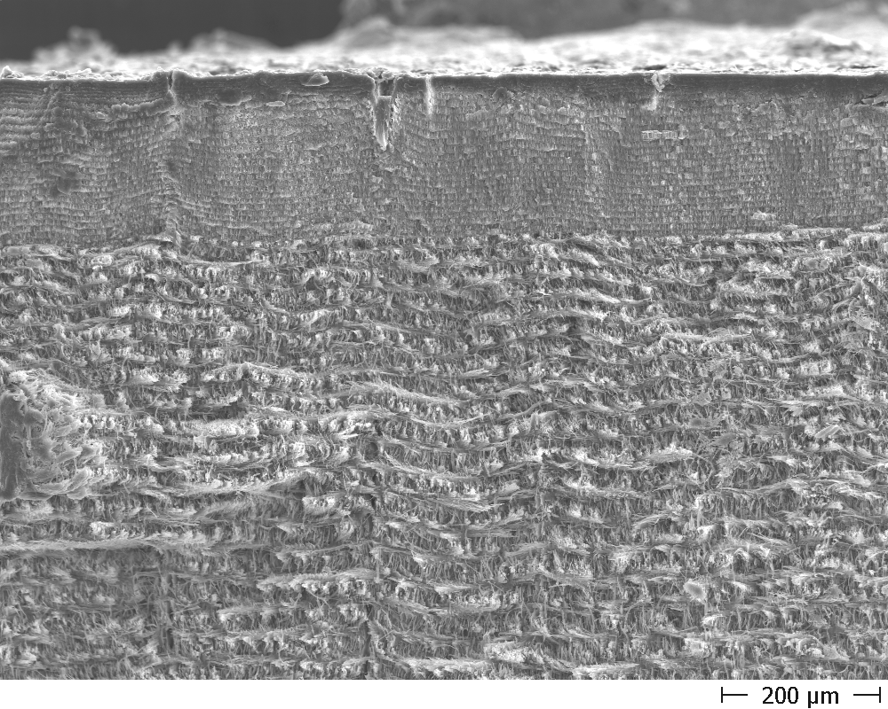
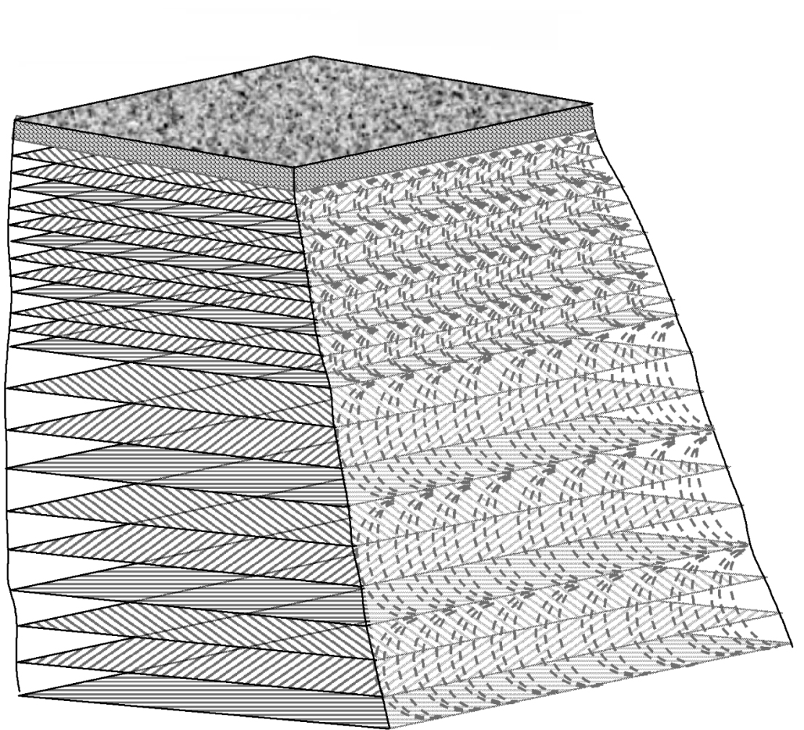
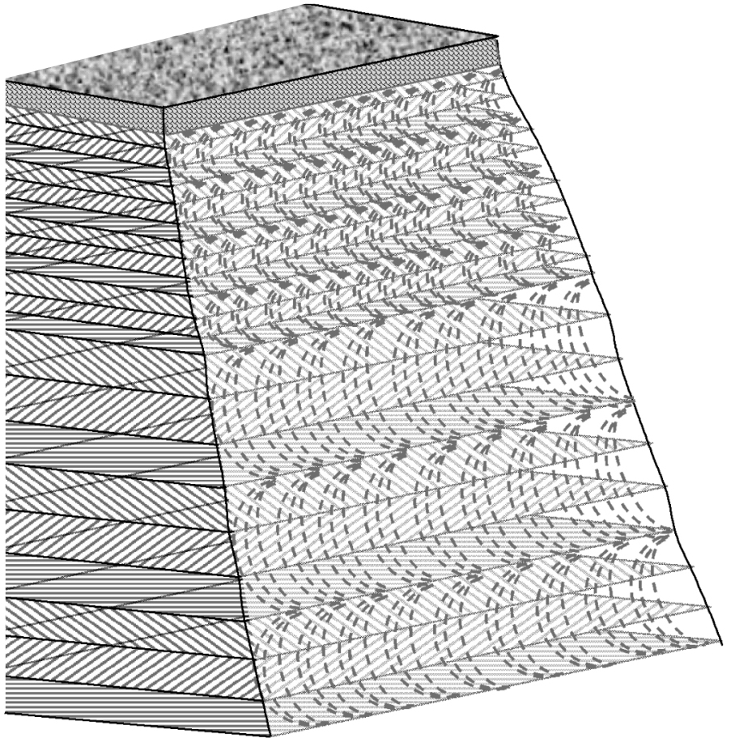
Epicuticle
Cuticle hardened by mineralization with CaCO₃
Exocuticle
Exocuticle and endocuticle have different stacking density of twisted plywood layers
Endocuticle

Slide 9
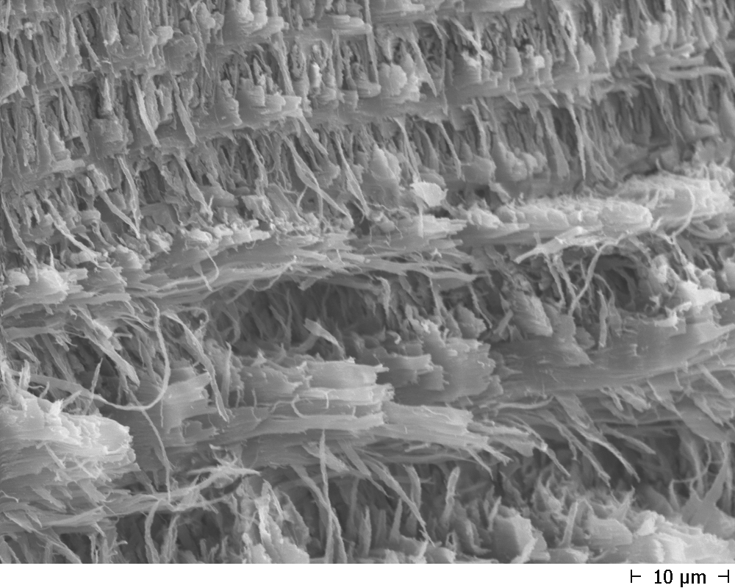
D. Raabe, P. Romano, C. Sachs, H. Fabritius, A. Al-Sawalmih, S.-B. Yi, G. Servos, H.G. Hartwig
Mater. Sc. Engin. A 421 (2006) 143–153
exocuticle
endocuticle
Nikolov et al.: Adv. Mater. 22 (2010) p. 519; Al-Sawalmih et al.: Adv. Funct. Mater. 18 (2008) 3307

Slide 10
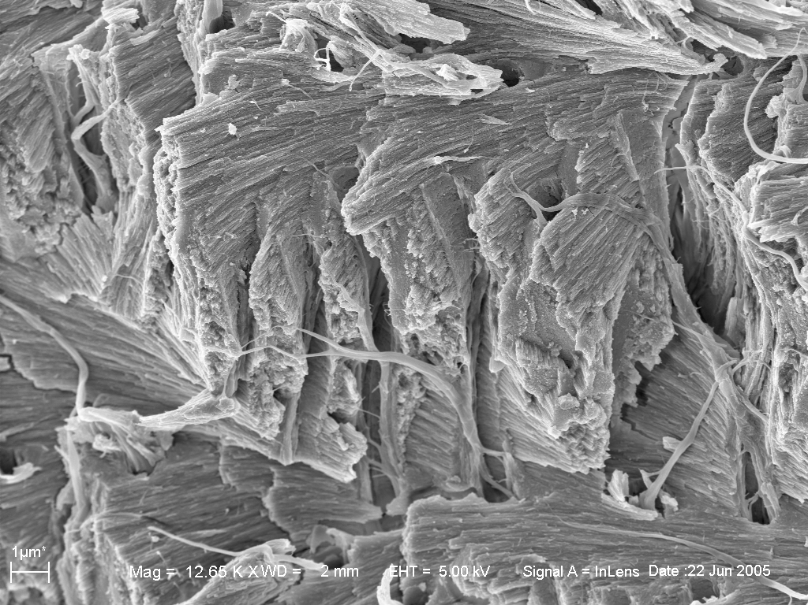
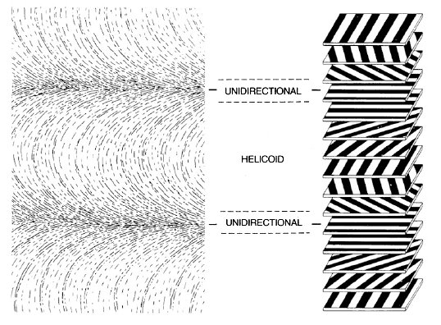
180° rotation of fiber planes

Slide 11
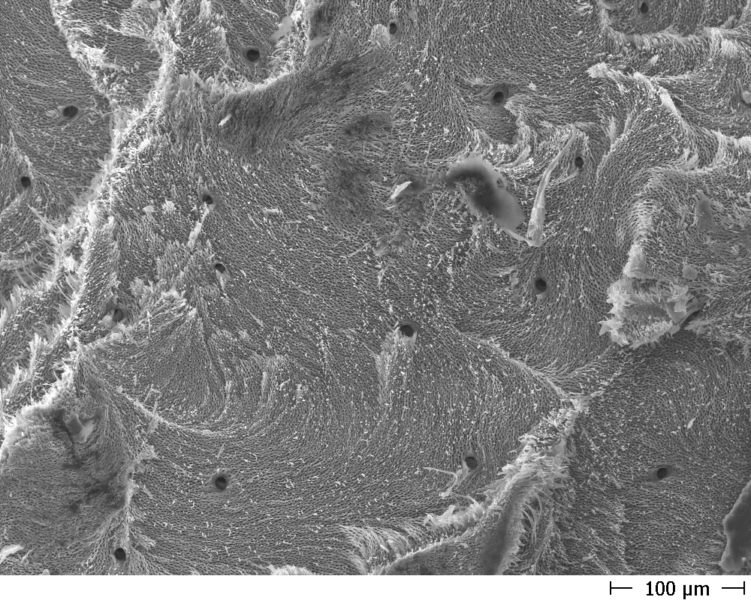
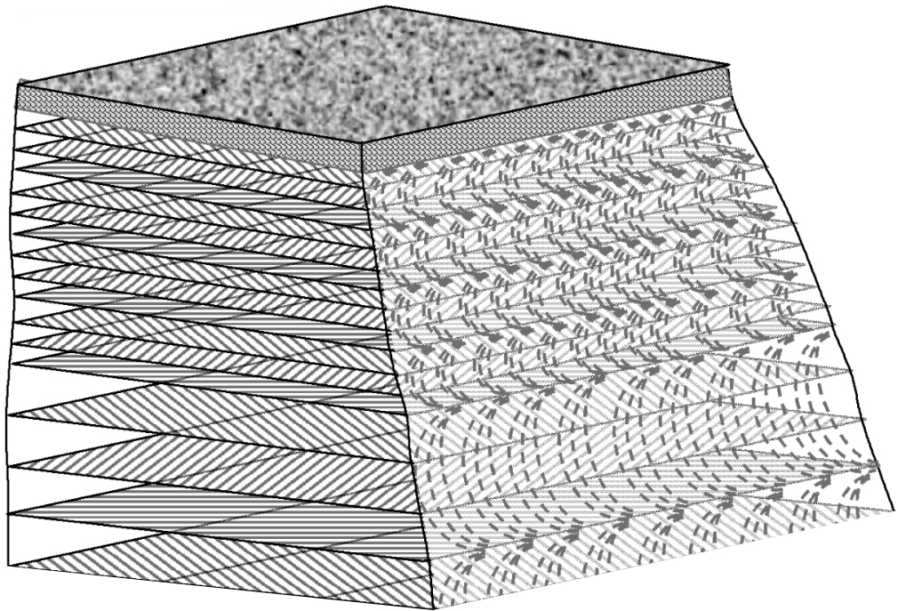
D. Raabe, P. Romano, C. Sachs, H. Fabritius, A. Al-Sawalmih, S.-B. Yi, G. Servos, H.G. Hartwig
Mater. Sc. Engin. A 421 (2006) 143–153

Slide 12
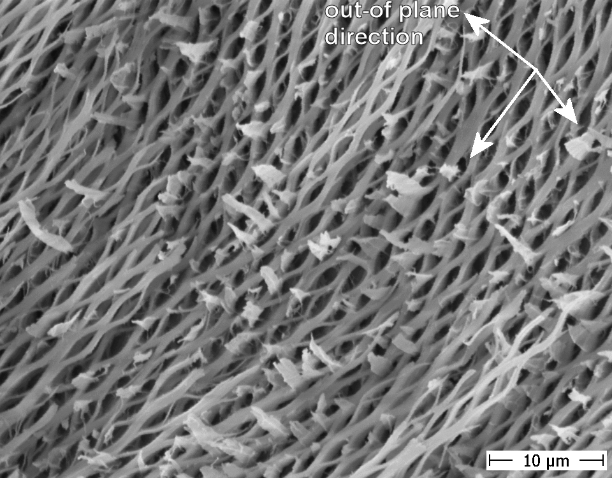

Slide 13
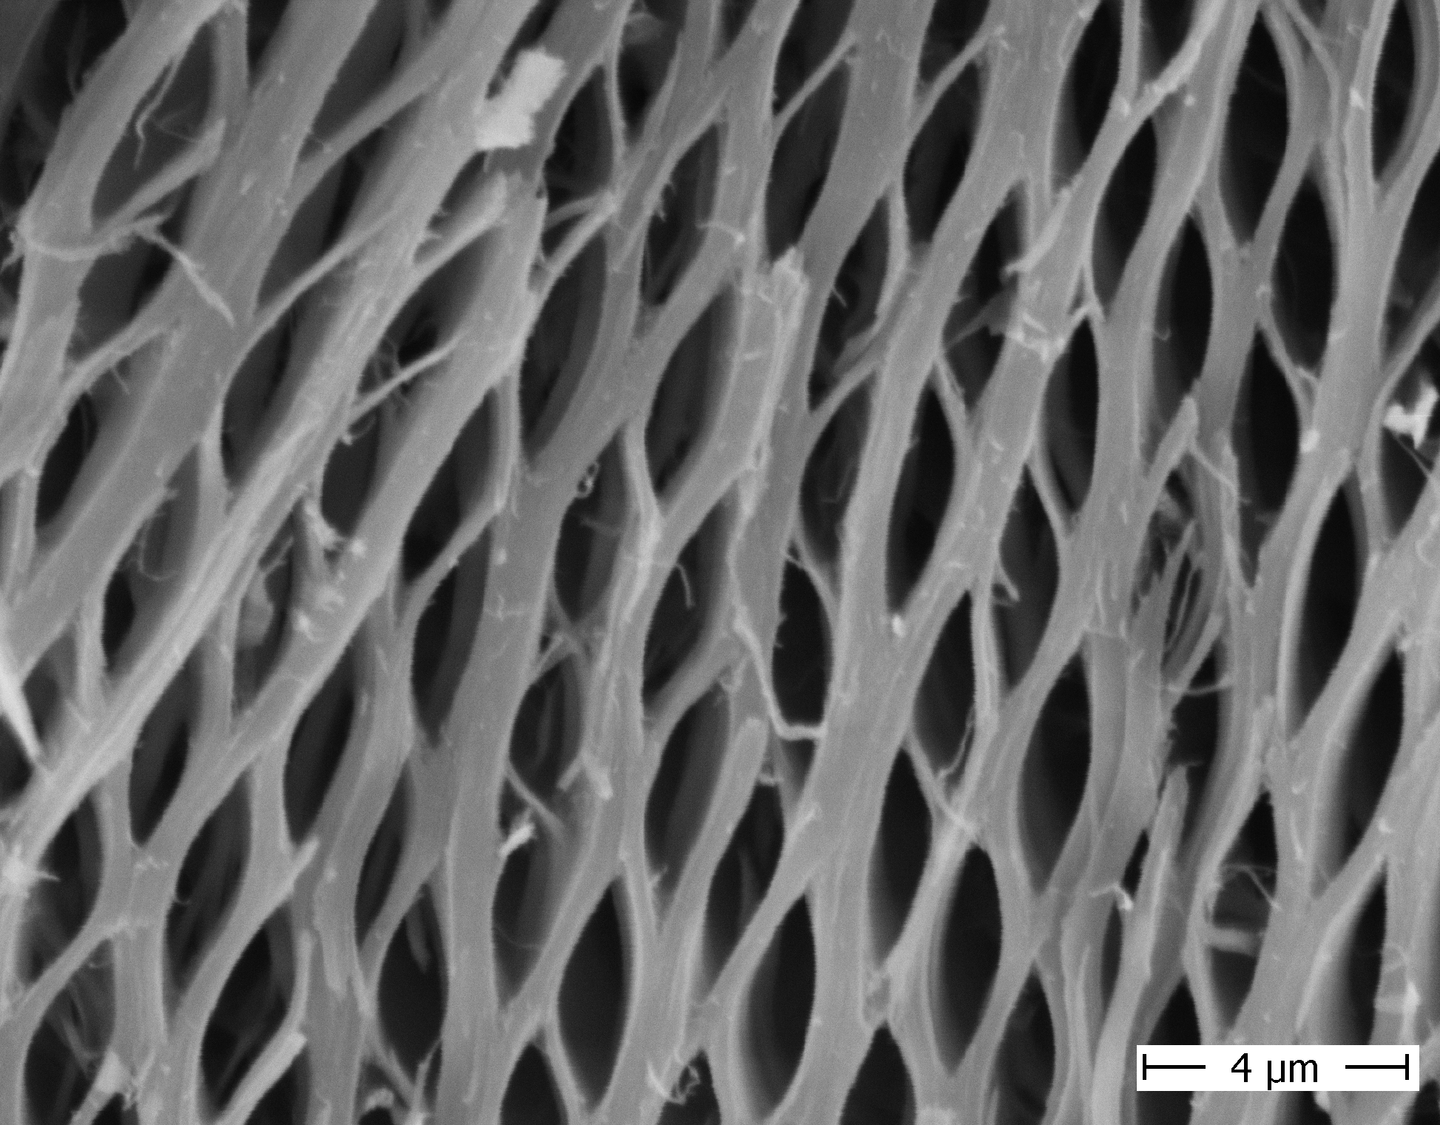

Slide 14
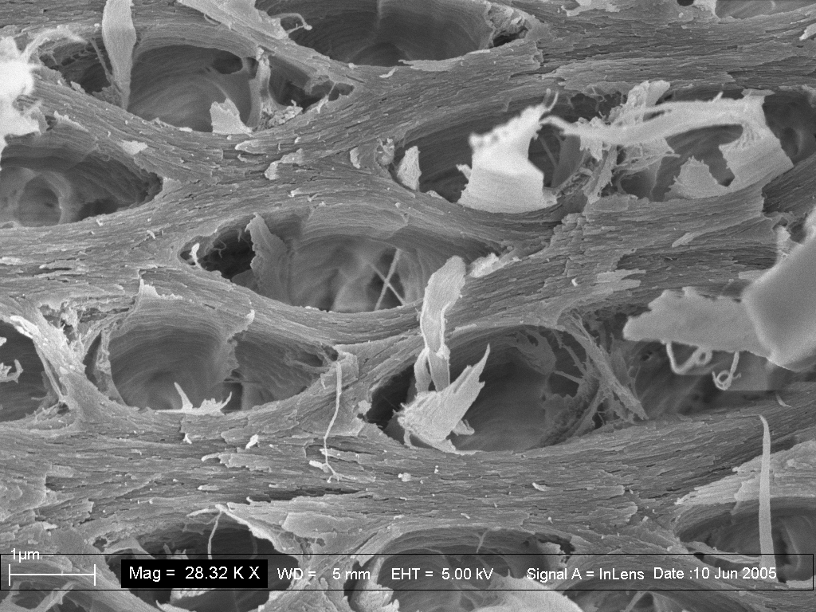

Slide 15
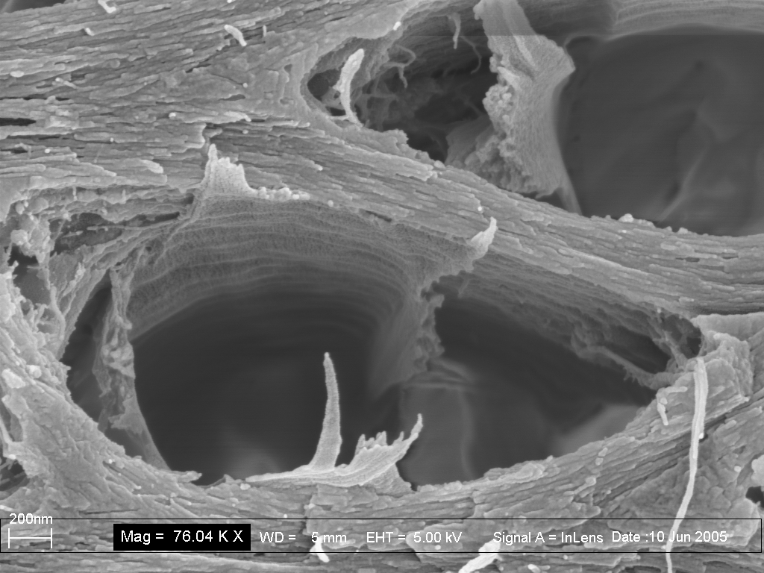

Slide 16
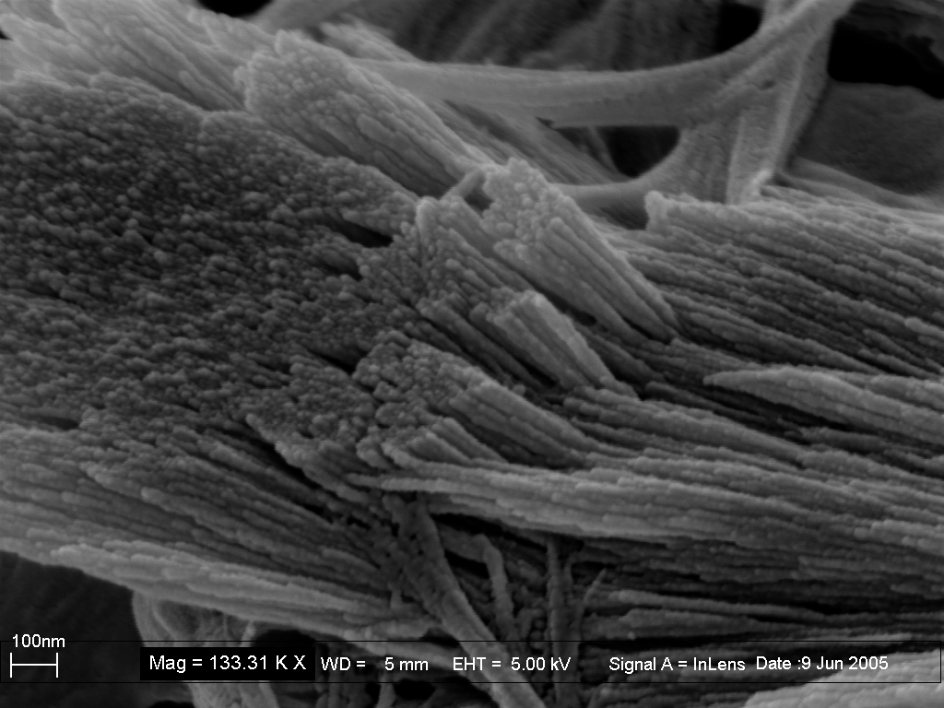

Slide 17
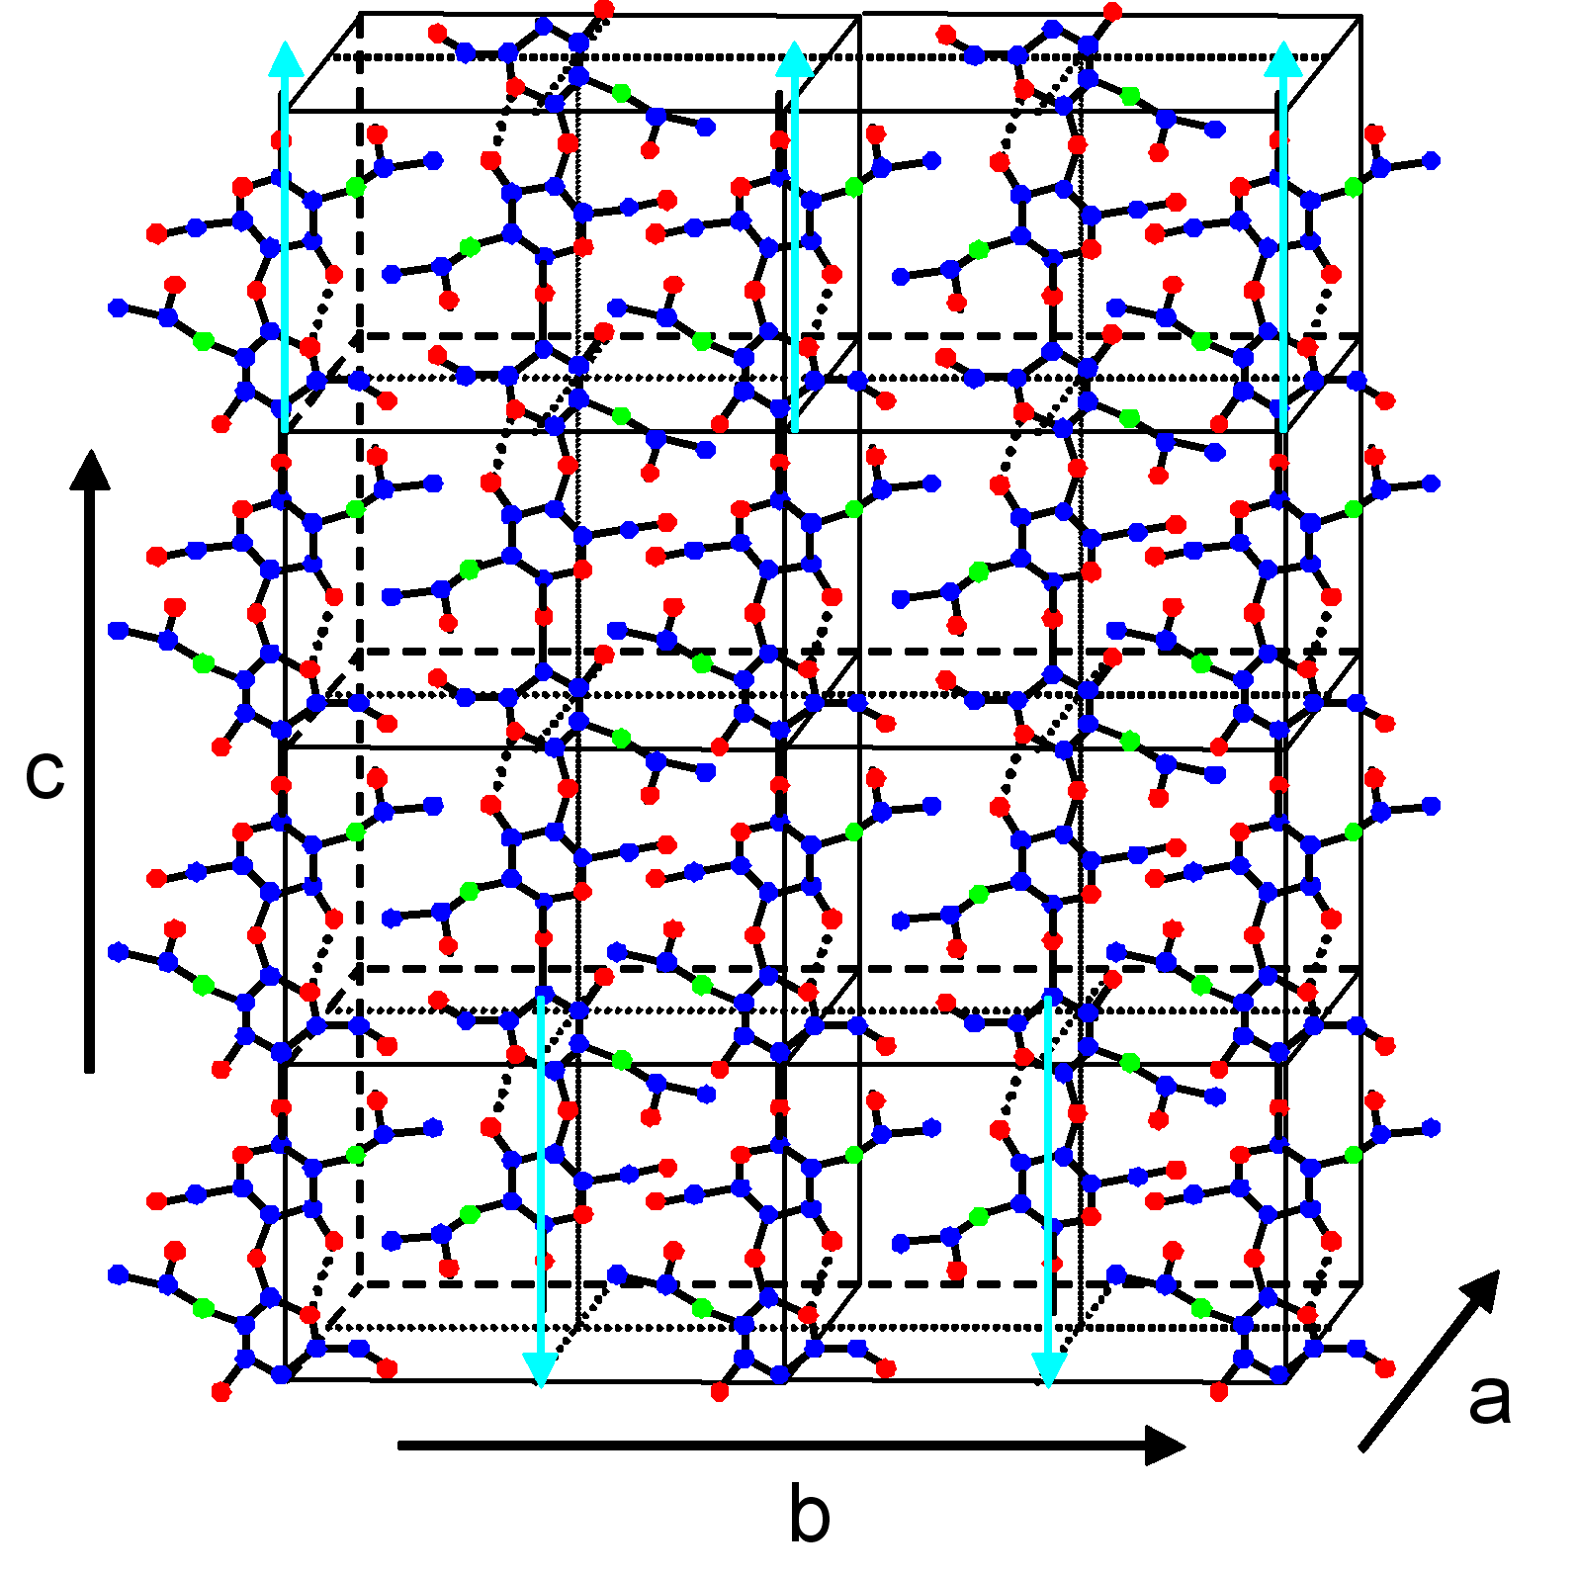
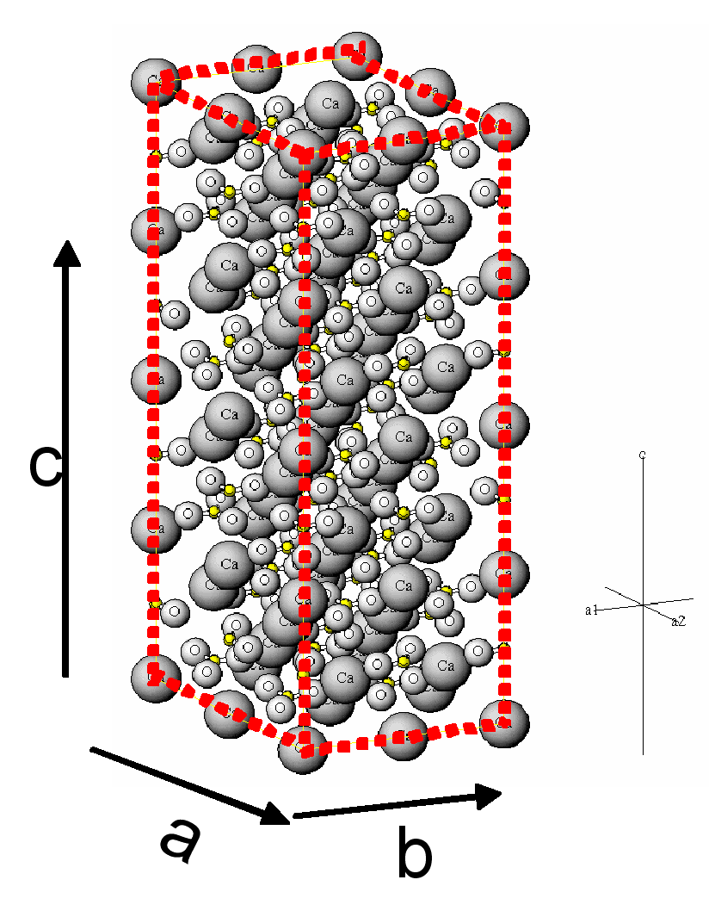
Phases and crystallography
α-Chitin C₈H₁₃NO₅
Calcite CaCO₃
Density: 1,41 gm/cm³
Lin. absorbtion coef : 3700 µm⁻¹ (@14 KeV(~ 1 Å))
Orthorhombic a= 4.74 Å, b= 18.86 Å, c= 10.32 Å (Takai et al, 1992)
Space group: P222 (# 16 @ITC)
Point group: 222
Density: 2,71 gm/cm³
Lin. Absorbtion Coef. : 200 µm⁻¹(@14 KeV(~ 1 Å))
Hexagonal , a=b=4,989 Å, c=17.062 Å ( Maslen et al. 1993)
Space group: R -3 2/c (#167 @ITC)
Point group: -3 2/m
Synchrotron sources: DESY, ANKA, BESSY

Slide 18
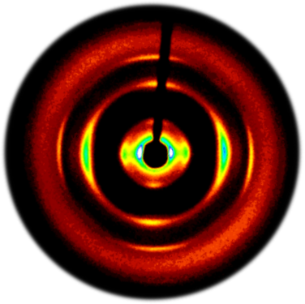
X-ray wide angle diffraction, lobster
λ= 0,9995 Å.
Al-Sawalmih et al.: Adv. Funct. Mater. 18 (2008) 3307

Slide 19
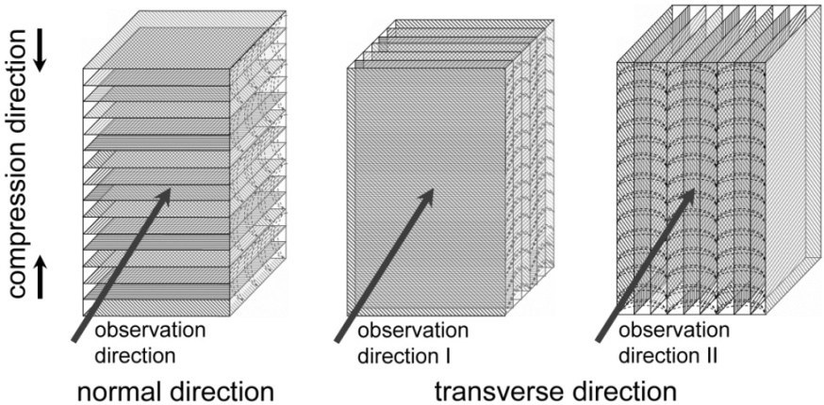
Compression tests (macroscopic), lobster
P. Romano, H. Fabritius, D. Raabe: Acta Biomaterialia. 3 (2007) 301

Slide 20
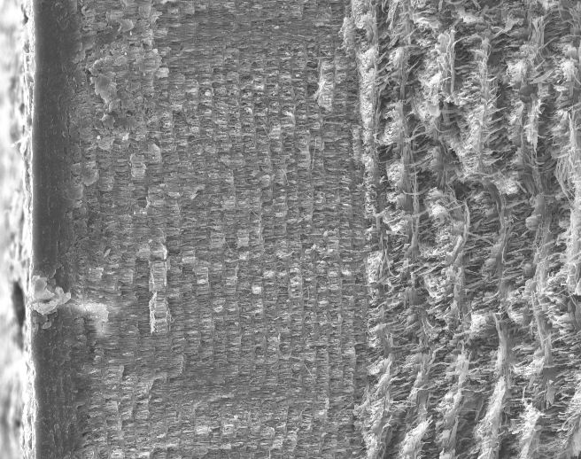
Hardness (mesoscopic)
350
Endocuticle
300
250
200
Hardness Universal, MPa
150
100
50
Exocuticle
0
0
100
200
300
400
500
600
surface
Cut Depth, µm
Raabe, Sachs, Romano: Acta Mater. 53 (2005) 4281

Slide 21
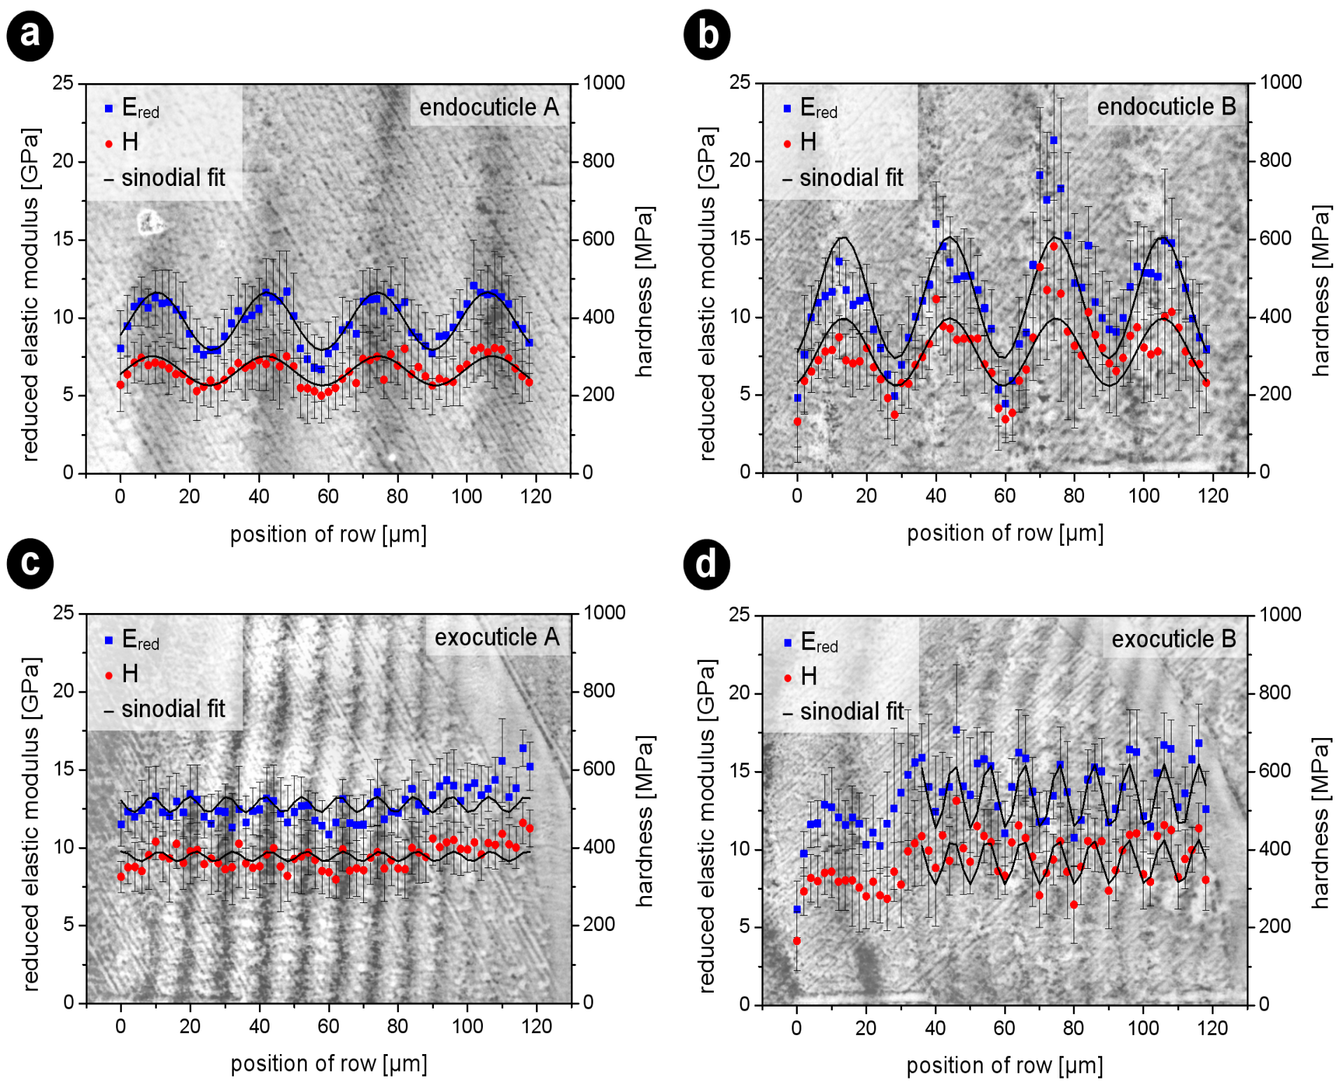
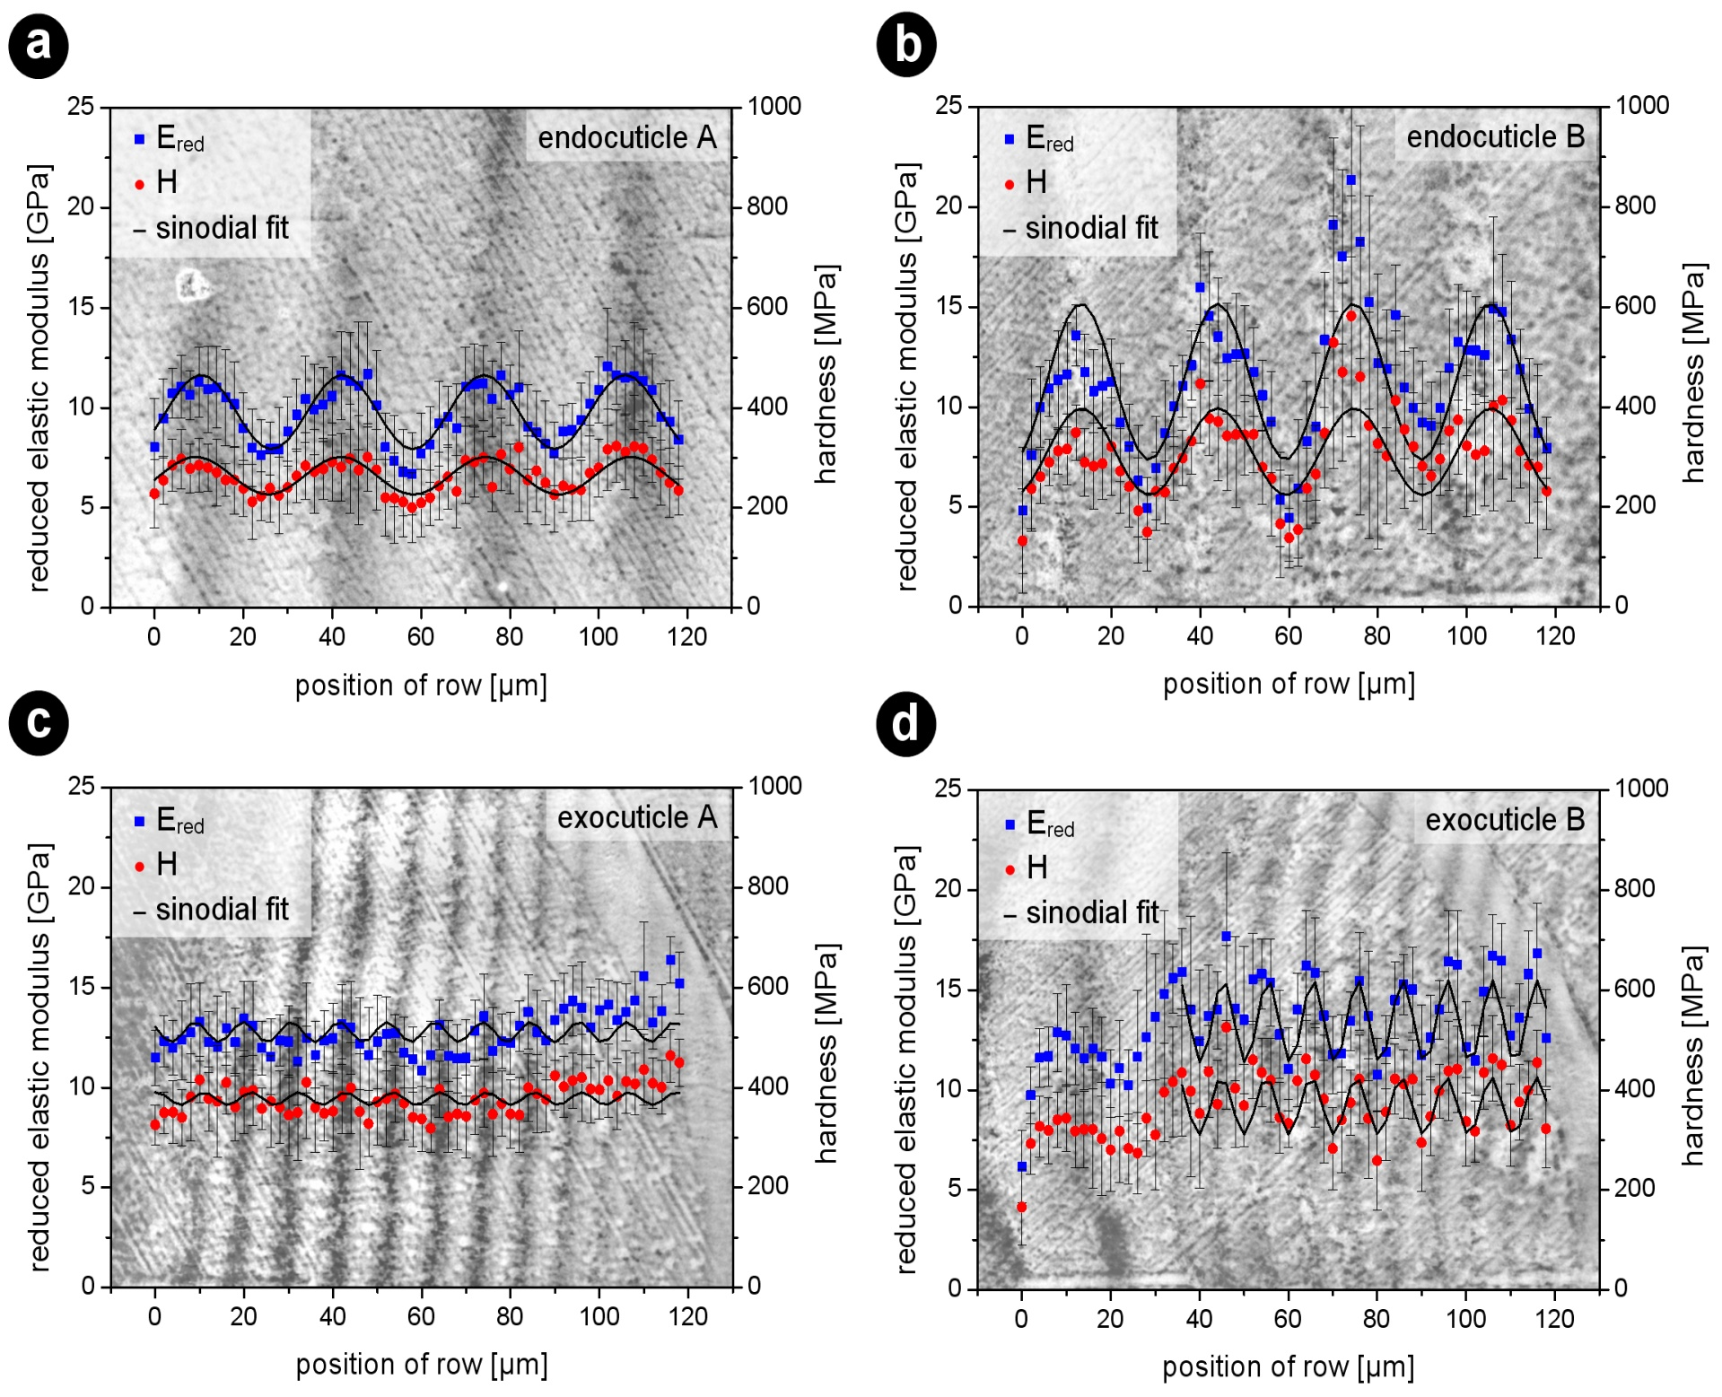
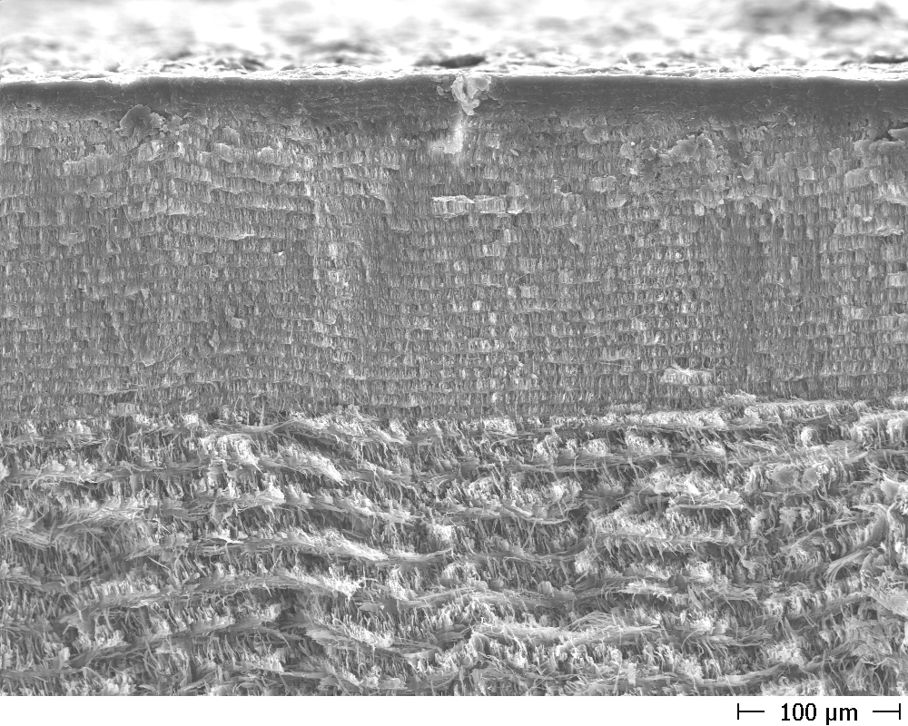
Mechanical properties (microscopic, nanoindentation)
Sachs, Fabritius, Raabe: J Material Research 21 (2006) 1987

Slide 22
Overview
Motivation
Structure and property overview
Ab initio prediction of chitin (structure, stiffness)
Ab initio prediction of calcite (dopant effects on structure)
Multiscale modeling of stiffness
Summary and conclusions
Raabe: Adv. Mater. 14 (2002)

Slide 23
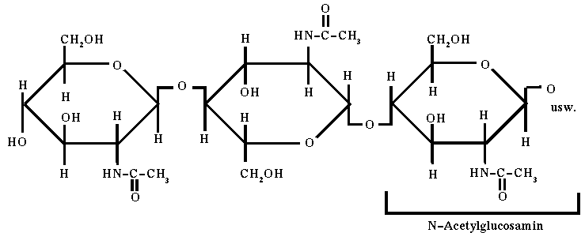
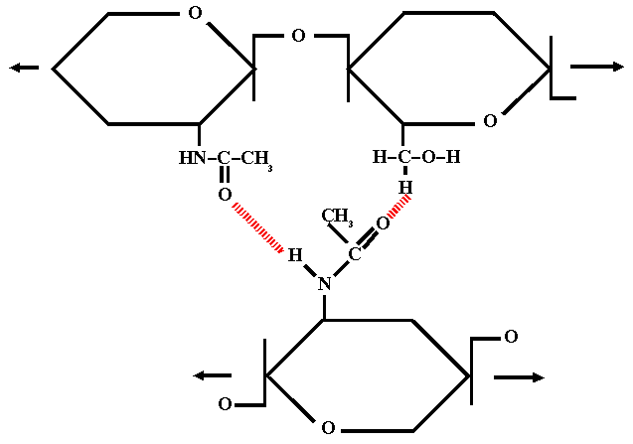
What is α-chitin?
Nikolov et al. Adv. Mater. 22 (2010), 519

Slide 24
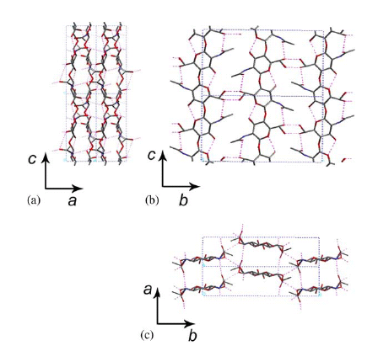
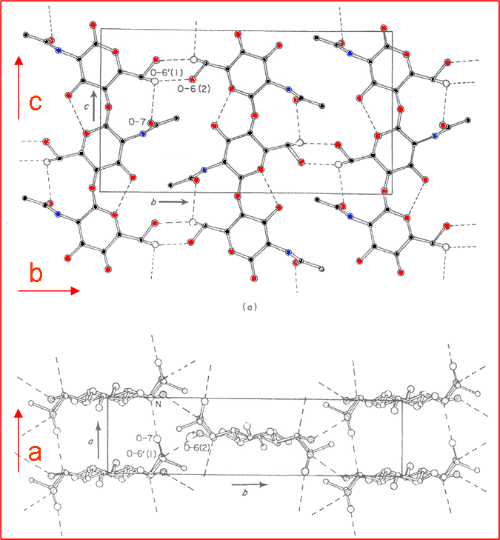
What is α-chitin?
108 atoms / 52 unknown H-positions
Hydrogen positions?
H-bonding pattern ?
two conformations
of α-chitin
Minke and Blackwell, J. Mol. Biol. 120, (1978)

Slide 25
Hierarchy of theoretical methods
CPU time
Accuracy
Resulting
structures
Empirical Potentials
Geometry optimization
Molecular Dynamics
(universal force field)
~10 min
Low
~10³
Tight Binding
(SCC-DFTB)
Geometry optimization
(SPHIngX)
~500 min
Medium
~10²
DFT
(PWs, PBE-GGA)
Geometry Optimization
(SPHIngX)
~10000 min
High
~10¹
C, C N H
Nikolov et al. Adv. Mater. 22 (2010), 519

Slide 26
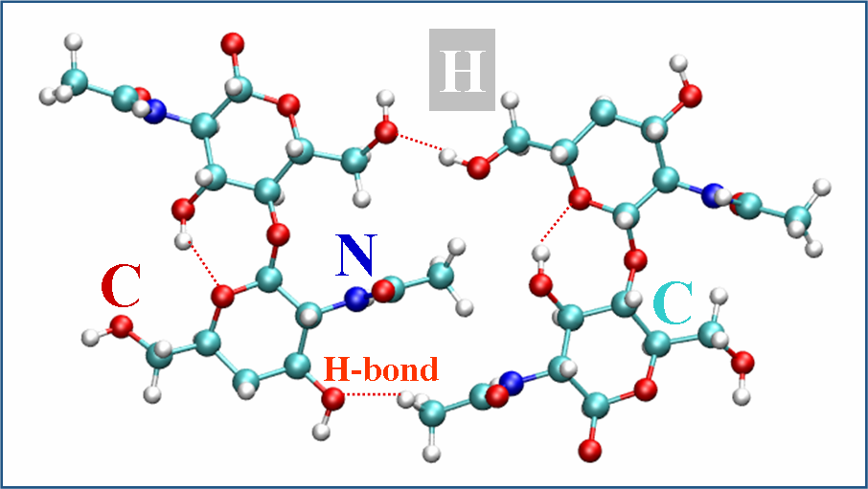
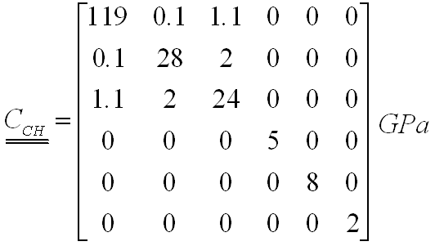
Ab initio prediction of α-chitin elastic properties
Ab initio calculations:
a = 4.98 Å; b = 19.32 Å; c = 10.45 Å
(this study)
Exp. measured
a = 4.74 Å; b = 18.86 Å; c = 10.32 Å
(Minke & Blackwell J. Mol. Biol. 1978)
c
b
C, C N H
Nikolov et al. Adv. Mater. 22 (2010), 519

Slide 27
Overview
Motivation
Structure and property overview
Ab initio prediction of chitin (structure, stiffness)
Ab initio prediction of calcite (dopant effects on structure)
Multiscale modeling of stiffness
Summary and conclusions
Raabe: Adv. Mater. 14 (2002)

Slide 28
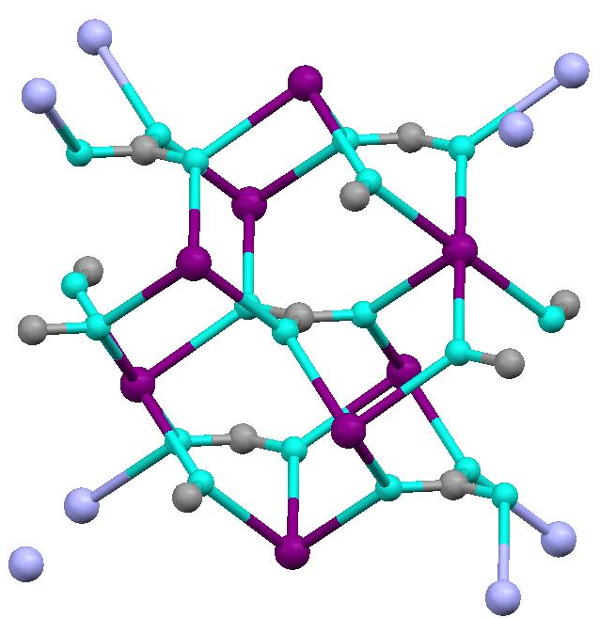
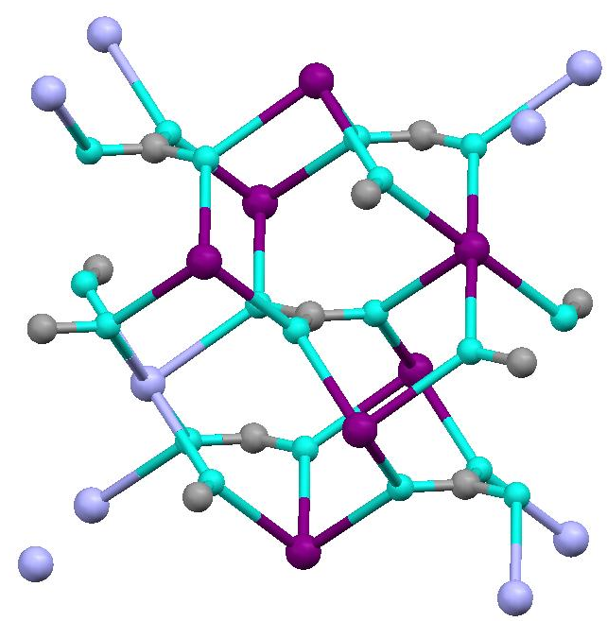
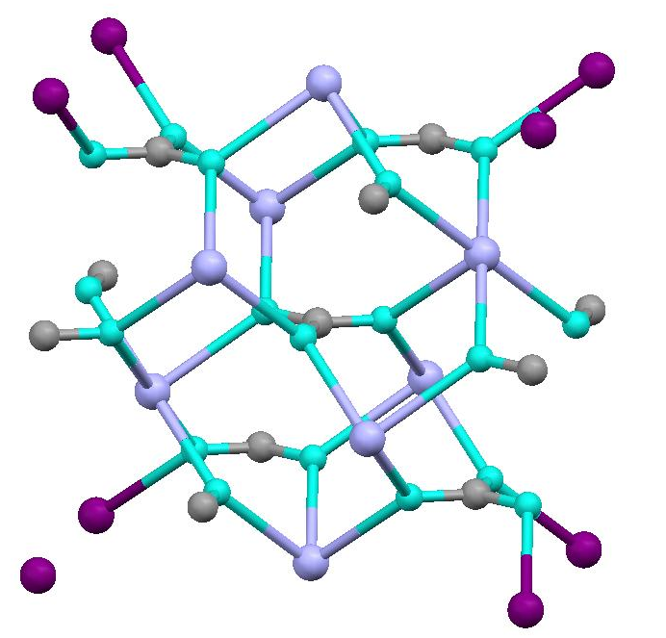
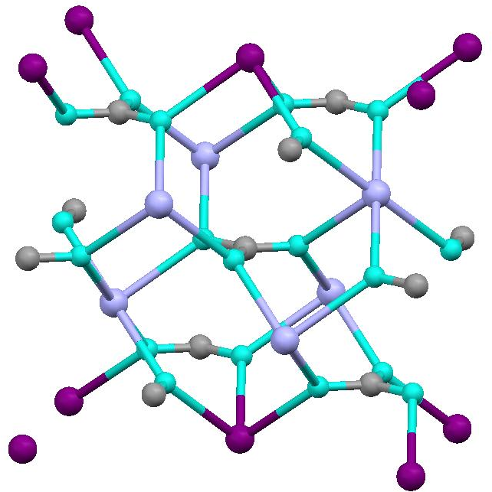
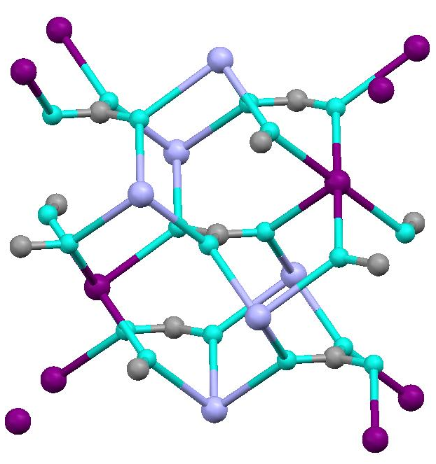
Mg_{m}Ca_{n}(CO₃)₆: energy vs. volume changes
MgCO₃
5 Mg-atoms
Etot [eV/atom]
CaCO₃
Volume [A^3/atom]
4 Mg-atoms
1 Mg-atom
2 Mg-atoms
3 Mg-atoms
Ab initio study of calcite substituted by Mg

Slide 29
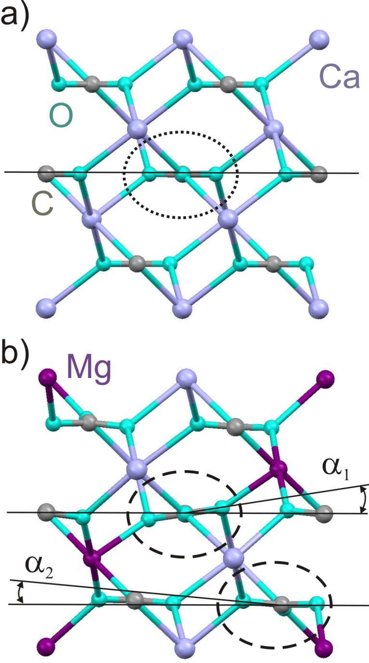
Mg_{m}Ca_{n}(CO₃)₆: distortions
α₁ = 7°46’
α₂ = 5°4’
Ab initio study of calcite substituted by Mg

Slide 30
Overview
Motivation
Structure and property overview
Ab initio prediction of chitin (structure, stiffness)
Ab initio prediction of calcite (dopant effects on structure)
Multiscale modeling of stiffness
Summary and conclusions
Raabe: Adv. Mater. 14 (2002)

Slide 31
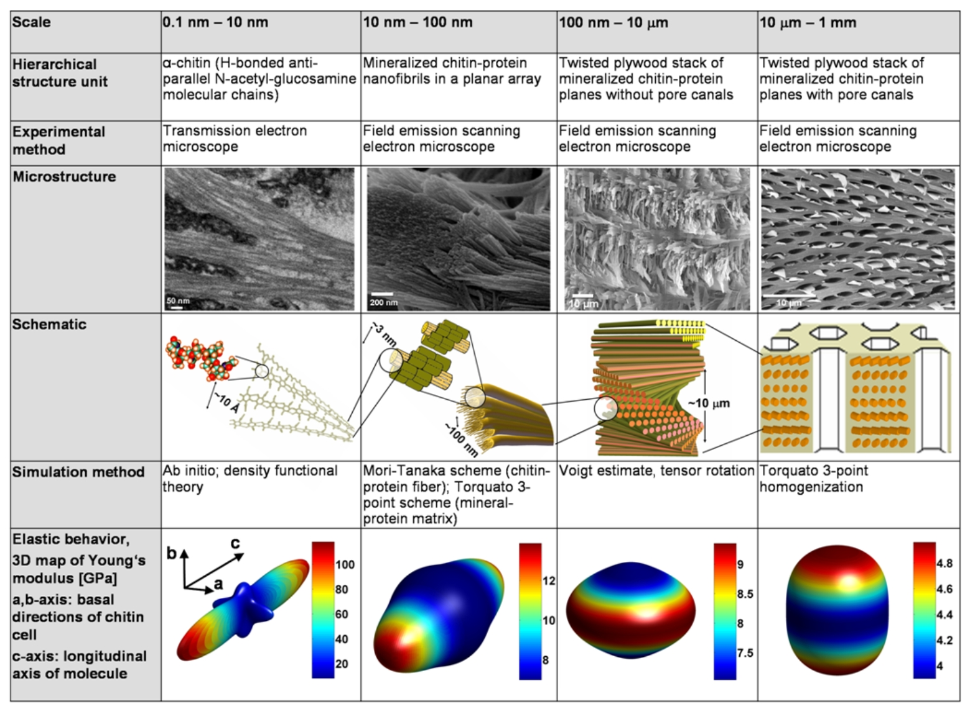
Hierarchical modeling of stiffness starting from ab initio
Nikolov et al. Adv. Mater. 22 (2010), 519

Slide 32
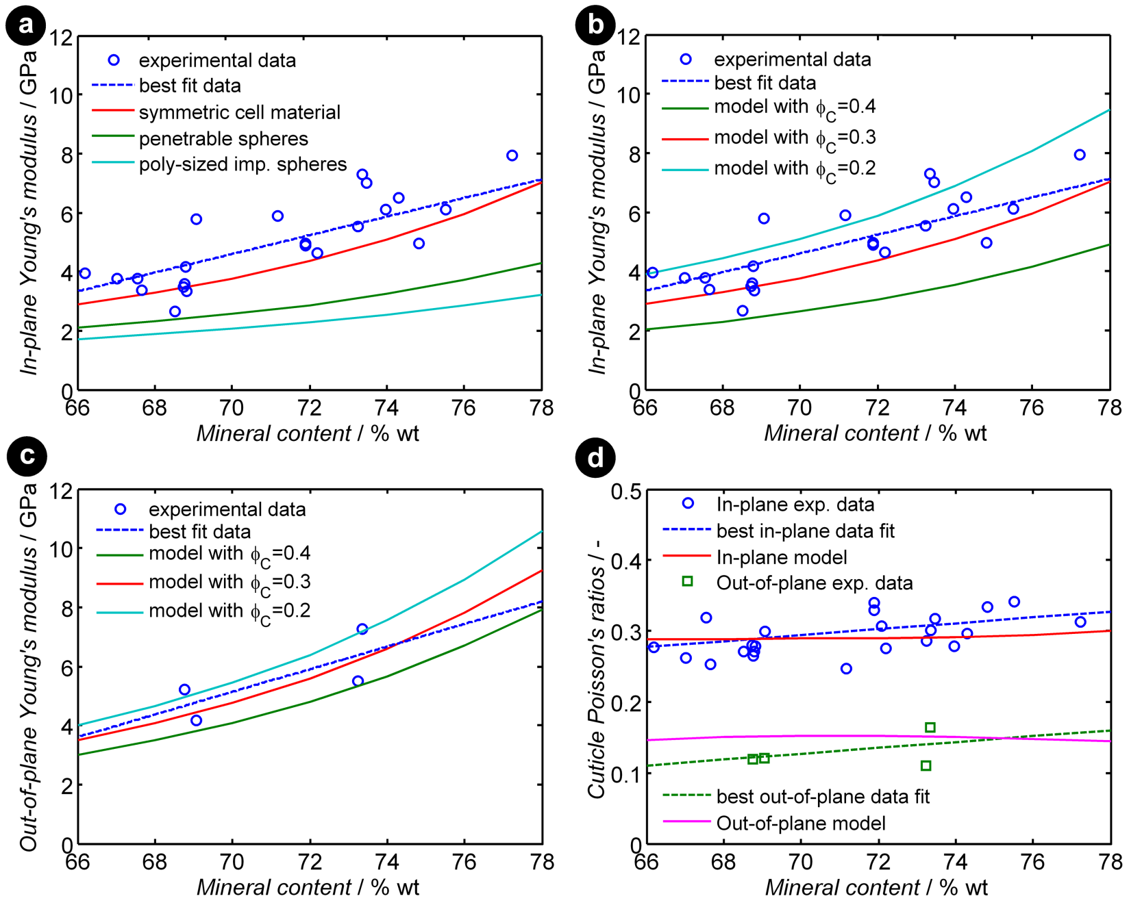
Predictions and comparison to experiments
Ф: In-plane fraction of pore channels

Slide 33
Comparison between model and experiment: error propagation
best-case
best-case
Experiment
Experiment
worst-case
worst-case
Cases obtained by accumulative changes that maximize (red) / minimize (green) the elastic overall moduli.
The experiments suggest that the hierarchical organization of the material provides an optimal use of the properties of the underlying ingredients.
Nikolov et al. Adv. Mater. 22 (2010), 519

Slide 34
Hierarchical modeling of stiffness starting from ab initio
Nikolov et al. Adv. Mater. 22 (2010), 519

Slide 35
Overview
Motivation
Structure and property overview
Ab initio prediction of chitin (structure, stiffness)
Ab initio prediction of calcite (dopant effects on structure)
Multiscale modeling of stiffness
Summary and conclusions
Raabe: Adv. Mater. 14 (2002)

Slide 36
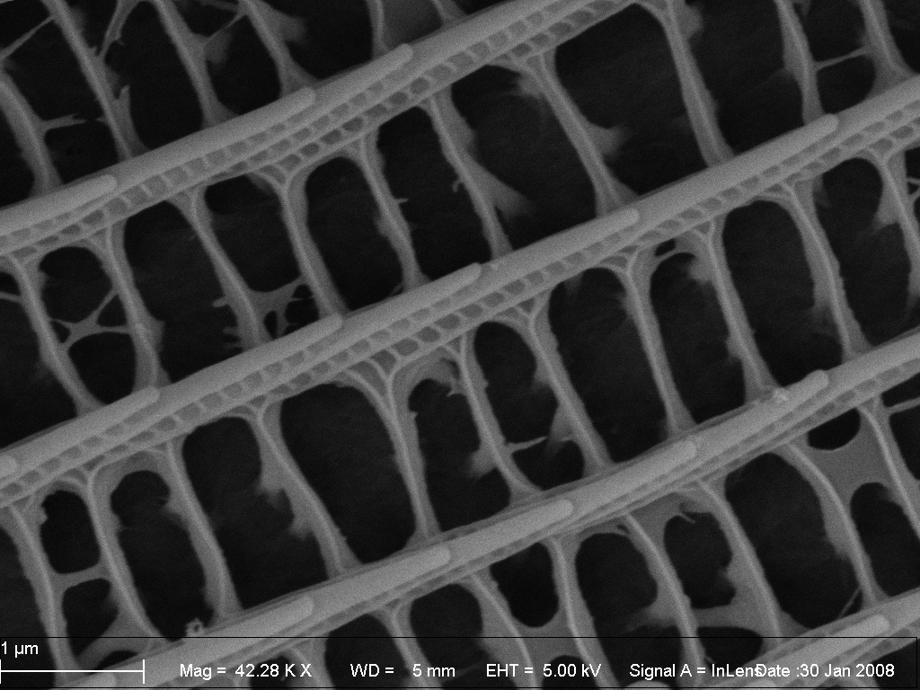
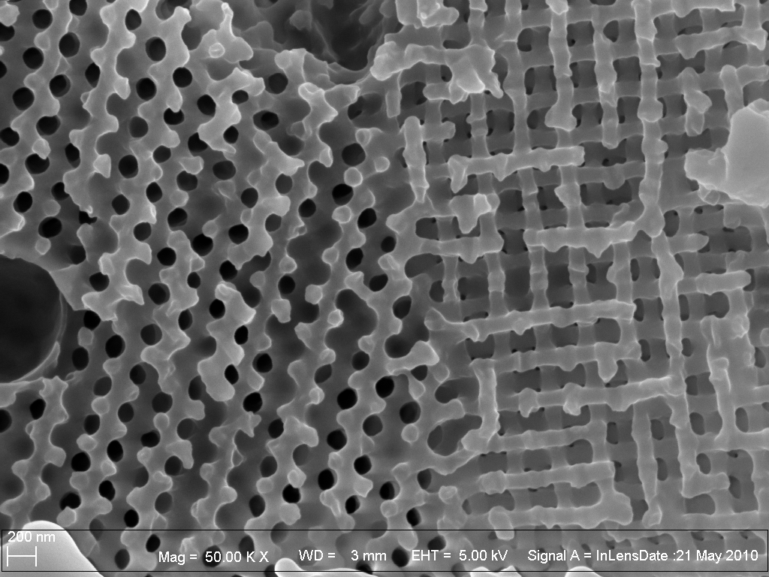
Summary and conclusions
Revealed hierarchical organization of lobster cuticle
Multiscale ab-initio based prediction of chitin and calcite structure and elastic properties
Integration into hierarchical multiscale model
Apply also to Crab and Bio-photonics (beetle, butterfly)

Slide 37
Additional references
D. Raabe, P. Romano, C. Sachs, H. Fabritius, A. Al-Sawalmih, S.-B. Yi, G. Servos, H.G. Hartwig: Mater. Sc. Engin. A 421 (2006) 143–153
Microstructure and crystallographic texture of the chitin-protein network in the biological composite material of the exoskeleton of the lobster Homarus americanus
D. Raabe, C. Sachs, P. Romano: Acta Mater. 53 (2005) 4281-4292
The crustacean exoskeleton as an example of a structurally and mechanically graded biological nanocomposite material
C. Sachs, H. Fabritius, D. Raabe: Journal of Structural Biology 155 (2006) 409–425
Experimental investigation of the elastic-plastic deformation of mineralized lobster cuticle by digital image correlation
C. Sachs, H. Fabritius, D. Raabe: Journal of Material Research 21 (2006) 1987-1995
Hardness and elastic properties of dehydrated cuticle from the lobster Homarus americanus obtained by nanoindentation
P. Romano, H. Fabritius, D. Raabe: Acta Biomaterialia. 3 (2007) 301-309
The exoskeleton of the lobster Homarus americanus as an example of a smart anisotropic biological material
C. Krywka, C. Sternemann, M. Paulus, N. Javid, R. Winter, A. Al-Sawalmih, S. Yi, D. Raabe, M. Tolan: Journal of Synchrotron Radiation 14 (2007). 244–251
The small-angle and wide-angle X-ray scattering set-up at beamline BL9 of DELTA
D. Raabe, A. Al-Sawalmih, S. B. Yi, H. Fabritius: Acta Biomaterialia 3 (2007) 882-895
Preferred crystallographic texture of α-chitin as a microscopic and macroscopic design principle of the exoskeleton of the lobster Homarus americanus
F. Boßelmann, P.Romano, H. Fabritius, D. Raabe, M. Epple: Thermochimica Acta 463 (2007) 65-68
The composition of the exoskeleton of two crustacea: The American lobster Homarus americanus and the edible crab Cancer pagurus
C. Sachs, H. Fabritius, D. Raabe: Journal of Structural Biology 161 (2008) 120-132
Influence of microstructure on deformation anisotropy of mineralized cuticle from the lobster Homarus americanus
A. Al-Sawalmih, C. Li, S. Siegel, H. Fabritius, S.B. Yi, D. Raabe, P. Fratzl, O. Paris: Advanced functional materials 18 (2008) 3307-3314.
Microtexture and Chitin/Calcite Orientation Relationship in the Mineralized Exoskeleton of the American Lobster
H. Fabritius, C. Sachs, P. Romano, D. Raabe : Adv. Mater. 21 (2009) 391–400
Influence of structural principles on the mechanics of a biological fiber based composite material with hierarchical organization: the exoskeleton of the lobster Homarus americanus
S. Nikolov, M. Petrov, L. Lymperakis, M. Friák, C. Sachs, H.-O. Fabritius, D. Raabe, and J. Neugebauer: Adv. Mater. 22 (2010), 519–526
Revealing the Design Principles of High-Performance Biological Composites Using Ab initio and Multiscale Simulations: the Example of Lobster Cuticle

